Slide 1
ManiVault: A Flexible and Extensible Visual Analytics Framework for High-Dimensional Data
A. Vieth¹, T. Kroes², J. Thijssen²,
B. van Lew², J. Eggermont², S. Basu²,
E. Eisemann¹, A. Vilanova³, T. Höllt¹, B. Lelieveldt²
¹ TU Delft, ² LUMC, ³ TU Eindhoven, The Netherlands
Notes:
Thanks! Let’s have a look at ManiVault, a project by Thomas Kroes, Julian Thijssen, me – Alexander Vieth – and other great colleagues from the TU Delft, LUMC and TU Eindhoven.

Slide 2
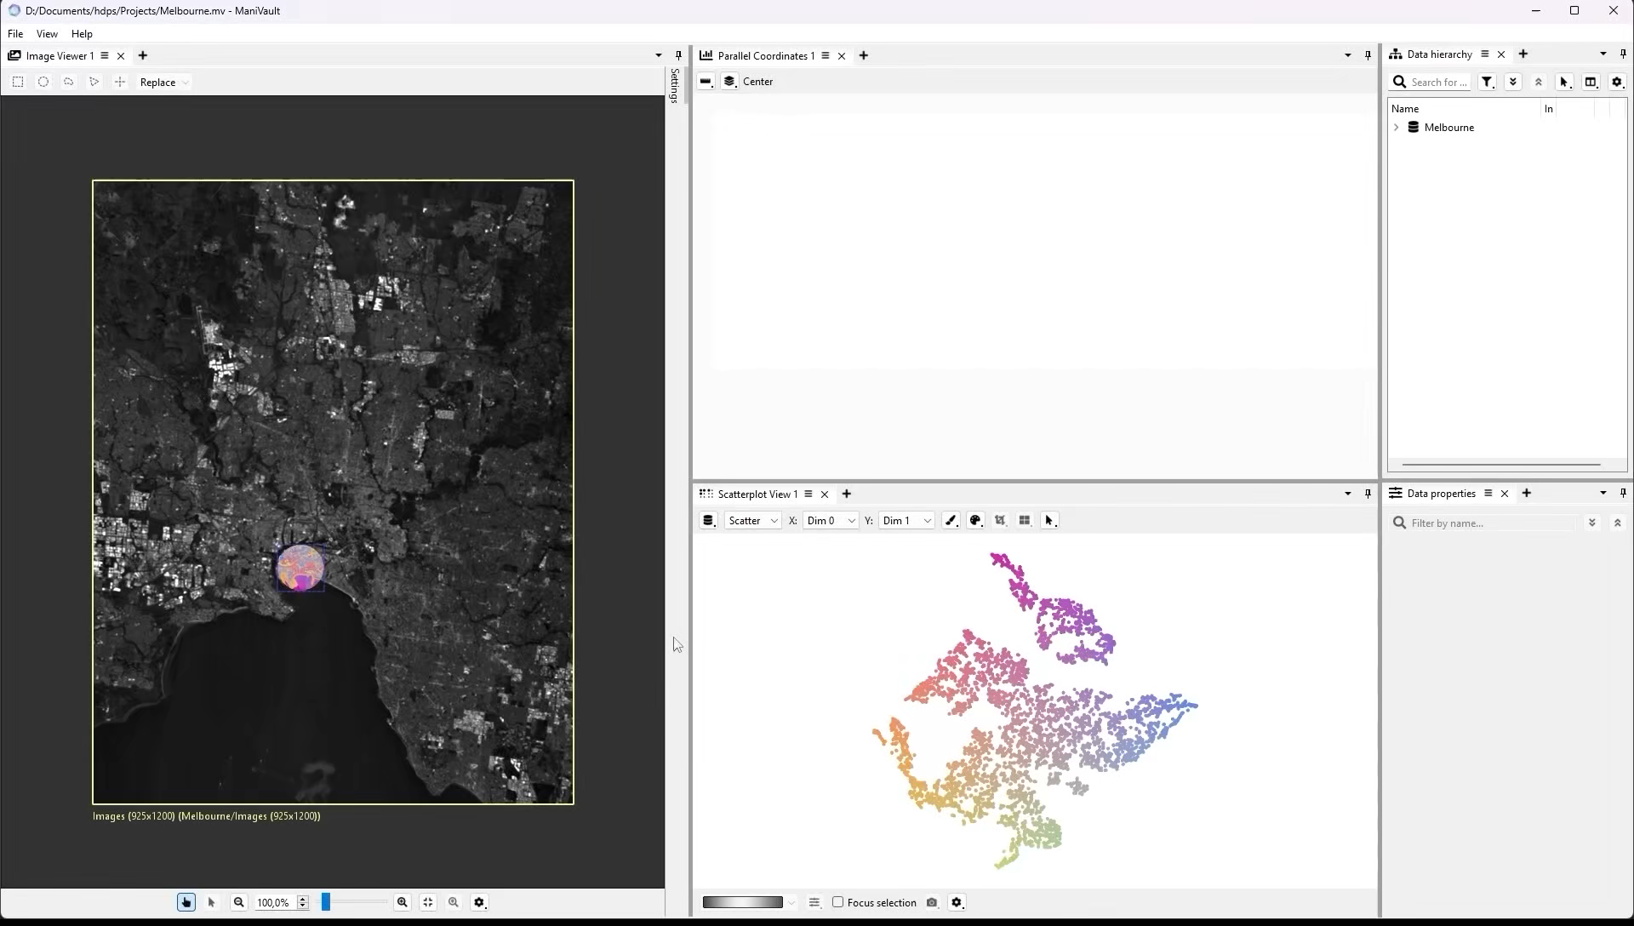
ManiVault
Notes:
Right now, we are looking at several examples of systems used for exploring and analyzing high-dimensional data.
Each one of them operates in a different application domain, with different data types, users, analysis methods, and a range of visual representations.

Slide 3
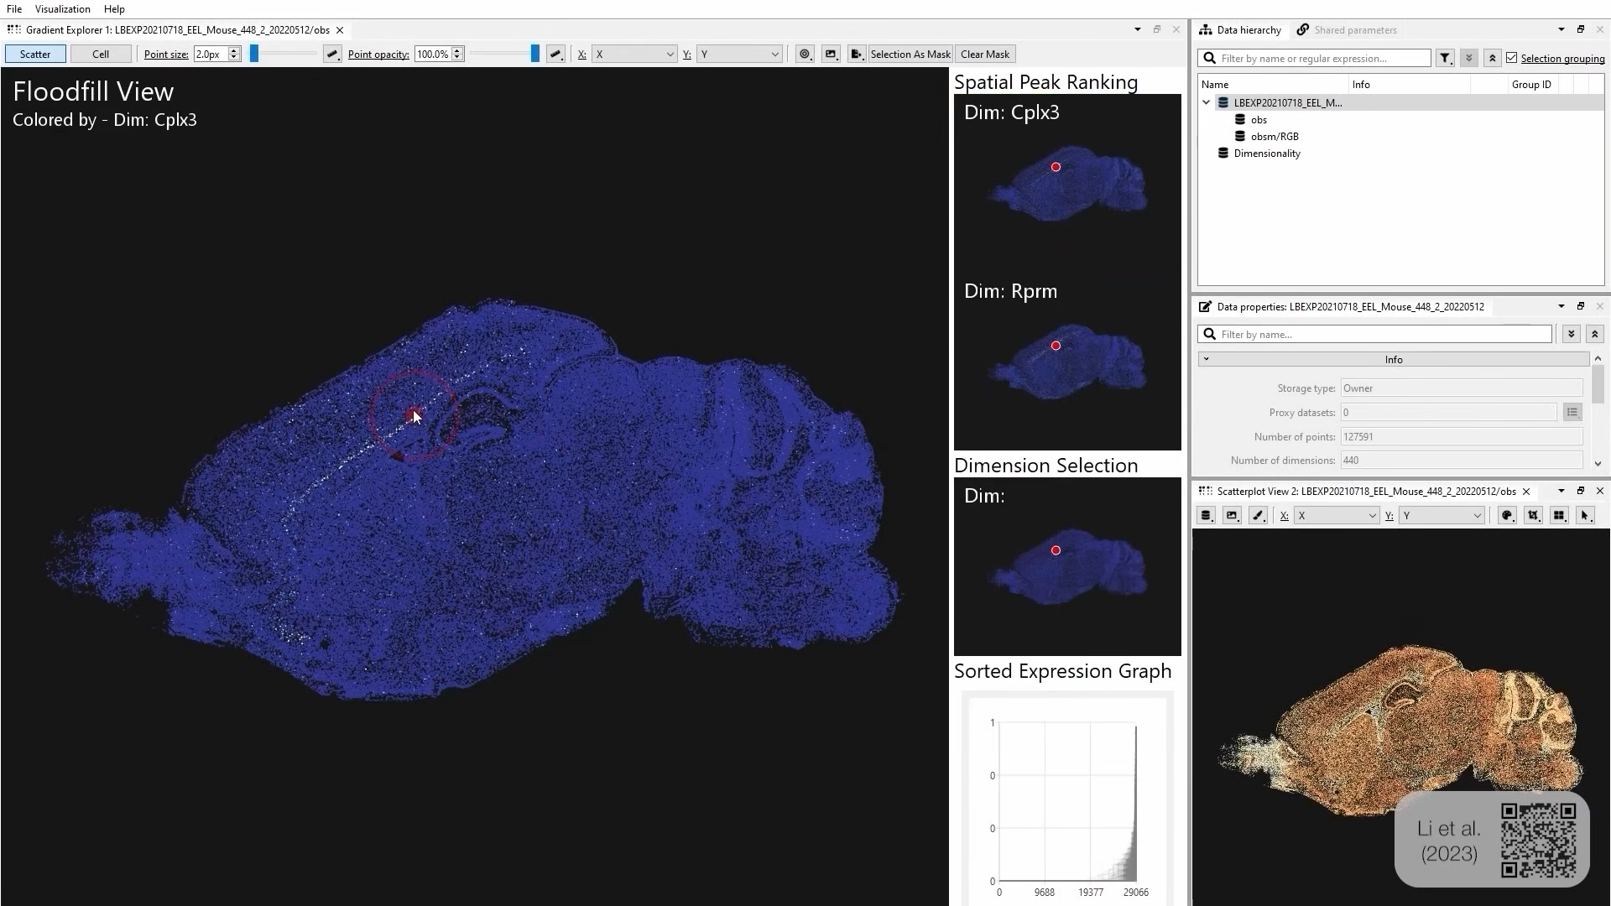
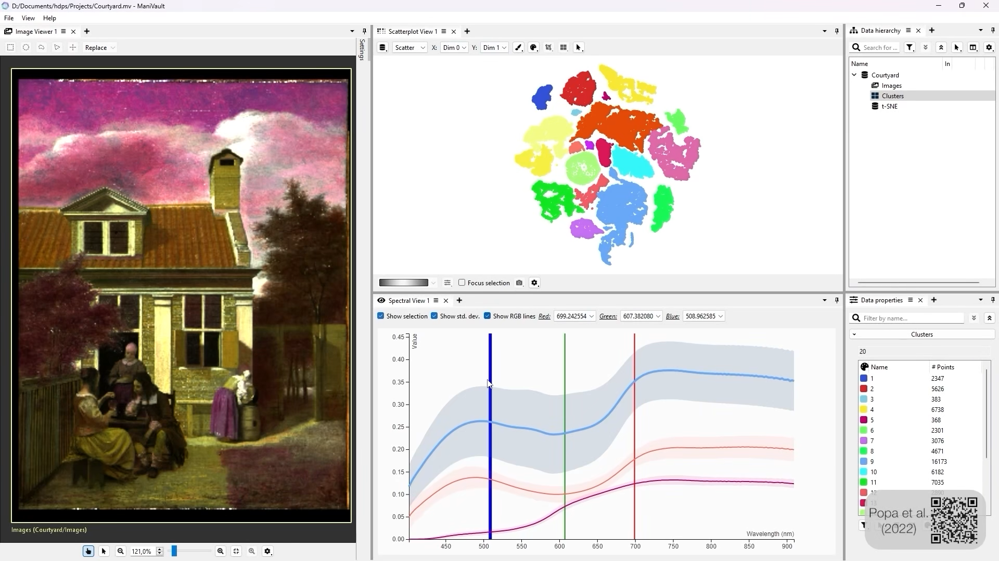
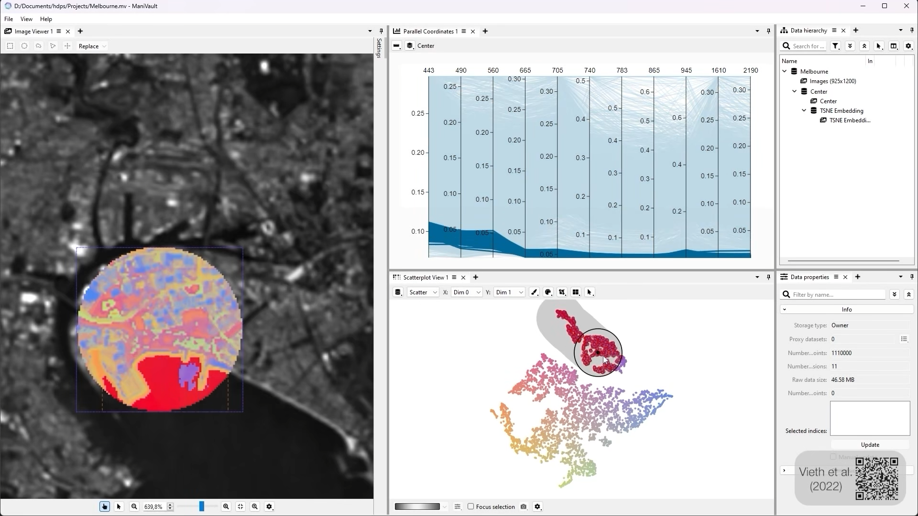
ManiVault

Slide 4
Motivation
Notes:
But looking closer, each software here – and by extension many other systems that are targeted at high-dimensional data -
utilizes similar sets of analytical and visual tools.
Often, these generic tools are combined with domain-specific ones into stand-alone applications.
But it is unnecessarily time-consuming to reinvent the wheel by re-implementing, for example,
a linked selection mechanism for multiple coordinated views every time
a domain-specific visual analytics solution is needed.
In fact, all these examples were created with ManiVault!

Slide 5

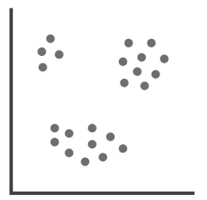
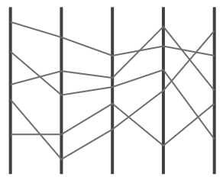
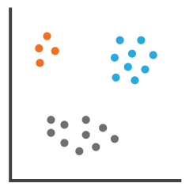
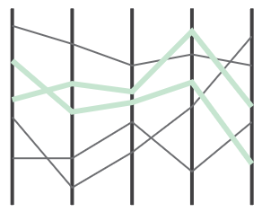
Goals
Re-use analytical and visual tools
Facilitate rapid construction
Share setups and results
Notes:
Our primary goal with ManiVault was to develop
a framework for exploration, analysis
and rapid prototyping
We saw the need for an interactive framework that makes it easy to re-use analytical and visual tools, for example
parallel coordinates plots, scatterplots, or dimensionality reduction and clustering algorithms.
The framework should facilitate the rapid construction of new VA software and it should be possible to share
exploration workflows and analysis results with it.
We found that, while there do exist many open-source visual analysis tools,
none fits our need for a framework that's focused on high-dimensional data,
is easily extensible, is designed with progressive visual analytics in mind,
and allows for flexible visual analytics system authoring.

Slide 6



General Context
Intended users
Goals & problems
Software design
Notes:
In the next couple of minutes, I want to highlight how our design motivations for the framework
led to specific software architecture choices.
Therefor, we must first ask and answer some fundamental questions:
Who are the intended users?
Which of their problems should the framework solve?
And ultimately, how does this shape its design?
(For that, we build on experiences made during multiple
collaborations with practitioners in various fields like systems biology,
cultural heritage, and more general visual analytics focused projects.)

Slide 7
Users of ManiVault
Target Audiences
Developer
Practitioner
Application Designer
User Objectives
Notes:
Let’s start with the target users.
Besides the practitioners, the software developers of analysis frameworks
are integral users themselves - be it, from a different perspective.
And further, we identified a third user group: the application designer.

Slide 8
Users of ManiVault
Target Audiences
Developer
Practitioner
Application Designer
Implement:
Visualizations &
algorithms
User Objectives
Notes:
Each user archetype comes with a set of different goals:
The developer wants to implement visualizations, algorithms, interaction mechanisms and more.

Slide 9
Users of ManiVault
Target Audiences
Developer
Practitioner
Application Designer
Implement:
Visualizations &
algorithms
Analyze,
explore,
share
User Objectives
Notes:
The practitioner cares about the analysis and exploration of their data and might want to share their results.

Slide 10
Users of ManiVault
Target Audiences
Developer
Practitioner
Application Designer
Implement:
Visualizations &
algorithms
Analyze,
explore,
share
Create
stand-alone
applications
User Objectives
Notes:
And finally, an application designer wants to use the framework as a visual anlytics design environment
to create user interfaces aimed at specific workflows.

Slide 11
Users of ManiVault
Target Audiences
Developer
Practitioner
Application Designer
Implement:
Visualizations &
algorithms
Analyze,
explore,
share
Create
stand-alone
applications
User Objectives
Notes:
Of course, most users do not fall exclusively into one of these categories:
there is a substantial overlap.
For example, a visualization researchers might both implement a novel chart type
and subsequently use it to explore results of their own study.
A domain expert might first analyse their data in a flexible setup and,
once converged to a stable workflow, fix the user interface and
share reproducible results in a stand-alone application.

Slide 12


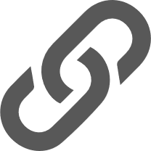
Design considerations
Flexible
Extensible
Linkable
Multiple application domains
New
functionalities
Synchronize parameters and
selections
Configurable
Distributable
Performant
Runtime GUI configuration
Save and reproduce
Interactive and
progressive VA
Notes:
We want ManiVault to facilitate the rapid construction of visual analytics applications
for all user groups alike.
This means, that ManiVault must enable flexible workflows in multiple application domains.
The system has to be easily extensible with new functionalities.
It should allow for linking data sets and share parameters across visualizations and algorithms.
The user interface should be configurable during runtime.
A user should be able to save and share this configured interface,
including loaded data sets and analysis results.
And of course, the entire system should be performant when handling large data.

Slide 13
Software Architecture
Plugins
User-facing
functionalities
Core
Light-weight
managers
Notes:
So, how do we approach this with ManiVault?
The framework is implemented as a modular system and consists of a core and plugins.
The core application is a lightweight set of managers.
Self-contained plugins supply all user-facing functionality.
This modularity provides a means to extend the software with new functions,
but seemingly stands in the way of another requirement that we just mentioned:
How can parameters be shared across plugins that are all self-contained?

Slide 14
Software Architecture
Plugins
Plugin
manager
Data
manager
Workspace
Project
Settings
Utilities
…
Core
Event
manager
Actions
Notes:
For that, let's have a look at ManiVault's architecture in more detail.
The core consists of a set of managers, actions and some utilizes.
The managers take care of, for example, the application layout, or plugins.

Slide 15
Software Architecture
Plugins
Analysis
View
Transform
Loader/Writer
Data
Plugin
manager
Data
manager
Workspace
Project
Settings
Utilities
…
Core
Event
manager
Actions
Notes:
We define six distinct plugin types that bundle various kinds of functionalities.
An analysis plugin, for example, performs computations on data
and creates derived data sets, like a low-dimensional embedding.
View plugins meanwhile provide visualizations and user interactions.
They can be based on diverse backends, like OpenGL and D3.

Slide 16
Software Architecture
Plugins
Analysis
View
Transform
Loader/Writer
Data
Data flow
Plugin
manager
Data
manager
Workspace
Project
Settings
Utilities
…
Core
Event
manager
Actions
Notes:
The core itself only knows about specific data types through plugins, which implement them,
for example, high-dimensional points or images.
(Each plugin might either consume data sets, produce them or both.
A data manger provides the API for passing data and views on data to the plugins.)

Slide 17
Software Architecture
Plugins
Analysis
View
Transform
Loader/Writer
Data
Core events
Plugin
manager
Data
manager
Workspace
Project
Settings
Utilities
…
Core
Event
manager
Actions
Notes:
Communication between the core and plugin comes two-fold:
Dataset-related chages are broadcasted to all plugins by an event manager in the core.
If, for example, a user selects a cluster in a scatterplot,
the respective view plugin can send this information
to the core, which will notify all other plugins about this change.

Slide 18
Software Architecture
Plugins
Linked parameters
Analysis
View
Transform
Loader/Writer
Data
Plugin
manager
Data
manager
Workspace
Project
Settings
Utilities
…
Core
Event
manager
Actions
Notes:
For a more general parameter sharing between plugins,
we introduce special GUI management objects,
called actions, that are linkable during runtime.
ManiVault provides a set of common action building blocks like numerical sliders,
color maps and selection modalities.
Using the action API, any custom parameter might be shared between plugins, too.
Let's delve into this a bit more.

Slide 19
Action system
View
Analysis
Core
Notes:
Here we see an abstract representation of a common setup:
we have a view and an analysis open

Slide 20
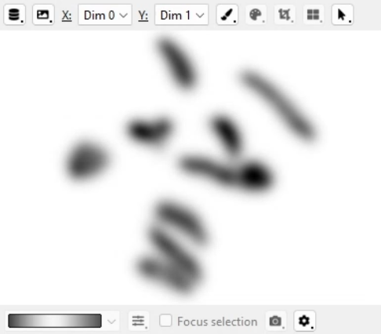
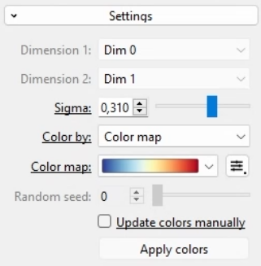
Action system
Density View
Cluster Analysis
Core
Notes:
for example, a density plot and a mean-shift clustering.

Slide 21
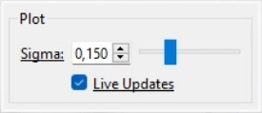
Action system
Density View
Analysis
Sigma (scalar)
Sigma (scalar)
Core
Notes:
Both plugins use a GUI element of the same type, a numerical slider.
The density plot to adjust its view and
the clustering algorithm to steer its computation.

Slide 22
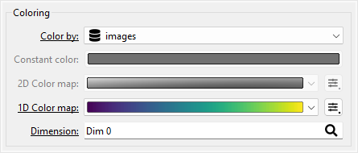
Action system
Density View
Analysis
Sigma (scalar)
Sigma (scalar)
Colormap
Trigger
.
.
.
.
.
.
Core
Notes:
Each plugin might come with a diverse set of other actions,
but we can only link two actions of the same type.

Slide 23
Action system
Density View
Analysis
Sigma (scalar)
Sigma (scalar)
Core

Slide 24
Action system
Density View
Analysis
Sigma (scalar)
Sigma (scalar)
Publish
Shared parameters
Sigma (scalar)
.
Core
.
.
Notes:
To do this, the user first publishes an action,
which creates a shared parameter that is managed by ManiVault's core

Slide 25
Action system
Density View
Analysis
Sigma (scalar)
Sigma (scalar)
Shared parameters
Sigma (scalar)
.
Core
.
Sync
.
Notes:
A second action can then be connected to the published one:

Slide 26
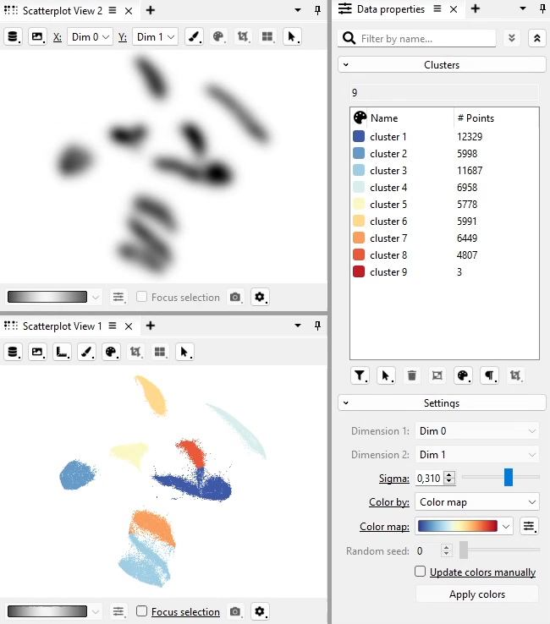
Action system
Density View
Analysis
Sigma (scalar)
Sigma (scalar)
Shared parameters
Sigma (scalar)
.
Core
.
Sync
.
Notes:
Any change to the parameter in one plugin will be synchronized with the other.
Here, for example, we make use of this connection to visually find a suitable density estimation
while updating the clustering automatically.

Slide 27
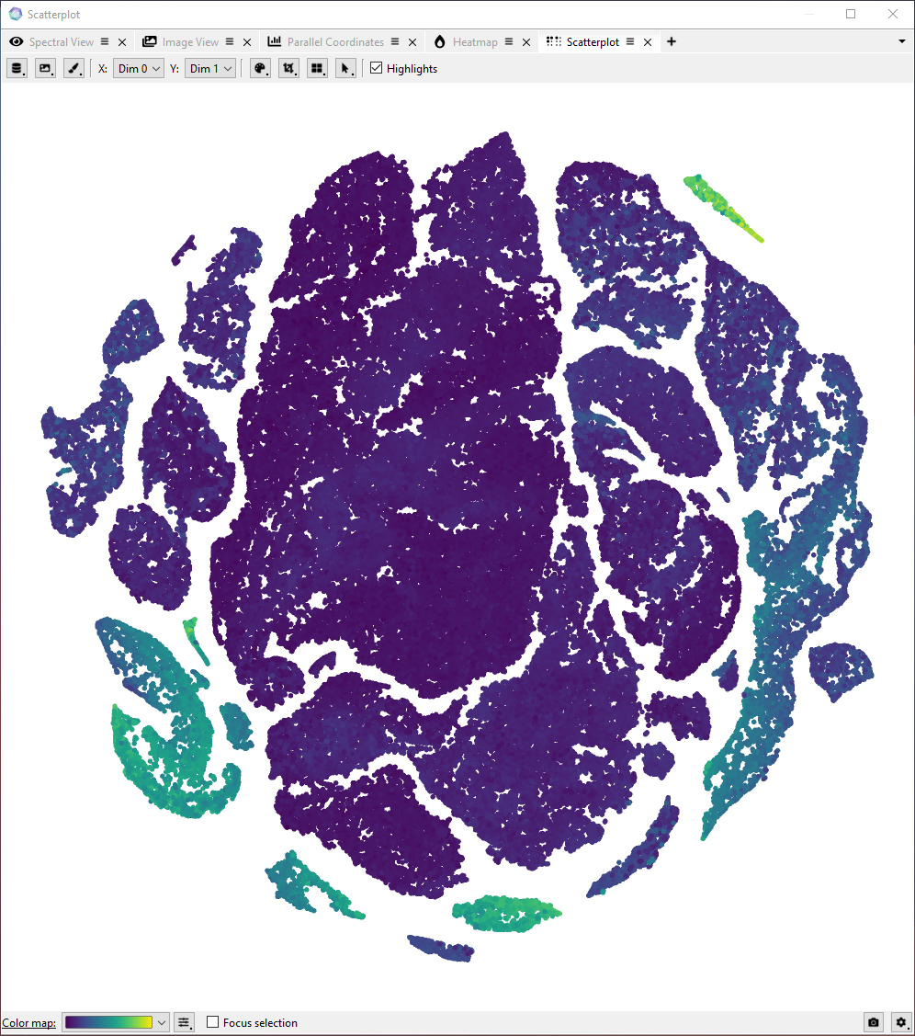
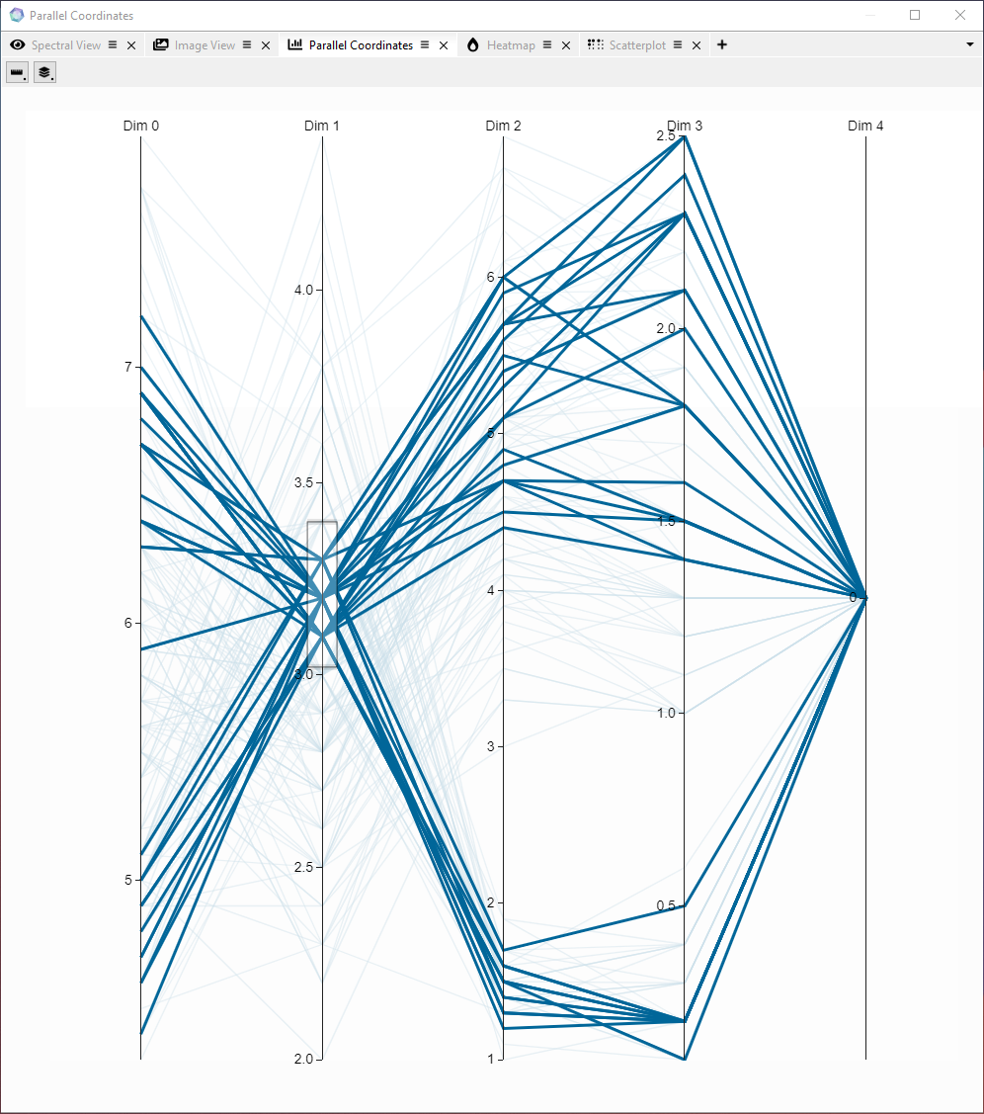
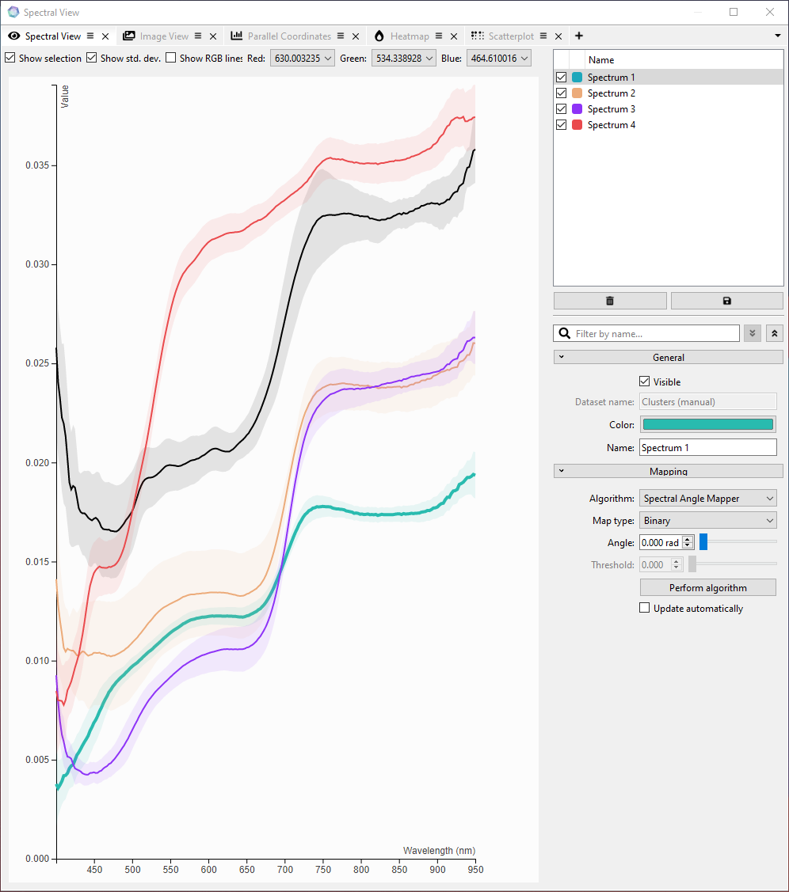
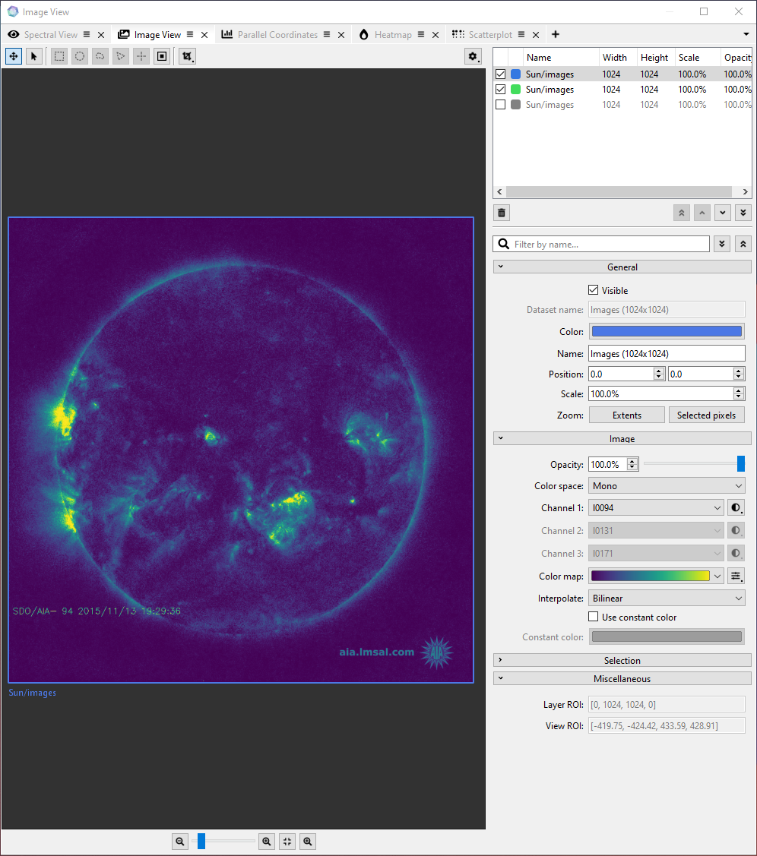
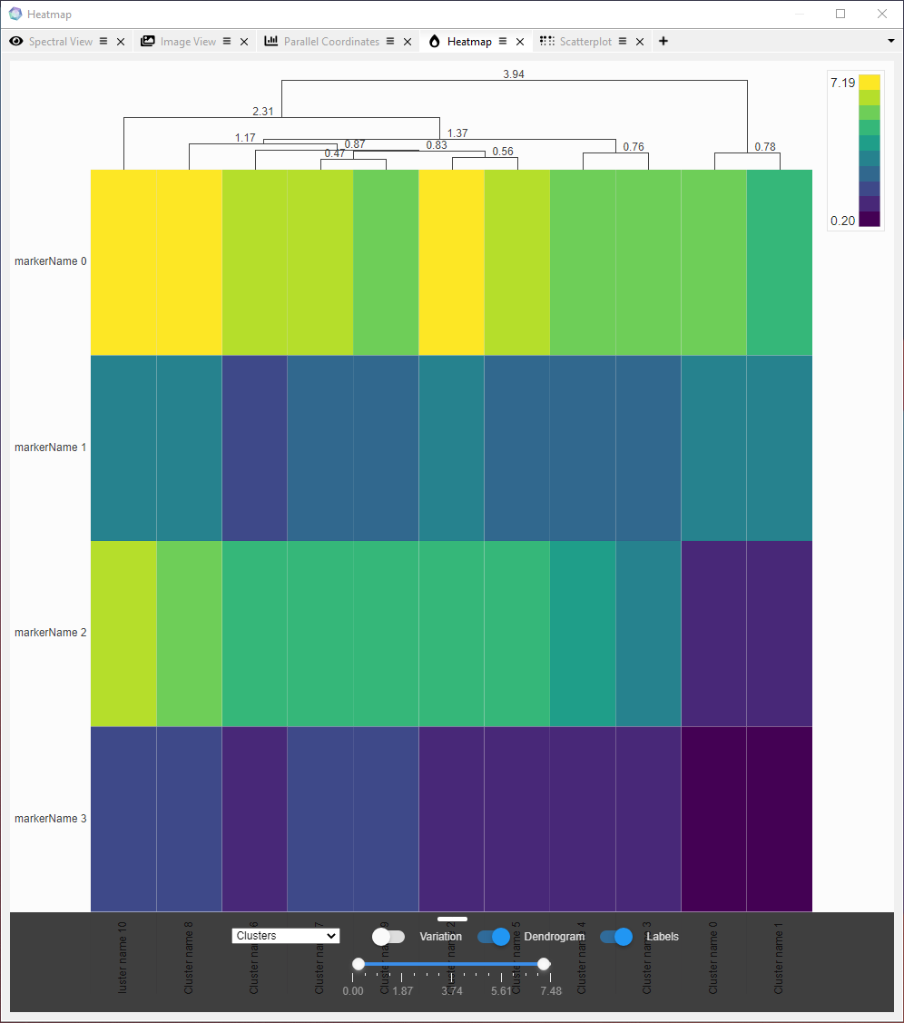
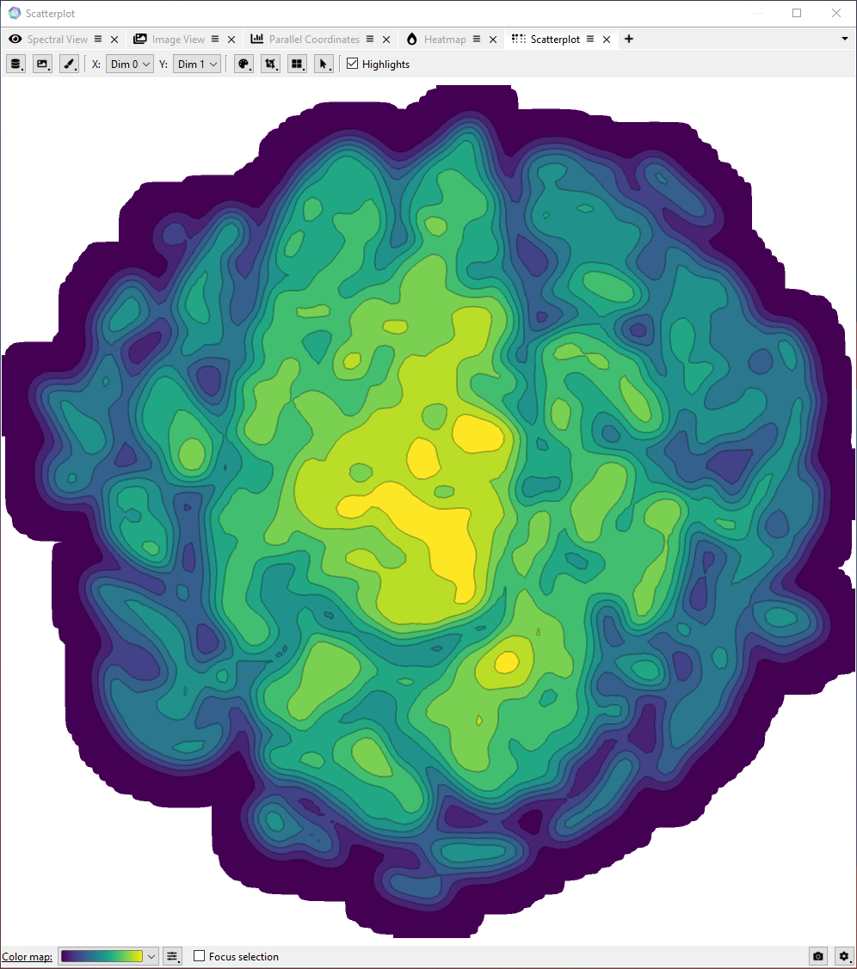
Plugins & Functionalities
Actions for serialization
Project & workspaces
Analysis, view, data, I/O and transform plugins
Notes:
Now, when a plugin consistently uses ManiVault’s actions API, all action’s states can be saved and loaded.
We use this to create presets for plugin settings and to save the state of entire projects, including the plugin layout and loaded data sets.
We currently have implemented a range of plugins, including different data types,
several viewers and common analytics methods like t-SNE and mean-shift clustering.
(workspace.json contains the CMV layout and actions state and a project.json saves the data hierarchy and additional project metadata.)

Slide 28
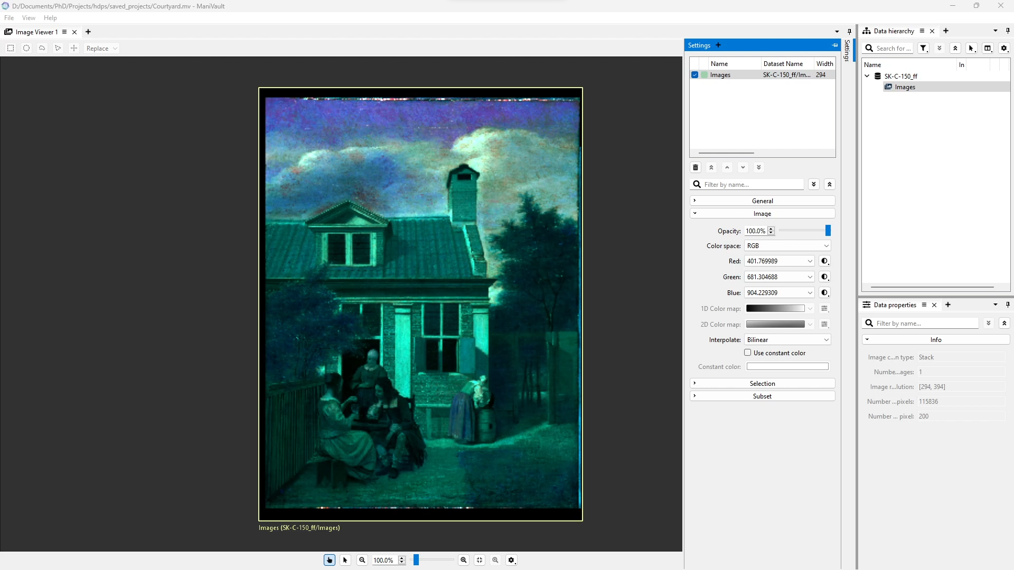
ManiVault in practice
Notes:
At this point, we should re-visit one of the application examples from the intro.
We are looking at an analytics setup for a high-dimensional image,
just as a domain expert in the field of cultural heritage might do.
A viewer plugin displays a false color image based on three of 200 image channels.

Slide 29

ManiVault in practice
Notes:
We'd now like to steer the selection of which channels are used for this recoloring.
We start with opening a t-SNE analysis through a context menu on our data set.
We can adjust settings and then inspect the resulting embedding in a scatterplot viewer plugin,
Where we define clusters of interest and display their average spectra in a line chart plugin.
Now, we'll make the parameters that we want to connect available through plugin-specific settings.
When selecting the parameter that we want to share, all parameters of the same type are highlighted - these
we can link with.
We could also turn entire GUI elements invisible
if we want to share this setup once it is in a well-adjusted state.
In a next step, we could save this setup as a project and send it to a colleague.
Upon opening it again, the setup including data, open plugins and parameter connections, will be restored.

Slide 30
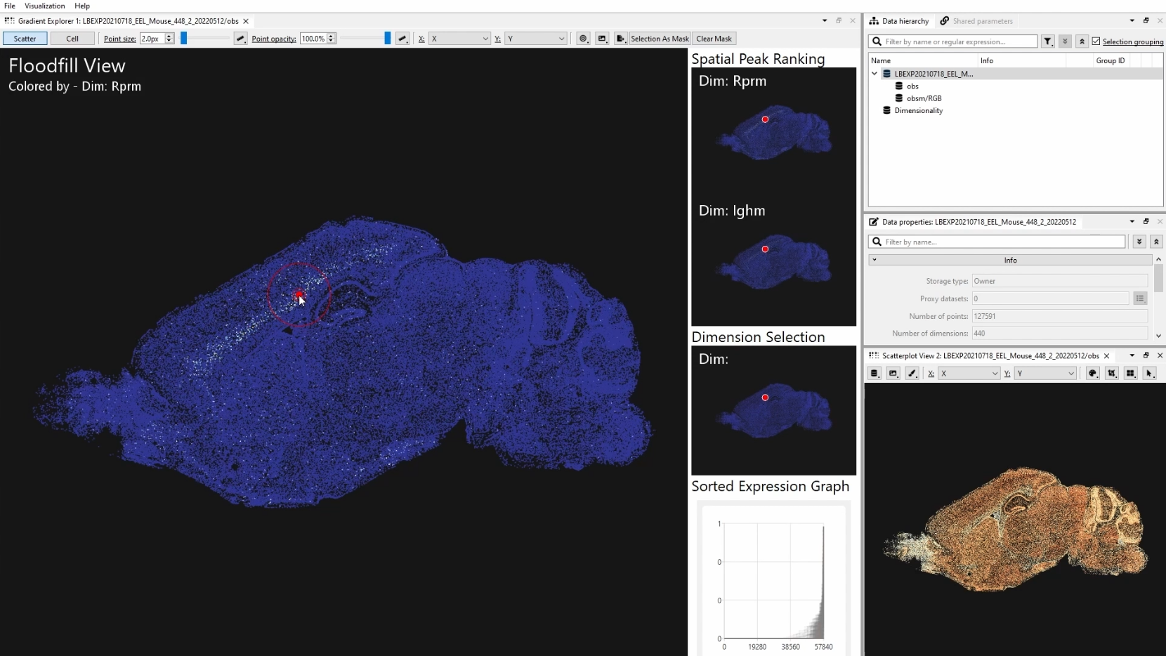
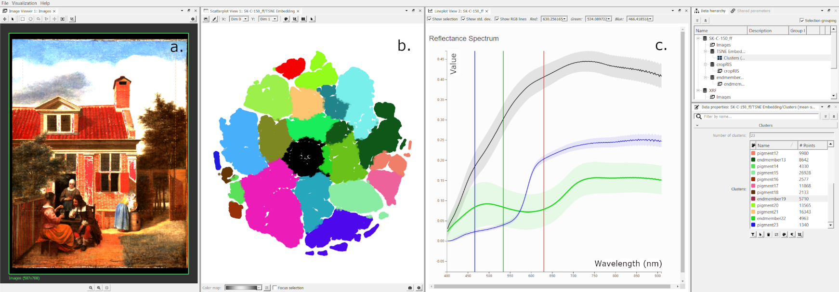
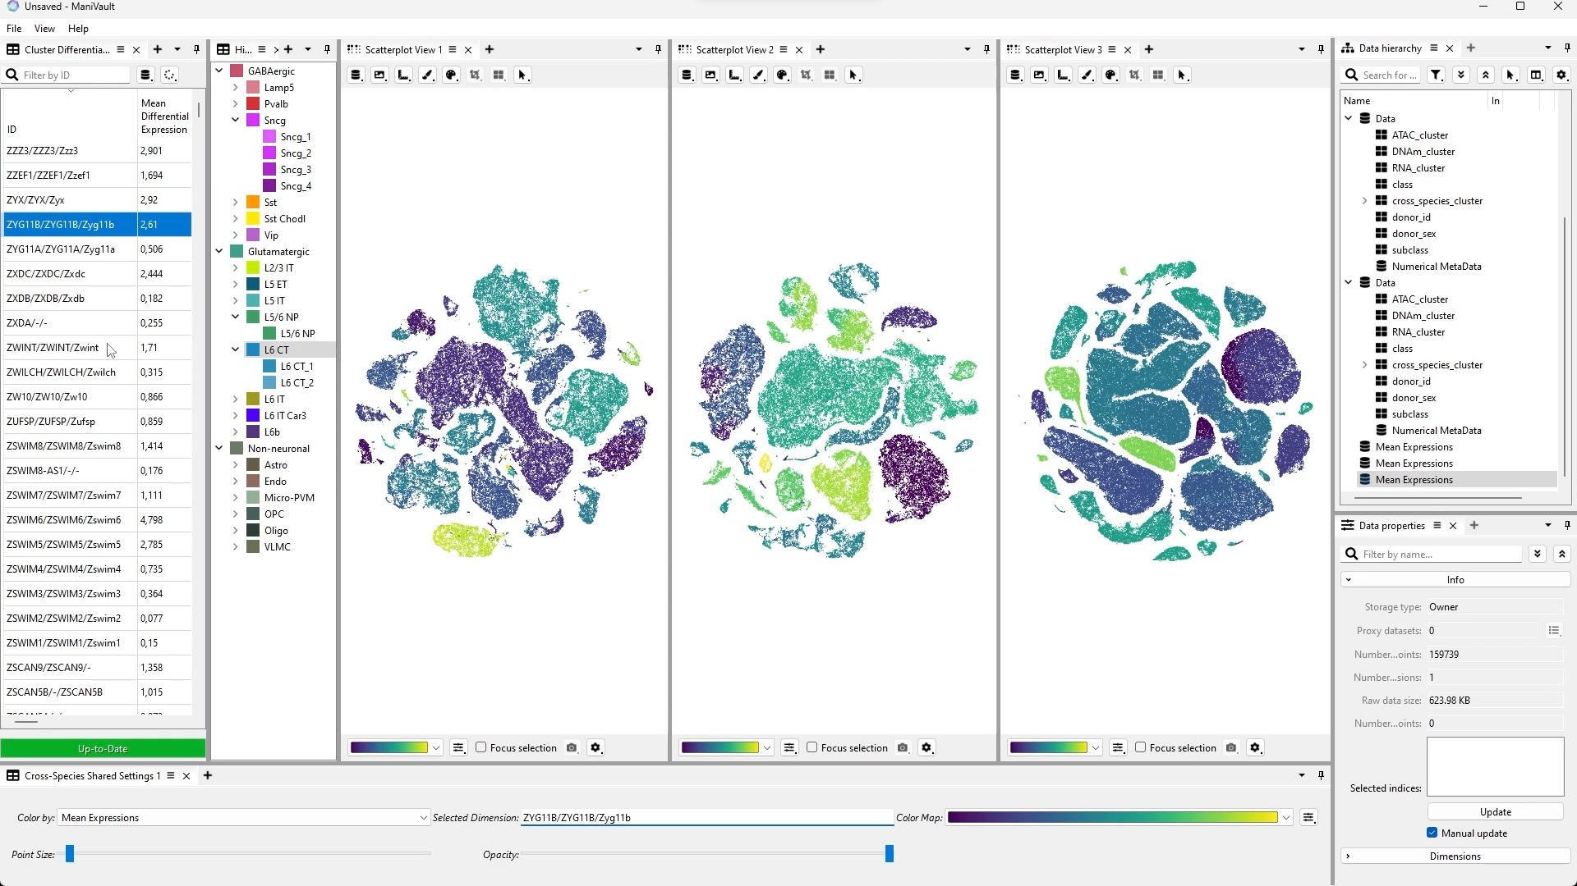
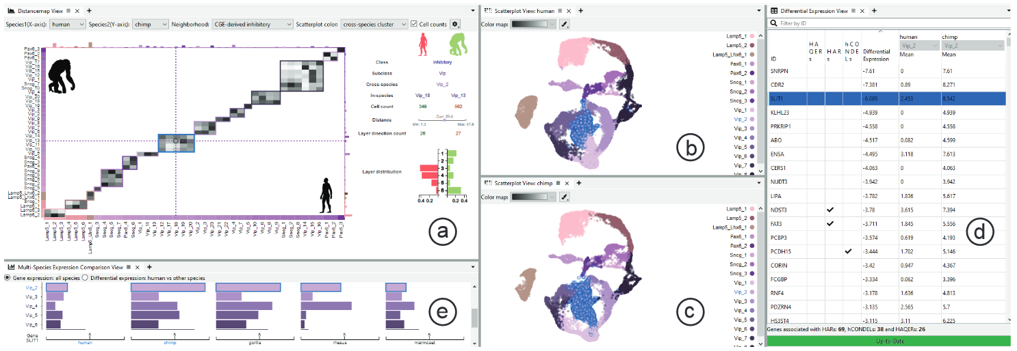
Conclusion
ManiVault for rapid prototyping of visual analytics systems
Used in several projects already
Open-source:
github.com/ManiVaultStudio
Notes:
Now, to conclude, we had a quick lock at ManiVault, a new framework for exploring and analyzing high-dimensional data that allows for rapid prototyping of visual analytics systems.
At this point already, development versions of ManiVault have been used in several project across four universities and in collaboration with several research institutions like the Allan institute in Seatle and the Rijksmuseum in Amsterdam.
(So far though, there have not been in-depth user studies, but we used the system in several Master projects where the system was picked up fast and received well.)
ManiVault is open-source. You can find it and a host of plugins on GitHub.
Additionally, there are examples that show the setup of each possible plugin type.

Slide 31
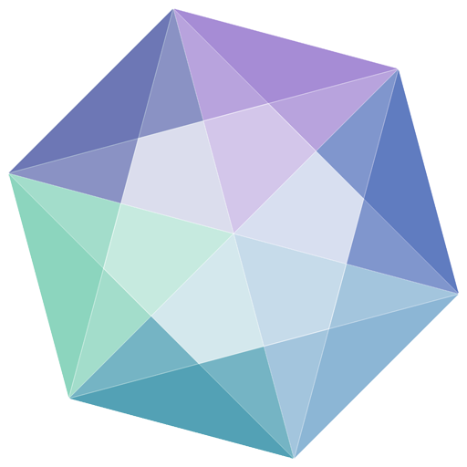
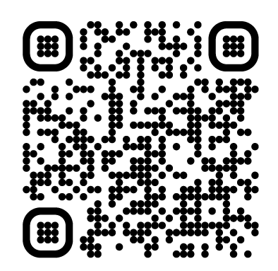



ManiVault is open-source!
www.manivault.studio
discord.gg/pVxmC2cSzA
youtube.com/@ManiVaultStudio
github.com/ManiVaultStudio
Notes:
Feel free to check out the software! We are happy about any sort of feedback.
Thanks for your attention.

Slide 32
ManiVault
Data flow
Core events
Linked parameters
Plugins
Analysis
View
Transform
Data (IO)
Flexible
Extensible
Distributable
Plugin
manager
Data
manager
Workspace
Project
Settings
Utilities
…
Linkable
Core
Configurable
Event
manager
Actions
Performant

Slide 33
Software Architecture
Data flow
Core events
Linked parameters
Plugins
Analysis
View
Transform
Loader/Writer
Data
Plugin
manager
Data
manager
Workspace
Project
Settings
Utilities
…
Core
Event
manager
Actions

