Slide 1
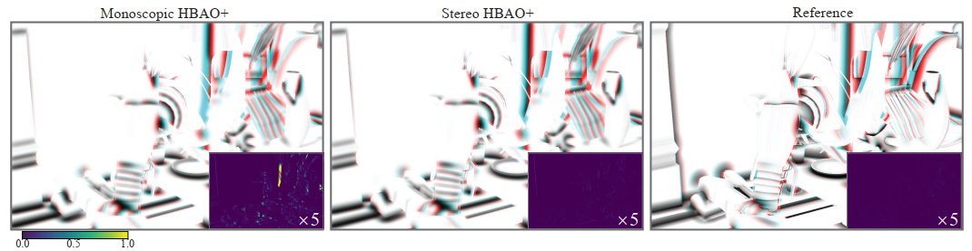
Stereo-Consistent Screen-Space
Ambient Occlusion
Peiteng Shi¹, Markus Billeter², Elmar Eisemann¹
¹ Delft University of Technology, the Netherlands
² University of Leeds, United Kingdom

Slide 2
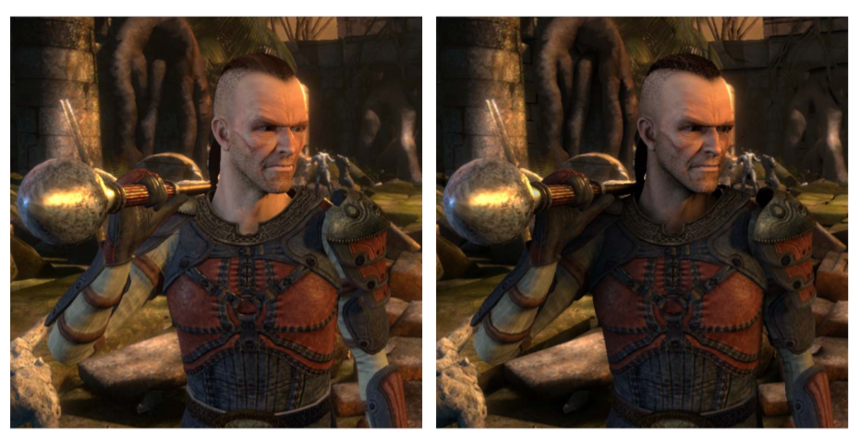
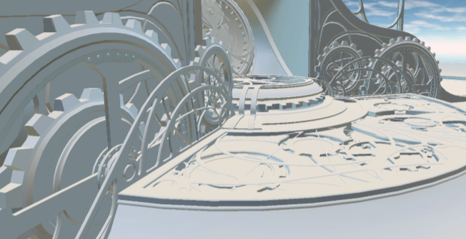
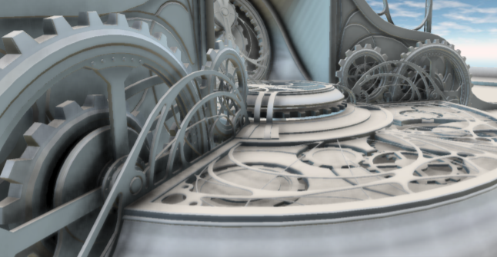
Ambient Occlusion (AO)
Without AO
With AO
Without AO
With AO
Image from:
Louis Bavoil, Miguel Sainz, 2009. Multi-Layer Dual-Resolution Screen-Space Ambient Occlusion. Presentation at SIGGRAPH.
McGuire et.al., 2011. The Alchemy Screen-Space Ambient Obscurance Algorithm.

Slide 3
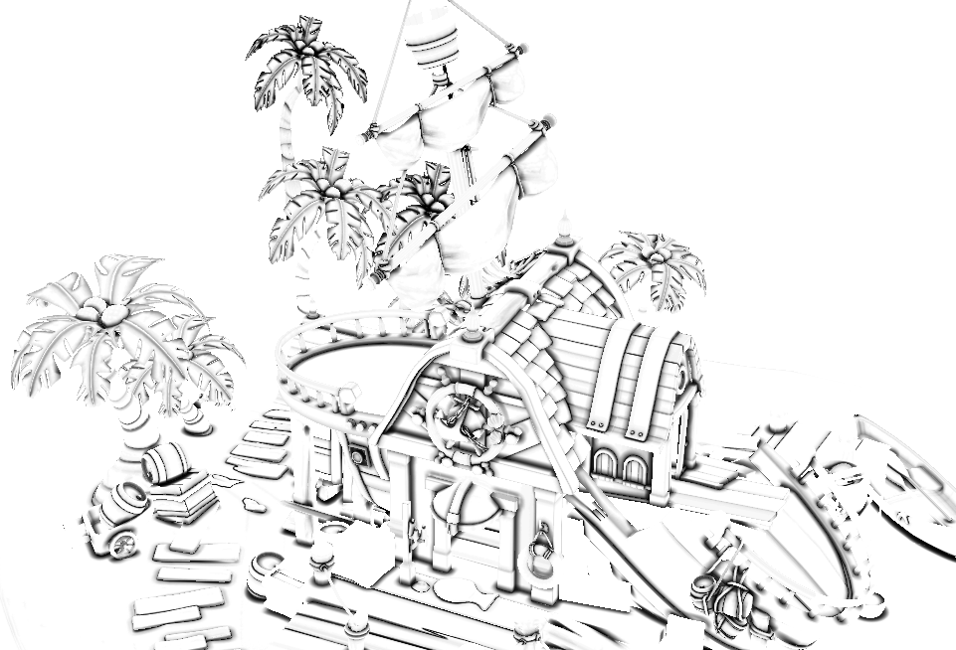
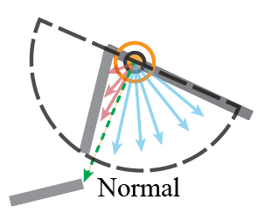
Ambient Occlusion (AO)
Ambient Occlusion (AO)
How the ambient light is blocked by a point’s
nearby objects
AO map
Geometry-based method

Slide 4
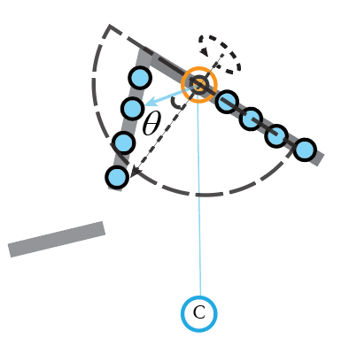
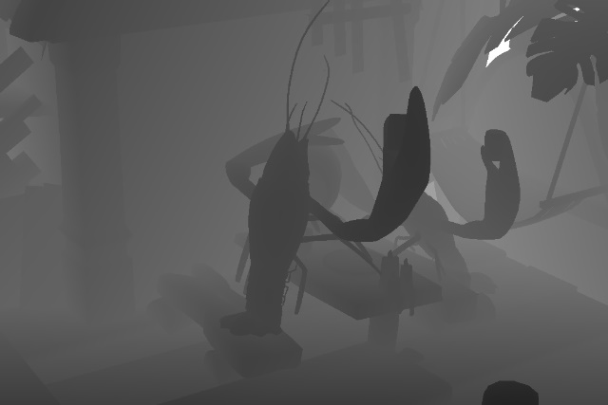
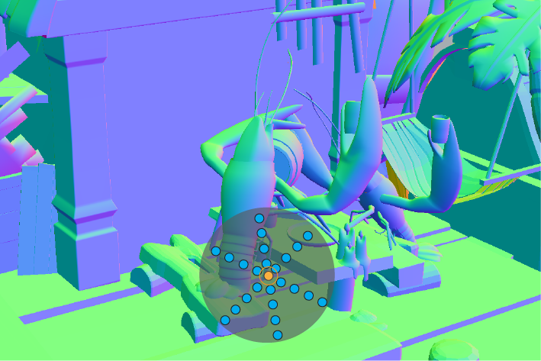
Screen-Space Ambient Occlusion (SSAO)
Screen-Space Ambient Occlusion: HBAO+
The obscurance value of a pixel :
Vector from the shaded point to the sample
Angle between the sample vector and the normal vector
Camera Position

Slide 5
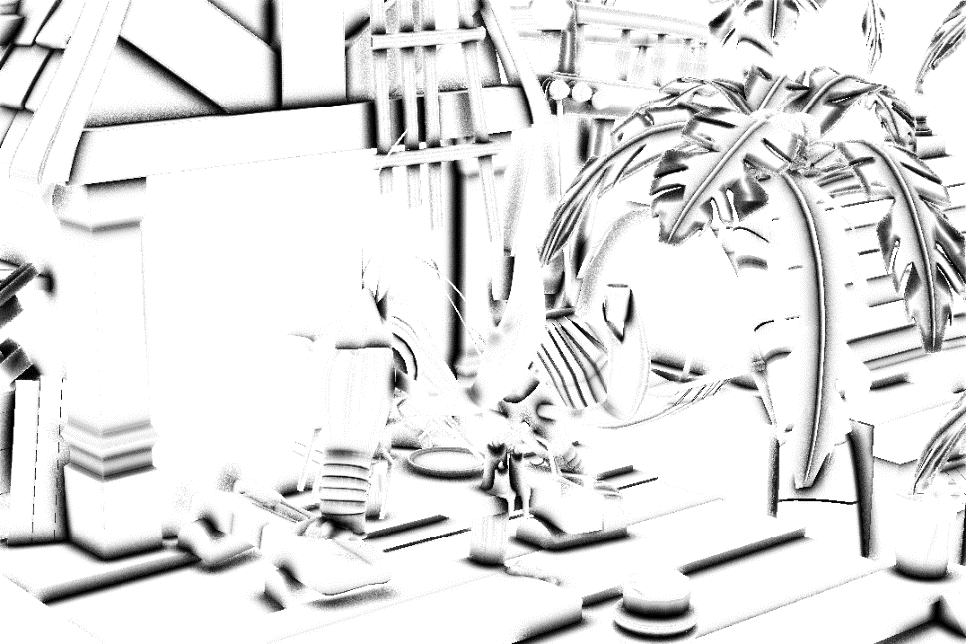

Screen-Space Ambient Occlusion (SSAO)
Workflow of SSAO
Noisy AO
Mono Raw Obscurance
Estimation Pass
Filtered AO
Mono Bilateral Filter
Pass

Slide 6

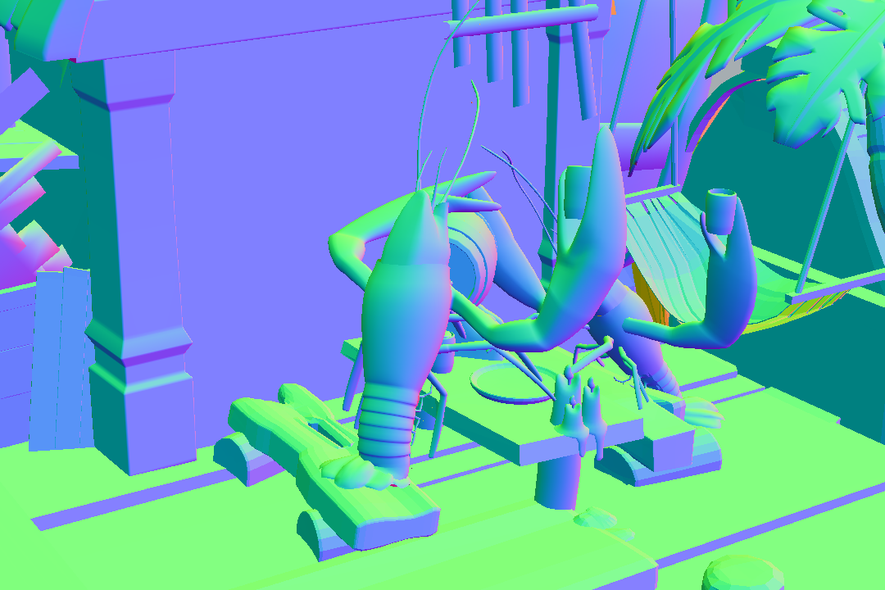
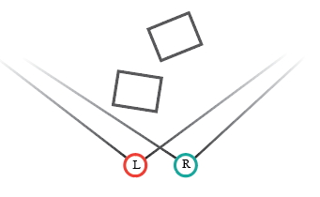
Stereo Screen-Space Differences
Left Screen Space

Slide 7
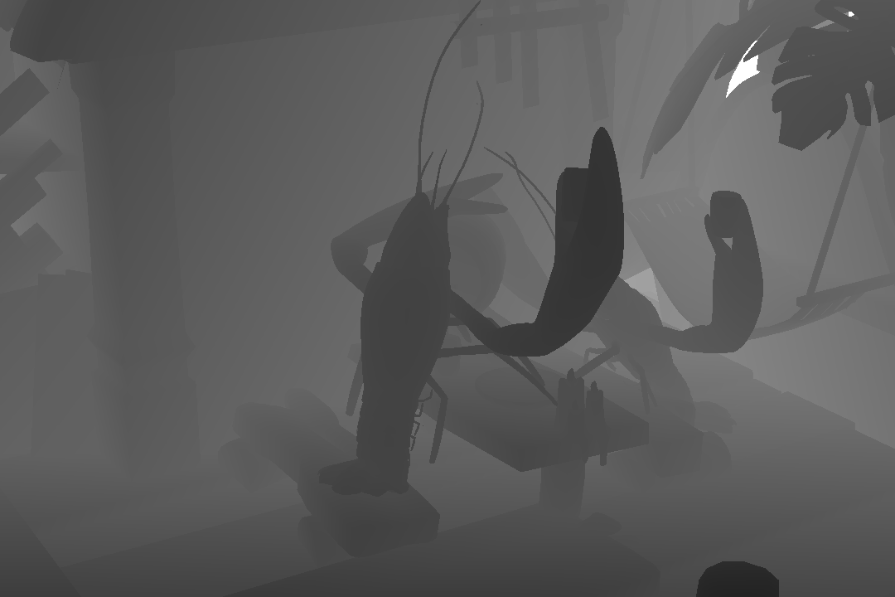
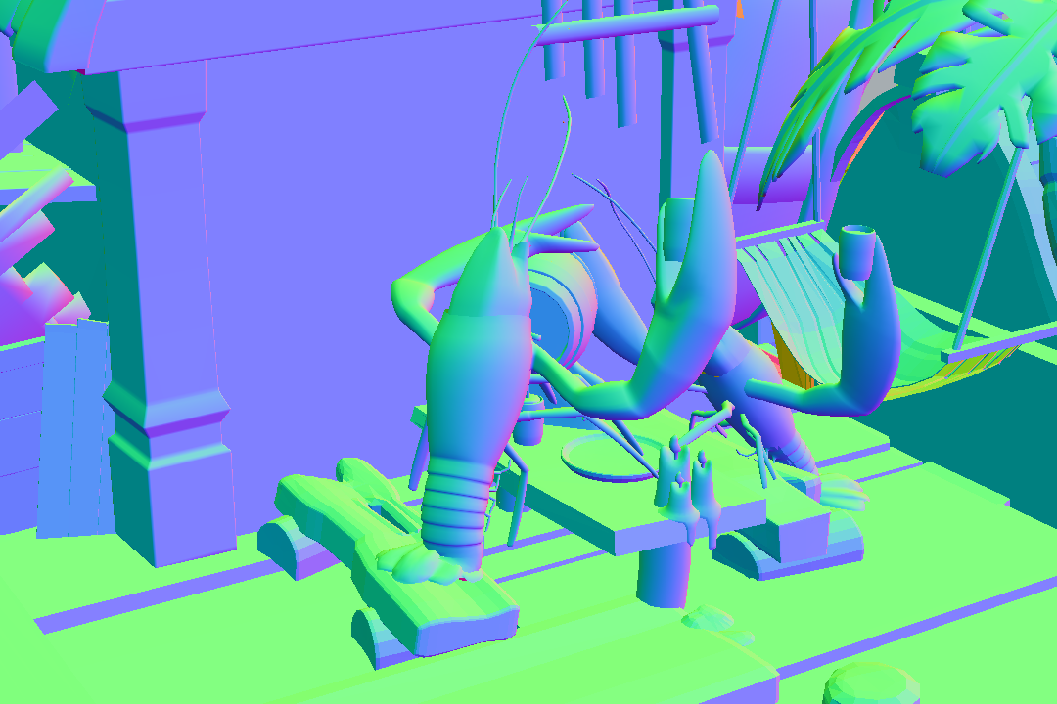
Stereo Screen-Space Differences
Right Screen Space

Slide 8
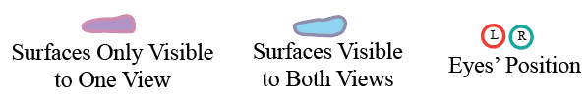
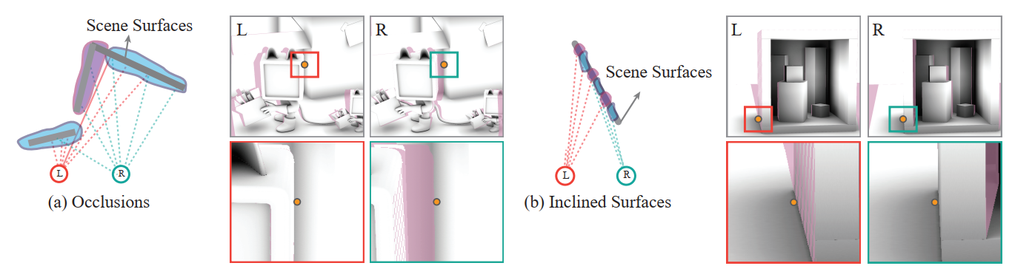
Stereo Screen-Space Differences
Pixels Visibility: visible for both eyes or only visible for one eye

Slide 9
Screen-Space Ambient Occlusion (SSAO)
Inconsistencies of SSAO methods
Mono Raw Obscurance
Estimation Pass
Introduces inconsistencies
Mono Bilateral Filter
Pass
Introduces inconsistencies

Slide 10
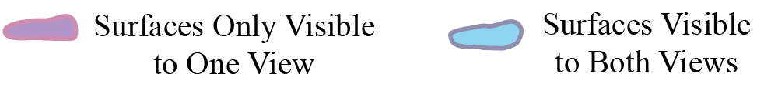
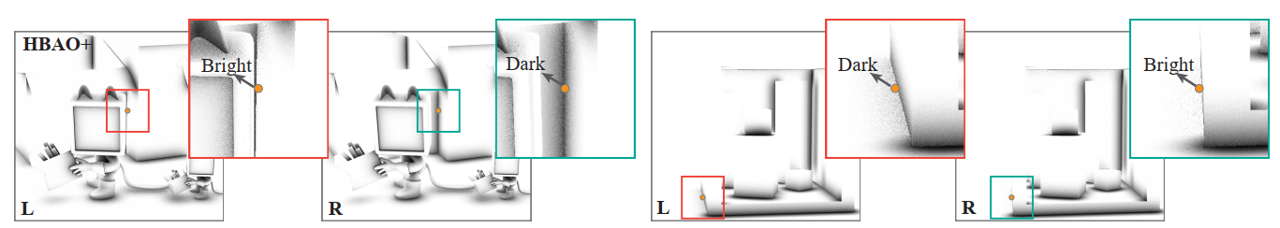
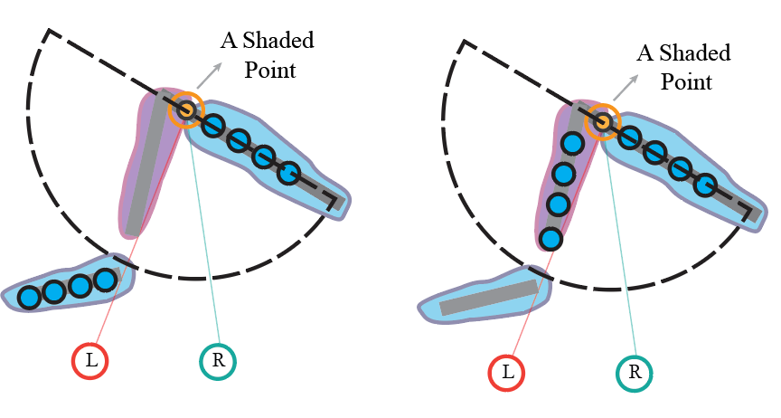
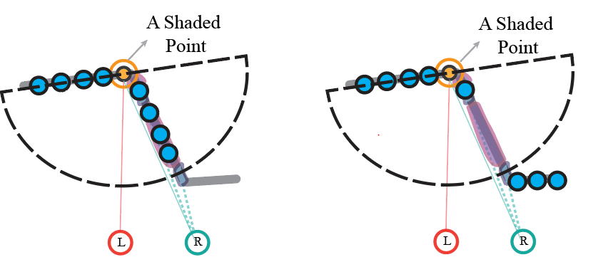
Mono Raw Obscurance Estimation
Left
Right
Left
Right

Slide 11
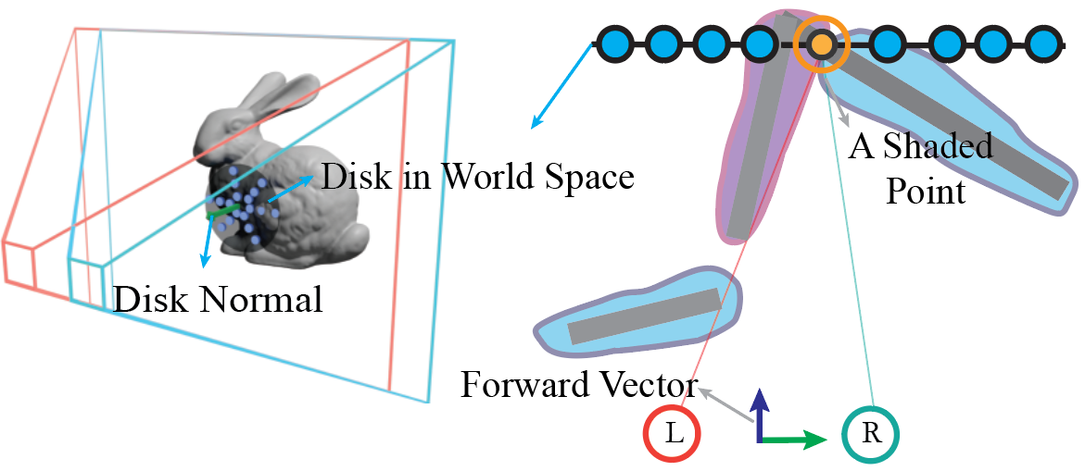
Stereo Raw Obscurance Estimation
Generate samples on a 3D disk

Slide 12
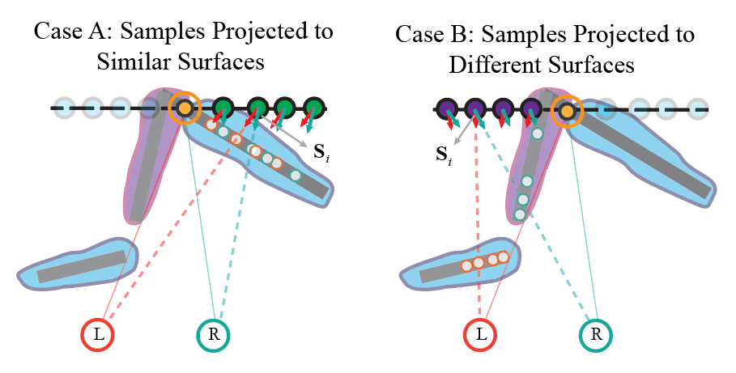
Stereo Raw Obscurance Estimation
Two cases

Slide 13
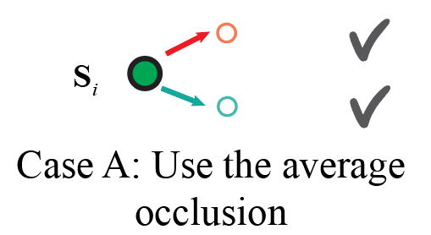
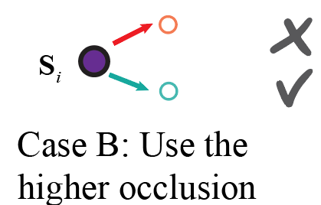
Stereo Raw Obscurance Estimation
Two cases

Slide 14
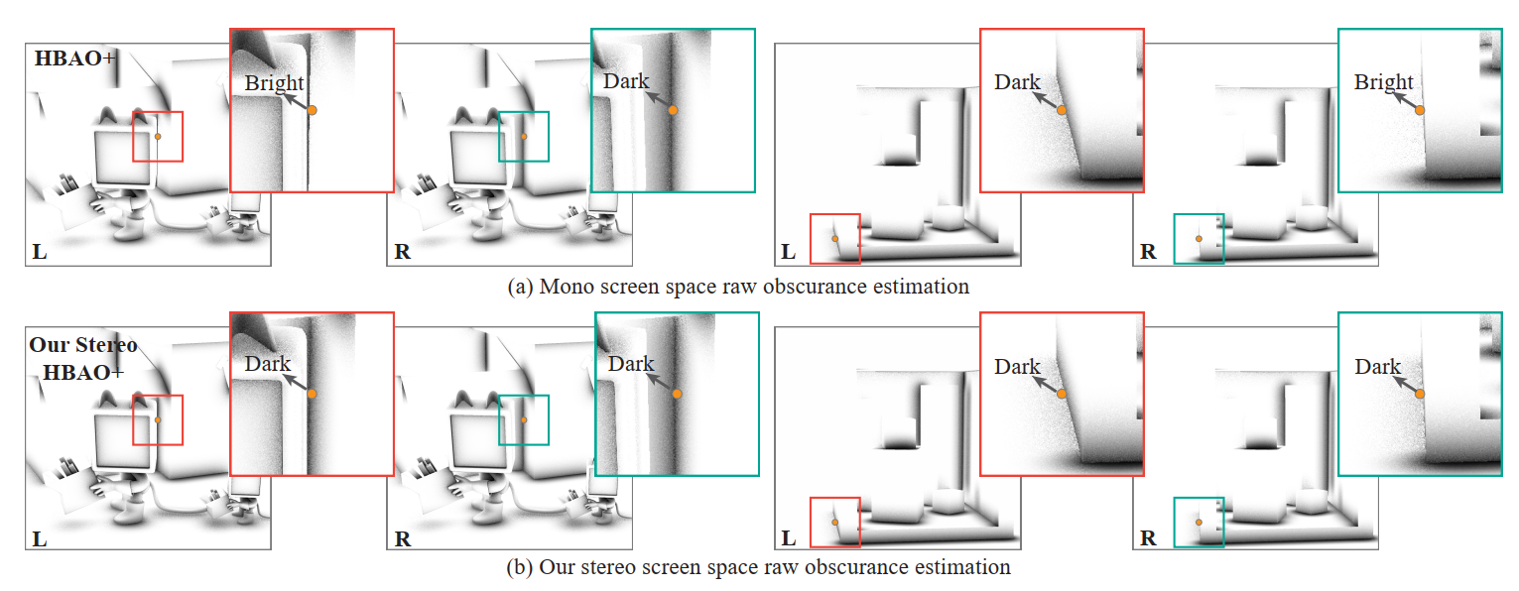
Stereo Raw Obscurance Estimation

Slide 15
Screen-Space Ambient Occlusion (SSAO)
Workflow of SSAO
Mono Raw Obscurance
Estimation Pass
Replace
Stereo Raw Obscurance
Estimation Pass
Mono Bilateral Filter
Pass

Slide 16
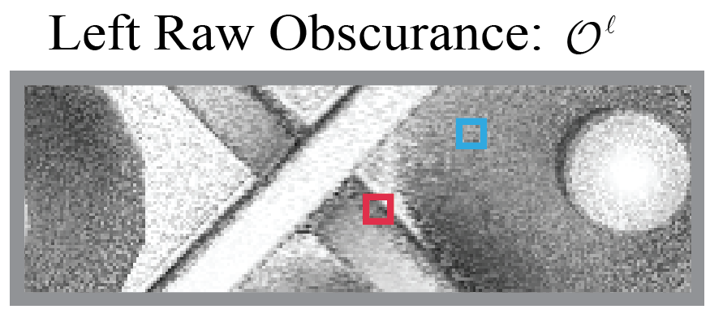
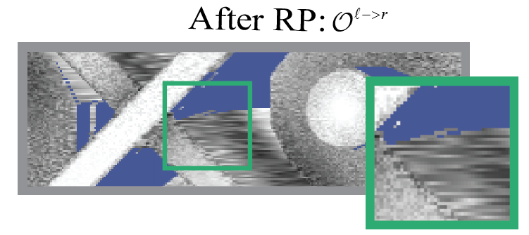
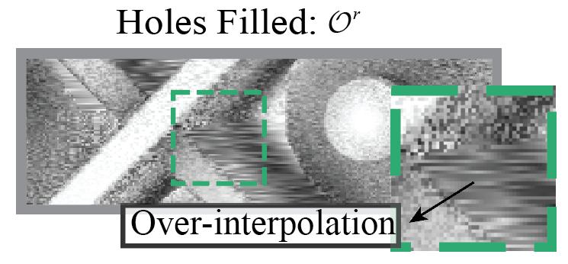
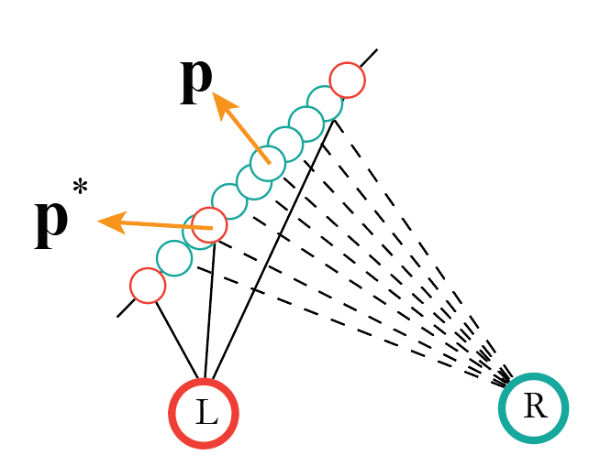
Stereo Raw Obscurance Estimation (RP)
Reverse Reprojection (RP)

Slide 17
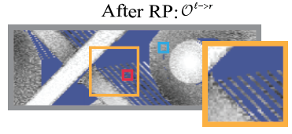
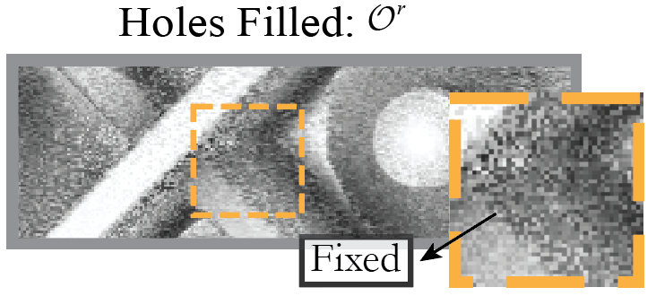
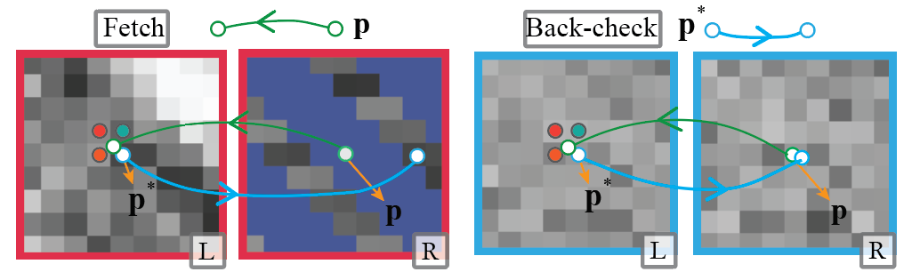
Stereo Raw Obscurance Estimation (RP)
Reverse Reprojection (RP) with back-check
Back-check

Slide 18
Screen-Space Ambient Occlusion (SSAO)
Workflow of SSAO
Stereo Raw Obscurance
Estimation Pass
Replace
Mono Raw Obscurance
Estimation Pass
Stereo Raw Obscurance
Estimation Pass (RP)
Replace
Mono Bilateral Filter
Pass
Reduce inconsistencies of
the filter pass in the following part

Slide 19
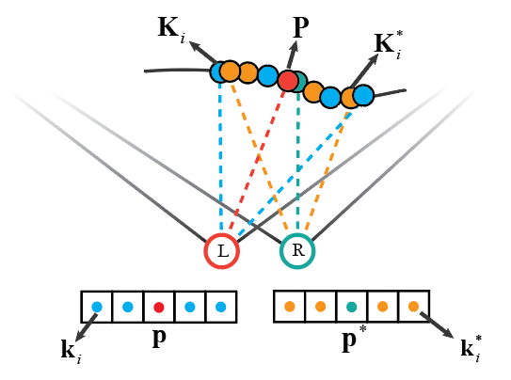
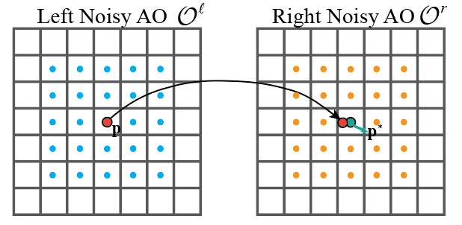
Stereo Filter Pass
Use filter samples from both views
Weight of a sample
Distance to the shaded point
Gaussian function
Contribution of each view
Combine both views

Slide 20
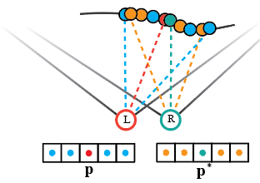
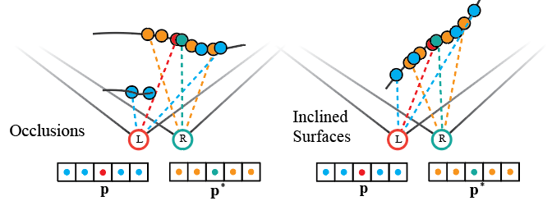
Stereo Filter Pass
Determining the weight of views
Filter samples cover similar regions
Filter samples cover distinct regions
Using the filter samples of the current view is enough
Combining both views with preference to the view with closer filter samples
Expectation:
Expectation:

Slide 21
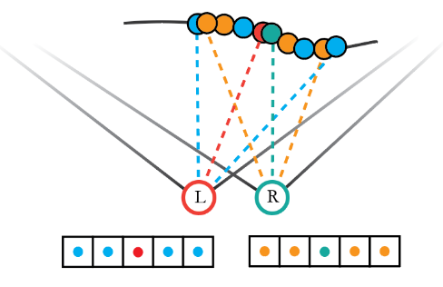
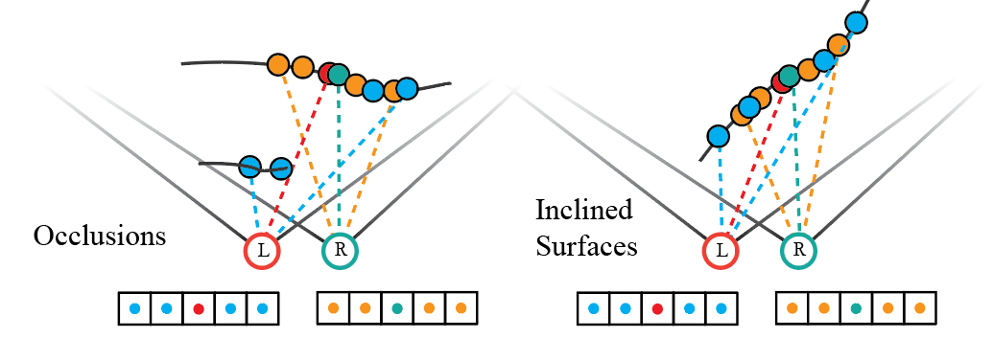
Stereo Filter Pass
Closeness of filter samples
Similar Regions
Expectation:
Distinct Regions
The sum of filter samples’ weight as defined before
Depend on samples’ distance to the
shaded point
Expectation:

Slide 22
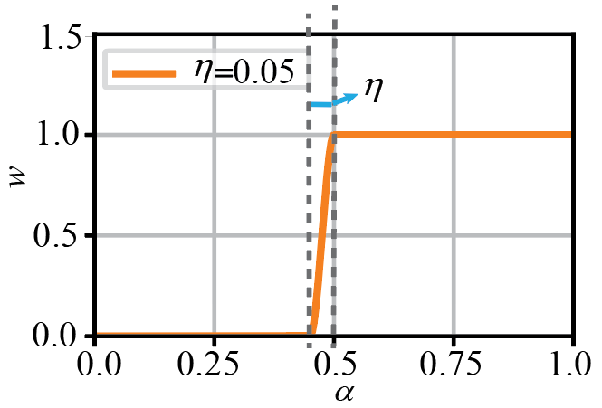
Stereo Filter Pass
Determining the weight of views
Similar Regions
Closeness of filter samples
Distinct Regions

Slide 23
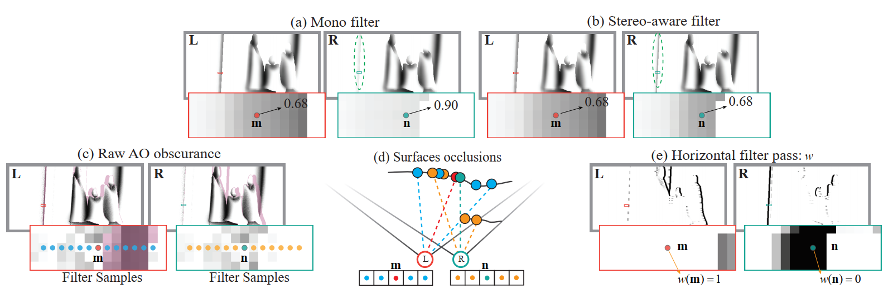
Stereo Filter Pass

Slide 24
Screen-Space Ambient Occlusion (SSAO)
Workflow of SSAO
Stereo Raw Obscurance
Estimation Pass
Replace
Mono Raw Obscurance
Estimation Pass
Replace
Stereo Raw Obscurance
Estimation Pass (RP)
Mono Bilateral Filter
Pass
Replace
Stereo-aware Filter Pass

Slide 25
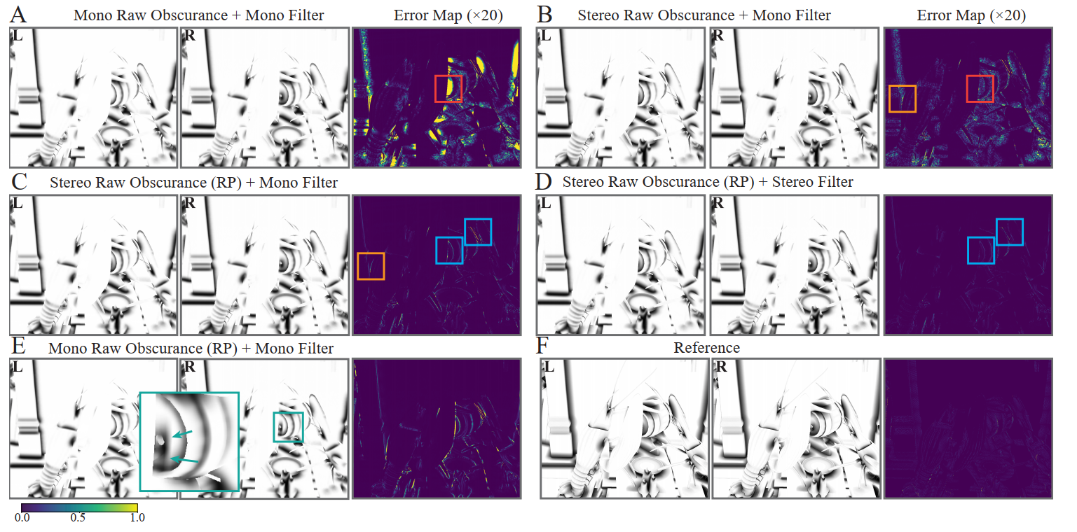
Stepwise Analysis
Mono Raw Obscurance
Estimation Pass
Mono Bilateral Filter
Pass

Slide 26
Stepwise Analysis
Stereo Raw Obscurance
Estimation Pass
Mono Raw Obscurance
Estimation Pass
Mono Bilateral Filter
Pass

Slide 27
Stepwise Analysis
Stereo Raw Obscurance
Estimation Pass
Stereo Raw Obscurance
Estimation Pass (RP)
Mono Raw Obscurance
Estimation Pass
Mono Bilateral Filter
Pass

Slide 28
Stepwise Analysis
Stereo Raw Obscurance
Estimation Pass (RP)
Stereo-aware Filter
Pass
Mono Bilateral Filter
Pass

Slide 29
Stepwise Analysis
Mono Raw Obscurance
Estimation Pass (RP)
Mono Bilateral Filter
Pass

Slide 30
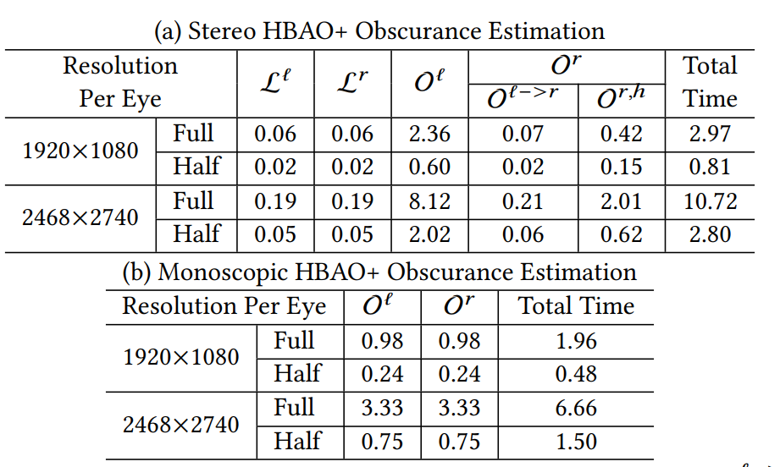
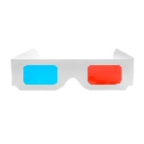

Rendering Time
Experiments setup:
I9-11900K 8-core processor; RTX 3090
The Raw Obscurance Estimation Pass (ms)
The most time-consuming step is the stereo raw
obscurance estimation step
With reverse reprojection, the computation cost is reduced significantly
Computing AO at half resolution is necessary
for VR
2~3 times more expensive than the mono version

Slide 31
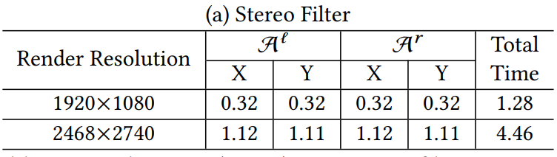
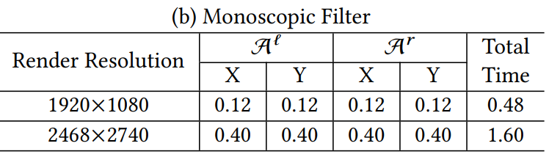
Rendering Time
The Filter Pass (ms)
The stereo filter is ~3 times as expensive as the mono filter

Slide 32
Future Work
Reduce the computation cost
Apply our stereo filter to ray-tracing denoising of stereo images
Importance sampling
Vardis et al. 2013, Multi-View Ambient Occlusion with Importance Sampling
Hybrid mono-stereo rendering
Other screen-space effects
Fink et al. 2019, Hybrid Mono-Stereo Rendering
in Virtual Reality
Screen-space stylization
Image dithering
Eye-tracking in VR
Weier et al. 2017, Saliency in VR: How Do People Explore Virtual Environments
Solve the hidden geometry artifacts
Vermeer et al. 2021, Stochastic-Depth Ambient Occlusion

Slide 33



Thank You
Peiteng Shi¹
Markus Billeter²
Elmar Eisemann¹
Questions ?
¹ Delft University of Technology, the Netherlands
² University of Leeds, United Kingdom
Find us on:
https://graphics.tudelft.nl
https://vcg.leeds.ac.uk

