Slide 1




Effect of White Matter Uncertainty Visualization in Neurosurgical Decision Making
Faizan Siddiqui^{1,2}, H. Bart Brouwers³, Geert-Jan Rutten³, Thomas Höllt¹, Anna Vilanova² ¹Delft University of Technology, The Netherlands
²Eindhoven University of Technology, The Netherlands
³Elisabeth-Twee Steden Hospital, The Netherlands

Slide 2
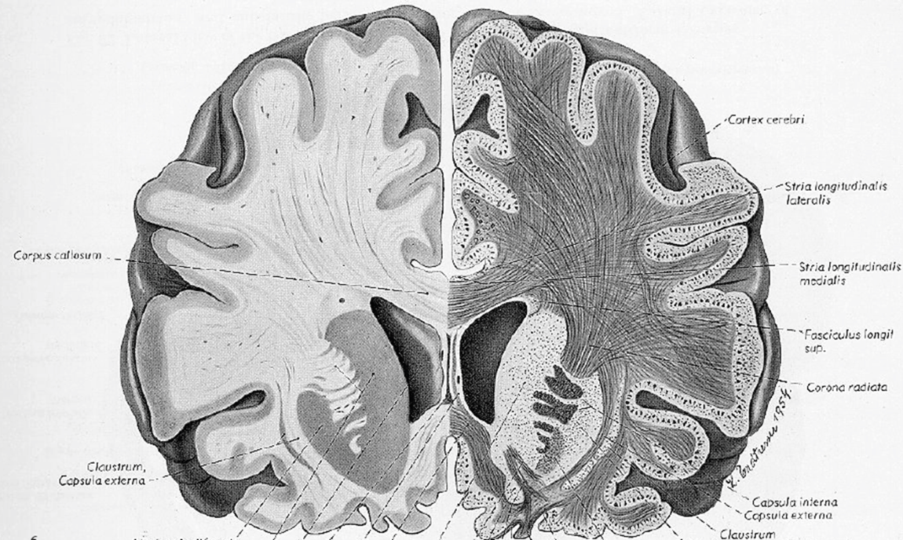
White Matter
White matter affects water diffusion properties
Gray matter
White matter
Voxel
Notes:
Brain white matter is fibrous tissue, coordinating the communication between different brain regions.
In order to characterize white matter, we need to resort to a physical phenomenon called water diffusion.
For example, for this voxel, water molecules diffuse more easily along the direction of white matter than perpendicular to it.
We can measure the diffusion extent for several directions, and model it as a ….
Bridge sentence:
the water diffusion can be mathematically described by a 2nd-order symmetric positive-definite tensor, the so-called diffusion tensor

Slide 3
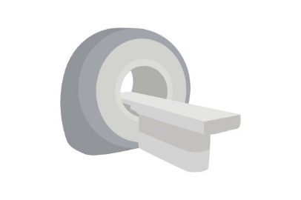
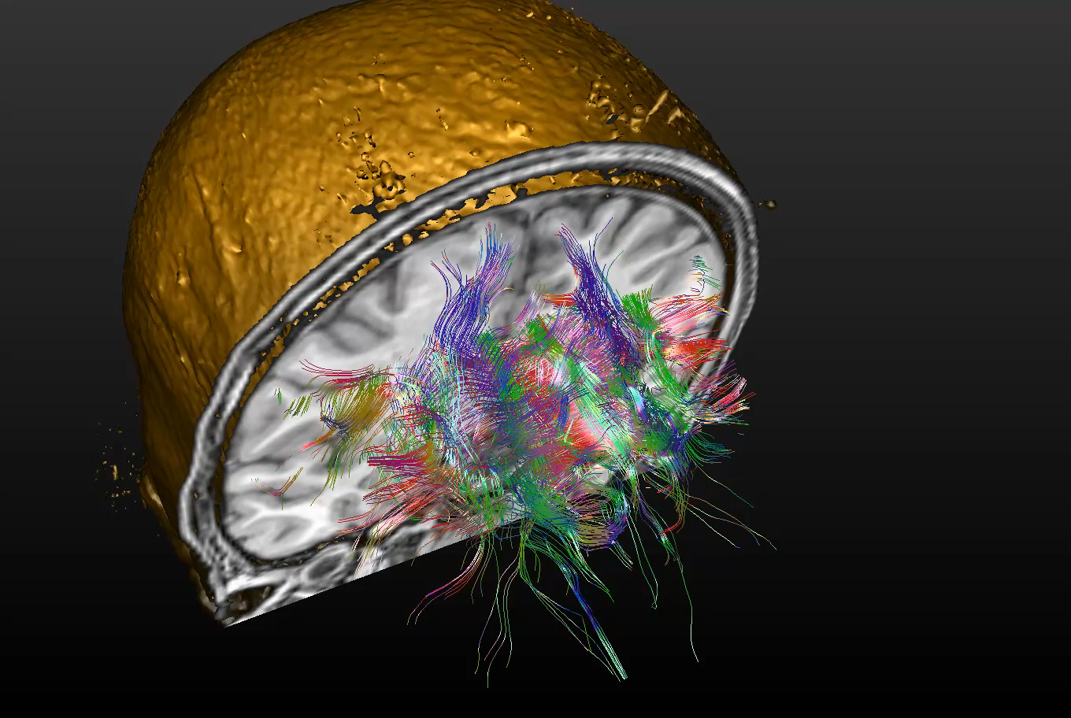
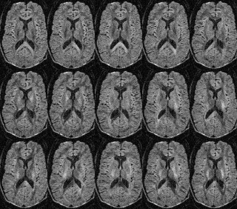
Fiber Tracking
Diffusion Weighted Magnetic Resonance Imaging (MRI)
Notes:
Similarly visualizing brain connectivity in-vivo is possible through measuring diffusion properties of tissue with Magnetic Resonanace Imaging
From the images we can reconstruct the white matter - the connections in the brain. As can be seen in the video
This is important for several medical applications. For example, understanding the brain and its development, or for tumor dissection by being able to see during planning important connections like fibers that connect to the body to the brain.

Slide 4
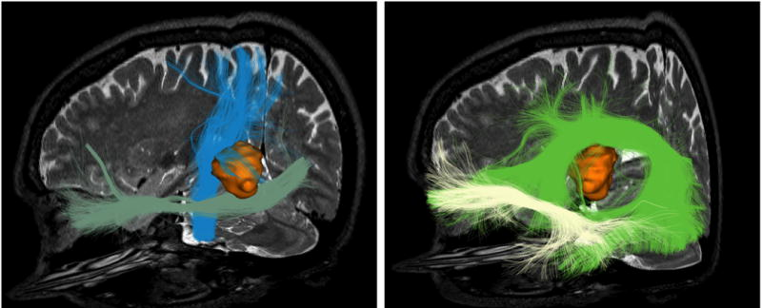
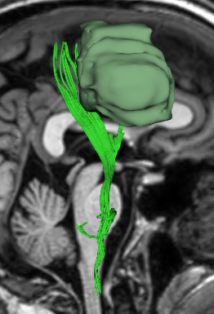
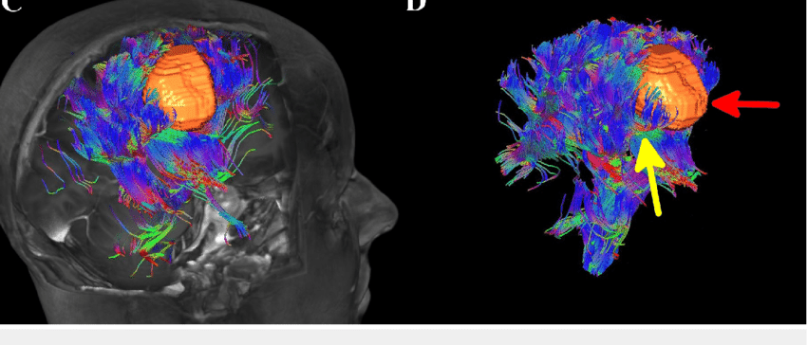
White Matter Visualization in a Neurosurgical Workflow
Zakaria H, Haider S, Lee I (September 06, 2017). Cureus 9(9): e1656. doi:10.7759/cureus.1656
Fiber Tracking with safety margin

Slide 5
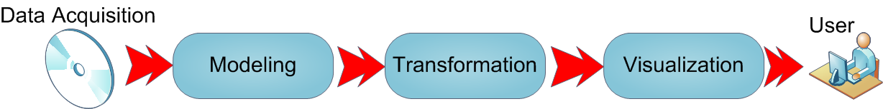
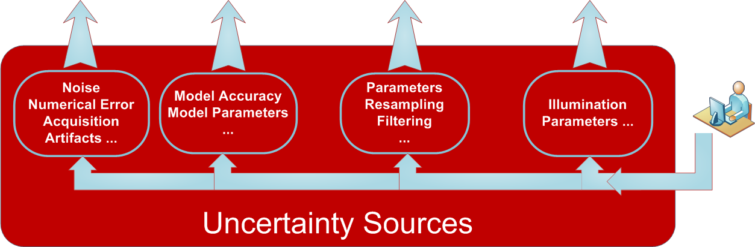
Visualization Pipeline

Slide 6
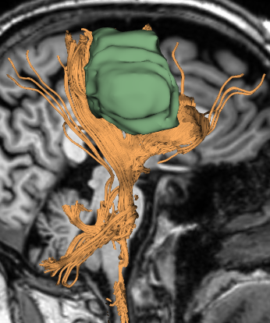
White Matter Visualization in a Neurosurgical Workflow
Zakaria H, Haider S, Lee I (September 06, 2017). Cureus 9(9): e1656. doi:10.7759/cureus.1656
Fiber Tracking with safety margin
Possible variations due to uncertainty

Slide 7
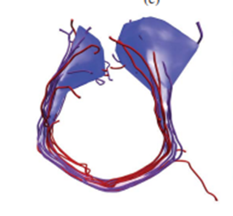
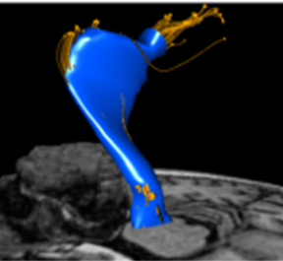
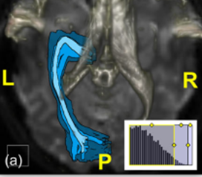
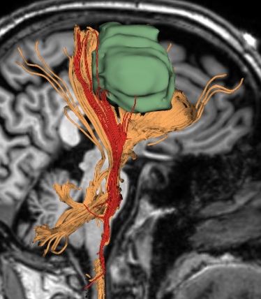
White Matter Uncertainty Visualization
Mirzagar et al. 2014
Enders et al. 2005
Brecheisen et al. 2013
Siddiqui et al. 2021

Slide 8
Goal
Evaluate if uncertainty visualization in fiber tracking influences neurosurgeon’s decisions and confidence in their decisions
Studies in other contexts
Padilla et al. “Uncertain about uncertainty: How qualitative expressions of forecaster confidence impact decisionmaking with uncertainty visualizations” Front. Psychol. 2021
Deitrick et al. “The influence of uncertainty visualization on decision making: An empirical evaluation,” in Proc. Int. Symp. Spatial Data Handling, 2006
Roulston et al. “A laboratory study of the benefits of including uncertainty information in weather forecasts,” Weather Forecasting, 2006.
Joslyn and LeClerc, “Uncertainty forecasts improve weather-related decisions and attenuate the effects of forecast error,” J. Exp. Psychol.: Appl., 2012
….
Notes:
We embraced the context as employed in the study by
Padilla et al.6 where the impact of uncertainty visualization
on decision-making is evaluated on the weather
forecaster by manipulating uncertainty intervals in the
results and analyzing how the decisions are changing
based on these presented uncertainties. Padilla et al.6
showed participants the distribution of possible variations
in temperature based on an artificial scenario
and were tasked to make a decision. They found that
participants made more informed and cautious decisions
when uncertainty was shown. Based this work,
we aim to analyze the impact of uncertainty visualization
on clinical decision-making, specifically when
showing uncertainty for fiber tracking results.
While some studies evaluate
the impact of uncertainties on decision-making in general,
6 extrapolating these results to the context of
fiber tracking proves challenging. This difficulty arises
due to the intricate task of representing uncertainty in
complex objects, such as fiber tracts, which contrasts
with the relative simplicity of handling uncertainty in
scalar values, such as a vessel diameter.

Slide 9
Hypotheses
Based on Padilla et al. 2021
H1: Visualization of uncertainty will influence the participants’ decision.
H2: Participants will make a more cautious decision when a larger uncertainty interval is visualized
H3: Confidence of the participants in decision-making will be affected by the uncertainty visualization

Slide 10
User Study Design
Decision / Questions
Cases
Uncertainty Visualization
Online interactive questionnaire
Distributed neurosurgeons in the Netherlands (15 participants)

Slide 11
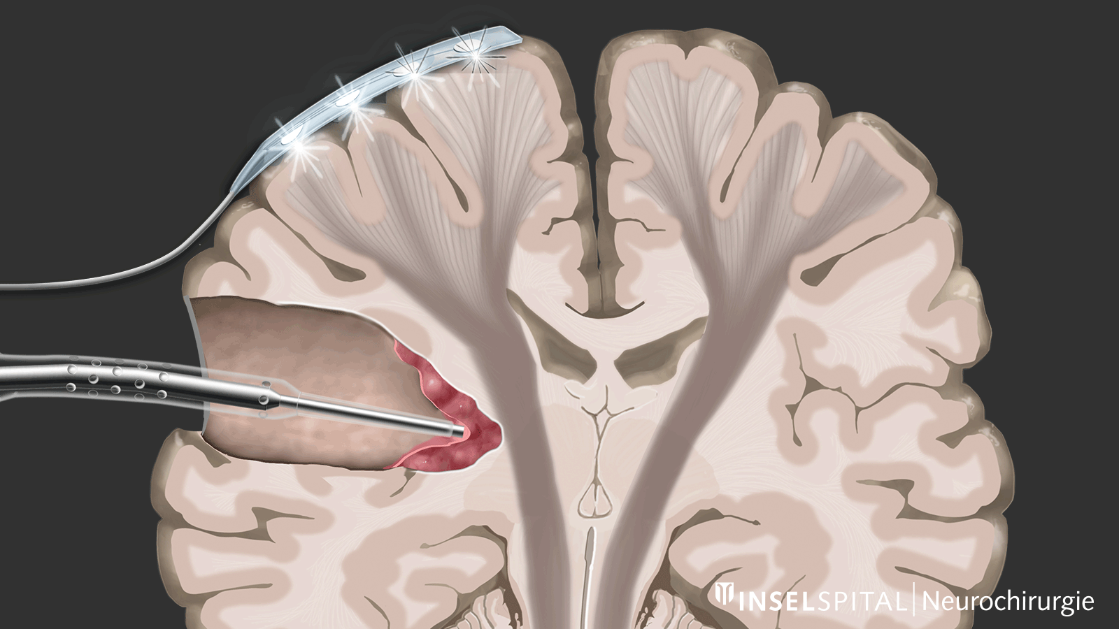
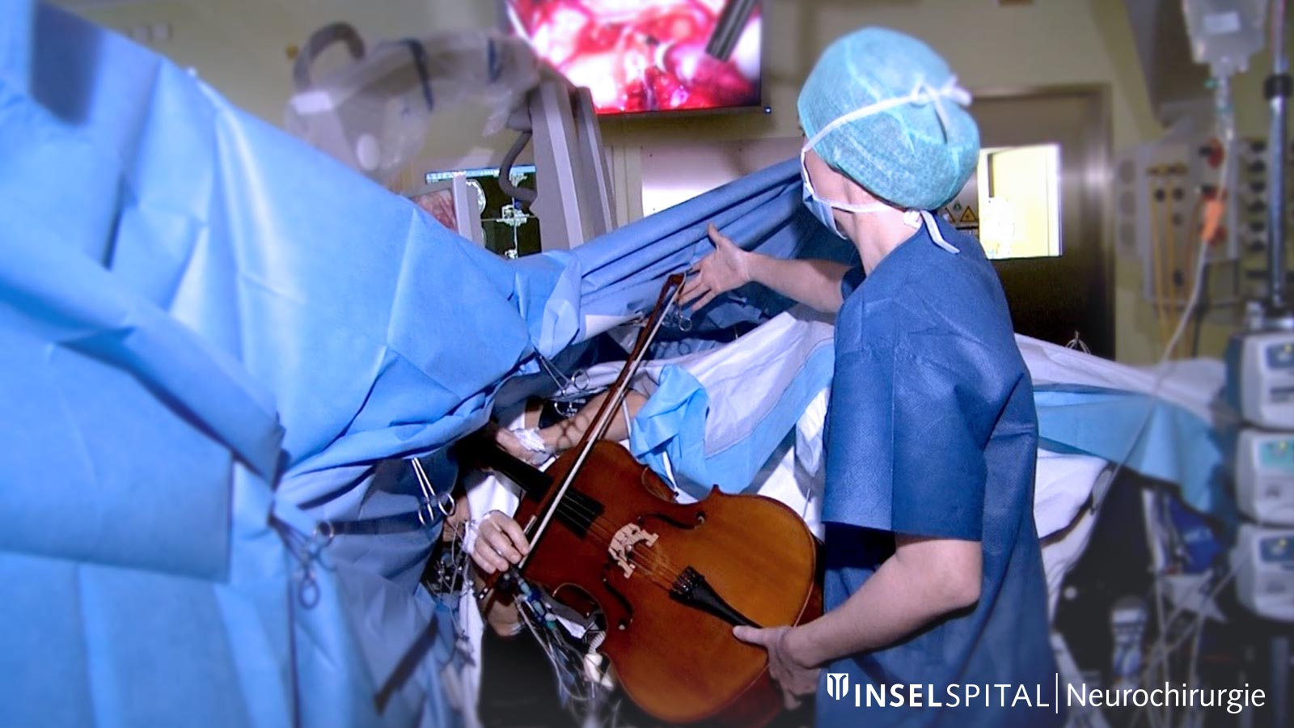
Intraoperative Neuromonitoring
Keeps the patient awake
Electrical stimulation while performing tasks to identify structures
Long and invasive procedure
https://neurochirurgie.insel.ch/en/diseases-specialities/intraoperative-neuromonitoring

Slide 12
Decision/Questions
Q1: Based on this visualization, will you recommend using Intraoperative Neurophysiological Monitoring (IONM) during the surgical procedure?
H1 & H2
Q2: Would you like to comment on your decision? You may want to comment, for instance, what arguments led you to this decision
Q3: How Confident are you about the decision?
H3

Slide 13
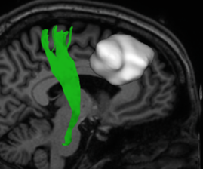
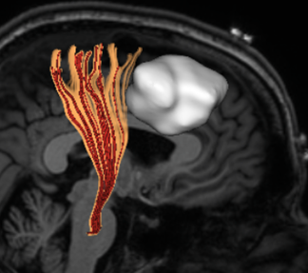
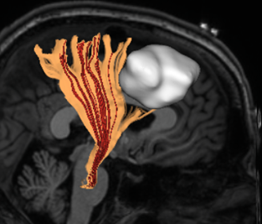
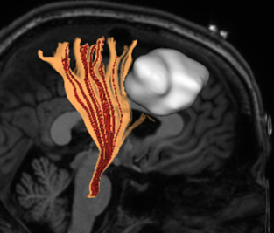
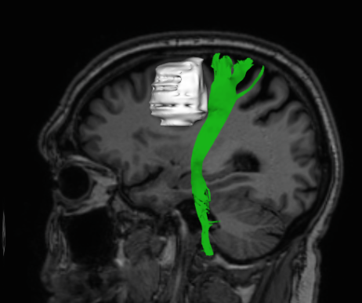
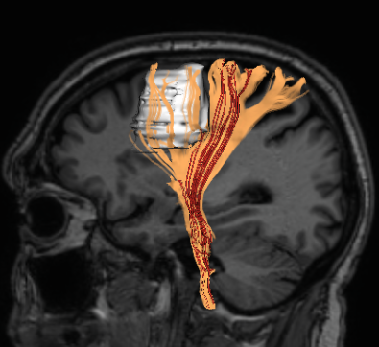
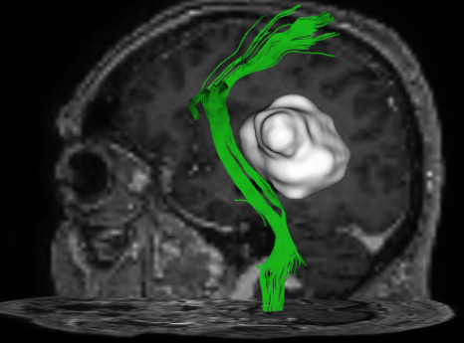
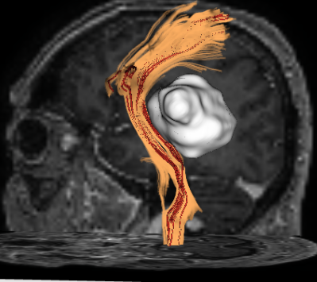
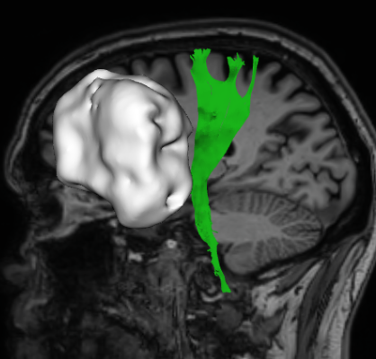
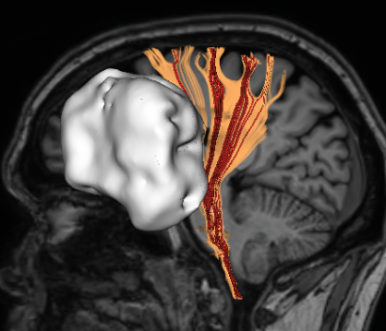
Cases and Uncertainty Visualization
Patient 1
No uncertainty
25% interval
75% interval
100% interval
Patient 4
Patient 2
Patient 3
Patient 4
Patient 1
No uncertainty
100% interval
No uncertainty
100% interval
No uncertainty
100% interval
Notes:
We chose four different anonymized patient datasets for testing our hypotheses with three uncertainty interval levels.

Slide 14
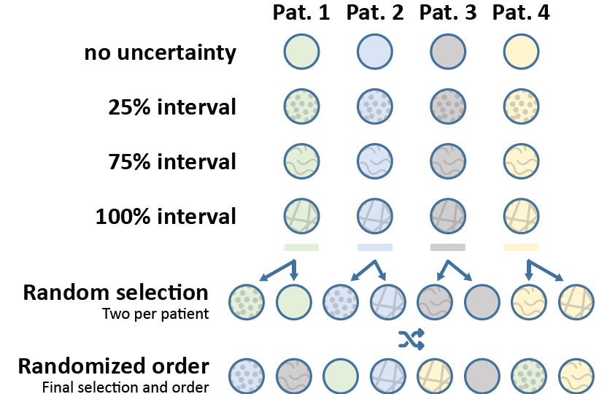
Cases presentation to the participants
Notes:
Each participant was presented with all four patients but only two randomly selected uncertainty intervals per patient

Slide 15
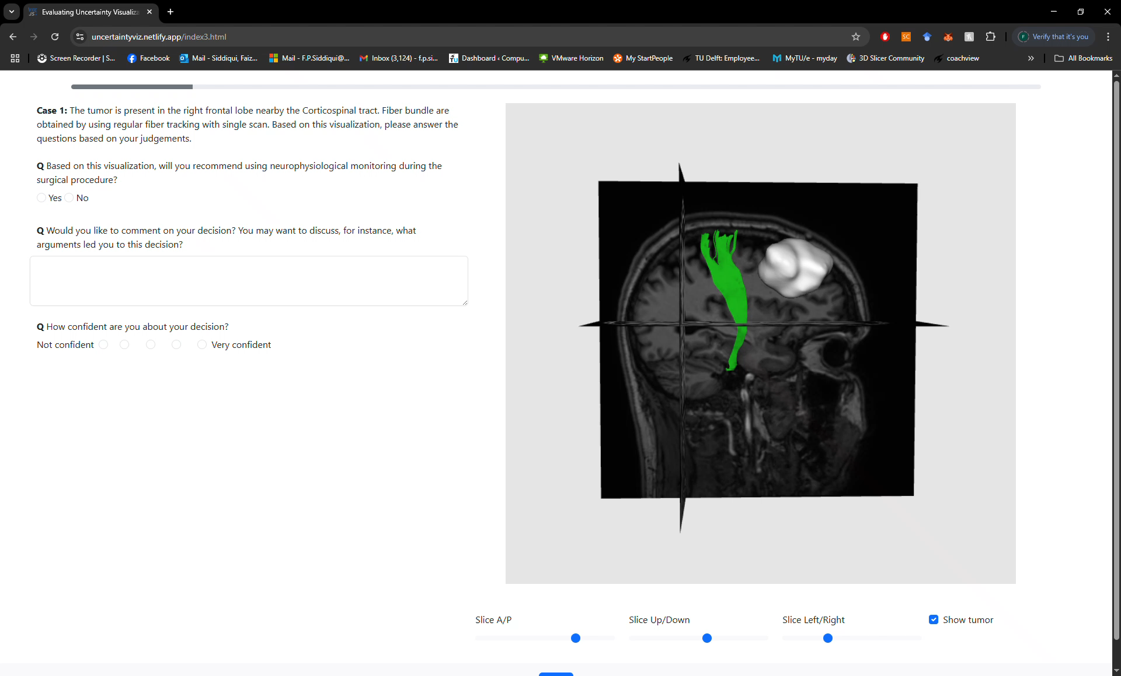
Web-based Questionnaire
15
https://uncertaintyviz.netlify.app

Slide 16
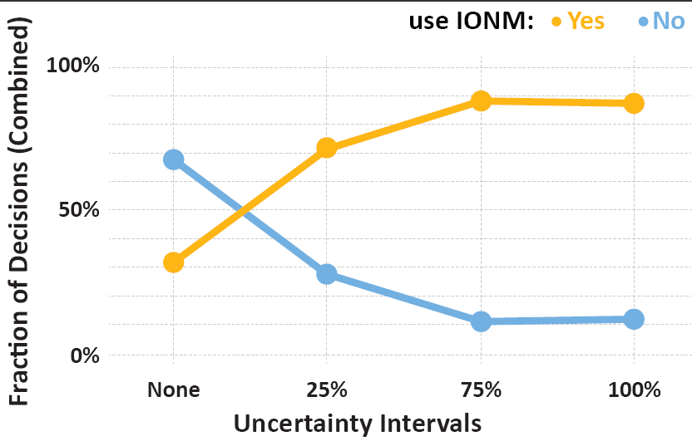
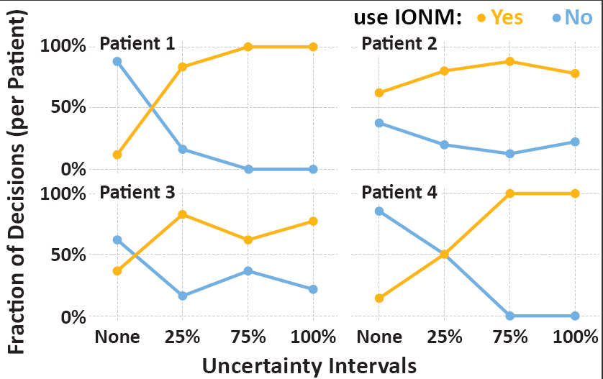
Results: Impact in decisions (H1 and H2)-Overview
Notes:
Overview of the trend of decisions taken by all participants (in percent) for the different uncertainty intervals.
The results indicate that uncertainty visualization impacts decision-making differently across different patients and participants.
Combined result of the decision taken (in percent) versus uncertainty intervals per patient.

Slide 17
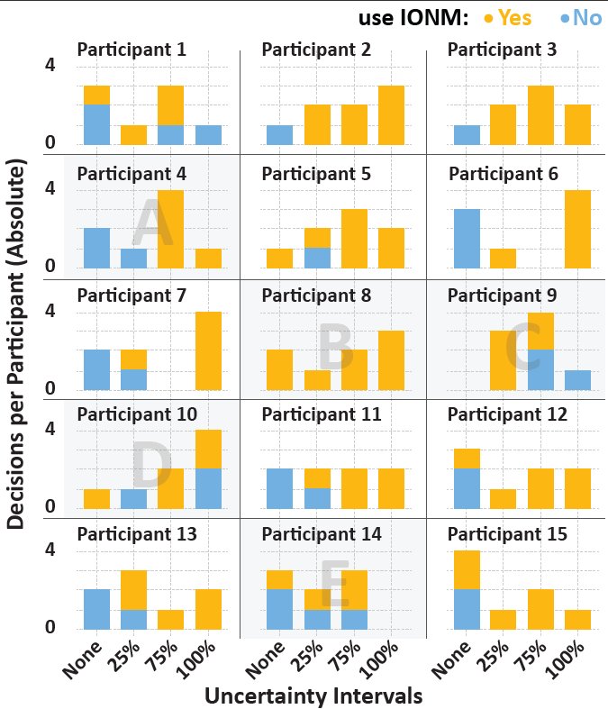
Results: Impact in decisions (H1 and H2) Individual Analysis
Notes:
The figure depicts the count of the responses per participant for each uncertainty interval accumulating over the four presented patients
This underscores the general trend of participants shifting their decisions from No to Yes in response to larger uncertainty intervals visualized, consistent with earlier observations.

Slide 18
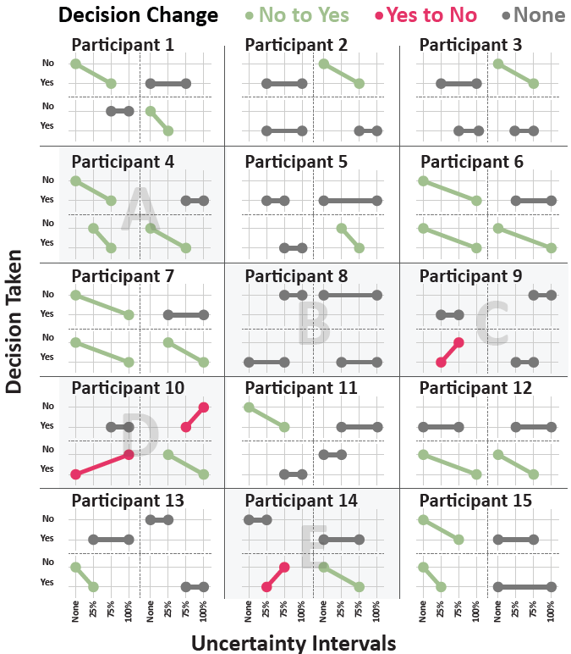
Results: Impact in decisions (H1 and H2) Individual Analysis
Notes:
The figure presents the change in participants’ decision with uncertainty intervals. Dots represent the individual decision per participants for different uncertainty intervals and per patient dataset. The plots are further subdivided into four quadrants for the four patients. The dots are connected to indicate the change in decision
The shows that most participants either did not change their decision or changed from No to Yes when larger uncertainty intervals were presented

Slide 19
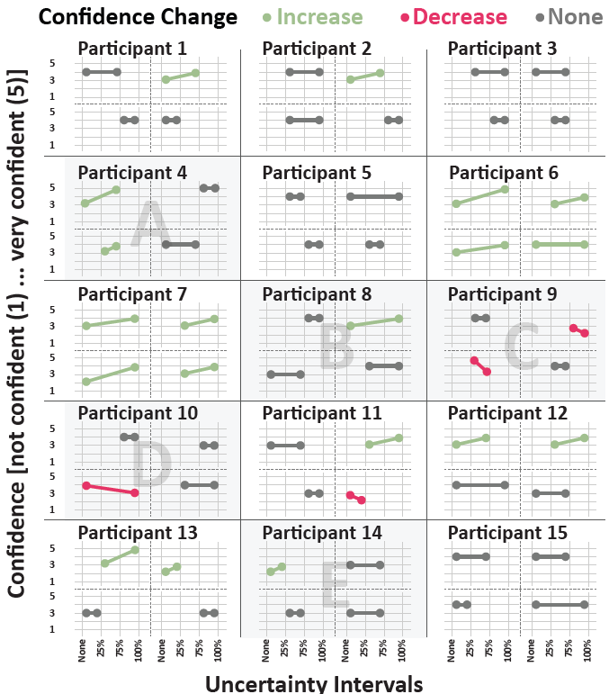
Results: Impact on confidence(H3)
Notes:
Overview of the participants’ confidence across different uncertainty intervals visualizations and cases. Each point represents one of the eight cases that each participant addressed. The answer to the decision of using IONM is shown in orange for Yes and blue for No.
The visualized uncertainty intervals mostly seem to not influence the level of confidence, while for a few participants, they slightly correlate with the level of confidence positively
Change in participants’ confidence with increasing uncertainty intervals. Dots represent the selected confidence per participant for different uncertainty intervals and per patient data-set. The plots are further subdivided into four quadrants for the four patients. The dots are connected to indicate the change in confidence
The chart reveals that the dominant trend is no change in confidence (38 cases), followed by increase in confidence (18 cases) and only four occurrences with a decrease in confidence

Slide 20
Conclusions
H1: Visualization of uncertainty will influence the participants’ decision.
H2: Participants will make a more cautious decision when a larger uncertainty interval is visualized.
H3: Confidence of the participants in decision-making will be affected by the uncertainty visualization..
Participants incorporate uncertainty into their decision-making process
Indications of a tendency to make more cautious choices under higher uncertainty
Confidence remained unchanged regardless of uncertainty.
Not conclusive results
Notes:
In a few cases, confidence increased with more uncertainty, but this was inconsistent. Overall, no clear correlation between uncertainty and confidence was found, making the results inconclusive

Slide 21
Discussion
Confirm other findings that uncertainty visualization influences decisions, often promoting more cautious choices.
Number of fibers shown also influence decisions, suggesting participants may respond to visual density rather than statistical reasoning.
No clear relationship found between uncertainty intervals and participants’ confidence.
Study limitations include small sample size, few open-ended responses, limited cases, and visualization specifics constraints.

Slide 22
Future work
Investigate how users interpret fiber density vs. uncertainty statistics.
Explore decision-making strategies and participants’ understanding of uncertainty.
Assess the role of different visualization techniques in shaping decisions.
Improve study design and feedback mechanisms to gain deeper insights.

Slide 23


Effect of white matter uncertainty visualization in neurosurgical decision making
Thank You for your attention!
Faizan Siddiqui, H. Bart Brouwers, Geert-Jan Rutten, Thomas Höllt, Anna Vilanova
This work is part of the research program “Diffusion MRI Tractography with Uncertainty Propagation for the Neurosurgical Workflow” with project number 16338, which is (partly) financed by the Netherlands Organization for Scientific Research (NWO).

Slide 24




We Are
Hiring
PhD on Multi-Faceted Visual Process Analytics
Are you eager to research and develop Visual Analytics techniques for Event Sequence exploration and analysis? Are you curious how to combine and explore the synergy between Visualization and Process Mining? In this project we aim to transform the way we analyze and visualize complex processes.
OR ASK:
Stef van den Elzen
s.j.v.d.elzen@tue.nl
Fernando Paulovich
f.paulovich@tue.nl
https://www.tue.nl/en/working-at-tue/vacancy-overview/phd-on-multi-faceted-visual-process-analytics

Slide 26

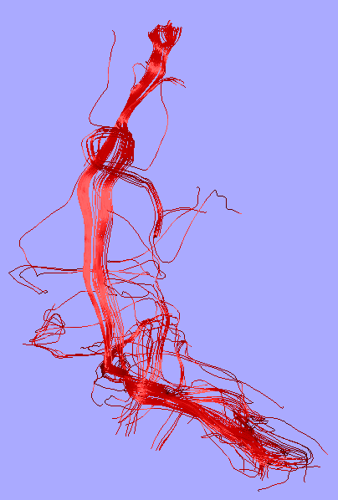

Uncertainty Effect
Distance Margin
Single White Matter fiber
Variations due to
Uncertainty

Slide 27
Uncertainty Visualization
Variations due to
Uncertainty

Slide 28
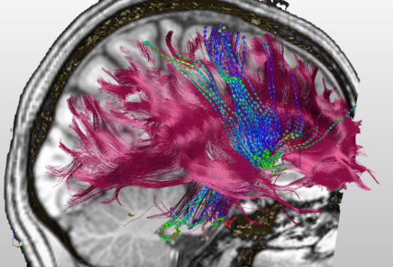
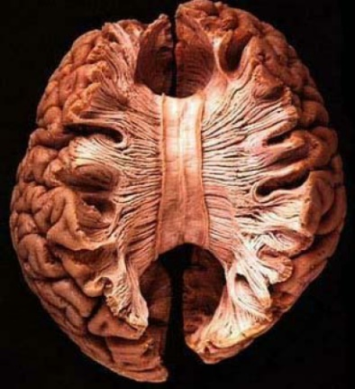
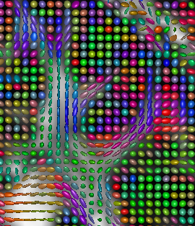
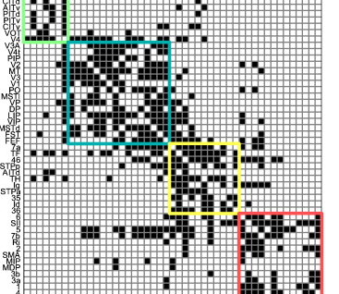

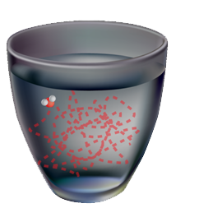
Magnetic Resonance Diffusion Weighted Imaging (MR-DWI)
d
Diffusion per Direction
White Matter Reconstruction
T.H. Williams et al.
Anatomical Fibrous
Structures
Connectivity Matrix
Brownian Motion
Second-Order Tensor Field
Notes:
MRI is able to measure diffusion of water. This is a measurement that based on knowledge of diffusion properties can help to reconstruct the white matter structure. However the measurement are not directly useful. We need to compute other derived features based on models of the relation of the diffusion, signal and fibers or connectivity measures. which remains a simplification of reality.
Brain [ http://www.vh.org/adult/provider/anatomy/BrainAnatomy/BrainAnatomy.html
https://www.sciencedirect.com/science/article/abs/pii/S105381190901074X
Since the 3000-4000 BC that we are measuring
Measuring is needed to obtain objective results trading and others
We wanted to model nature and their behaviour
The creation of mathematical models began in the late 19th century
A mathematical model is a description of a system using mathematical concepts and language.
A model may help to explain a system and to study the effects of different components, and to make predictions about behavior
Nature, social behavior, social sciences, …
Models are simplifications of reality
Models to understand or to predict behavior of reality
Success stories
Mental models
Reality is complex and often it is difficult to model
Most methods optimize some specific measurements computers deal with things that can be measured but often what to measure and whether it can be measured at all is complex to define.
Then what can be an issue is that you focus on what you measure and not in what is the essence of what you want to measure and you can get unexpected results.

Slide 29
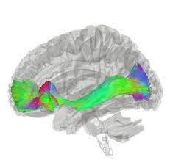
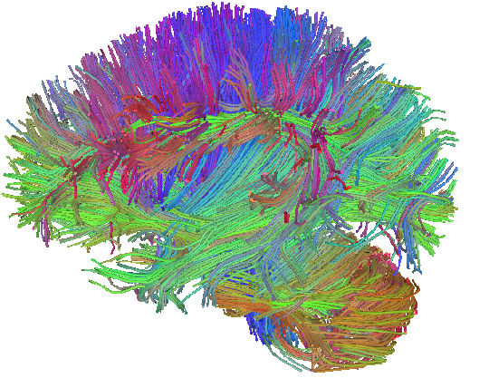
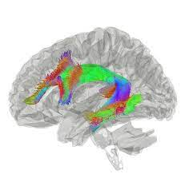
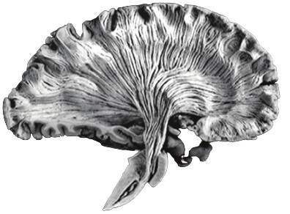
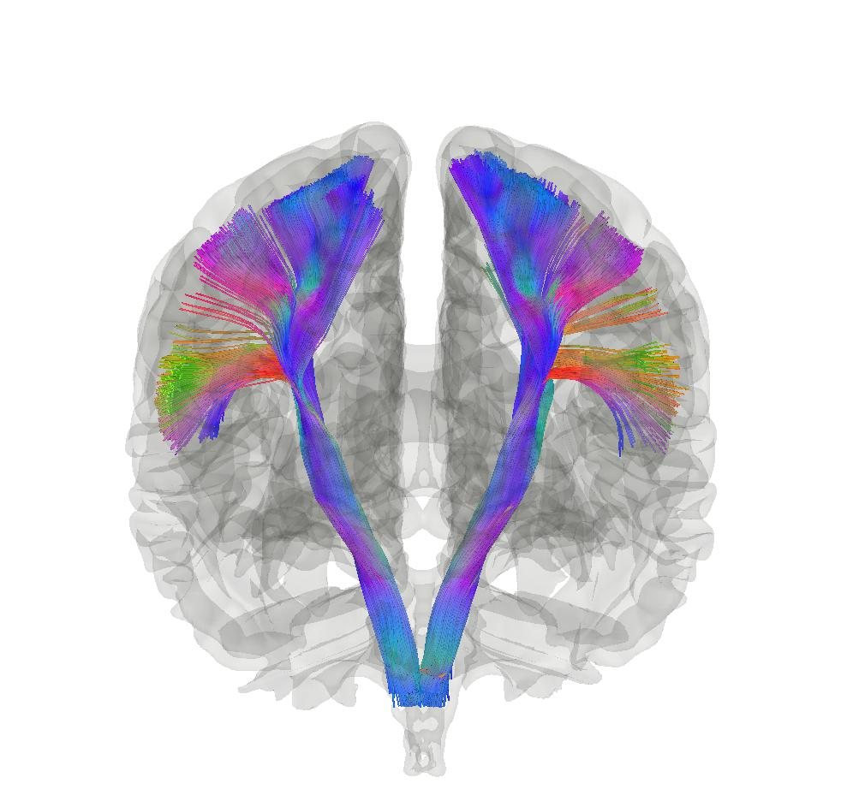
What is White Matter?
Gray matter
White matter
Inferior Fronto-Occipital Fasciculus (IFOF)
Arcuate Fasciculus (AF)
Virtual reconstruction of the brain’s white matter generated by using Fiber Tracking
Brain dissection
Corticospinal Tract (CST)

Slide 31
Effect of White Matter Uncertainty Visualization in Neurosurgical Decision Making
Faizan Siddiqui^{1,2}, H. Bart Brouwers³, Geert-Jan Rutten³, Thomas Höllt¹, Anna Vilanova²
¹Delft University of Technology, The Netherlands
²Eindhoven University of Technology, The Netherlands
³Elisabeth-Twee Steden Hospital, The Netherlands

