Slide 1
Sheared Polygonal Texture Filtering
Peter Lu, Jerry Guo, Petr Kellnhofer, Elmar Eisemann
Delft University of Technology
Notes:
Thank you for joining our presentation on Sheared Polygonal Texture Filtering.
My name is Peter. This work is a collaboration with: Jerry Guo, Petr Kellnhofer, and Elmar Eisemann.

Slide 2
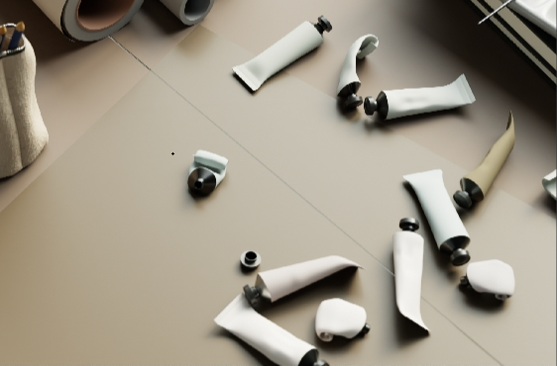
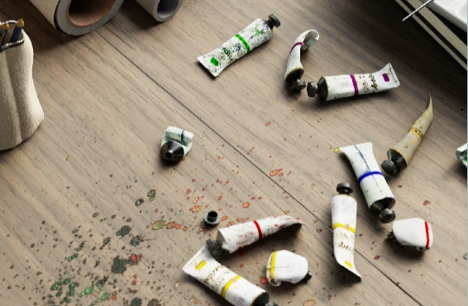
Texture
W/wo textures
“Physically Based Rendering: From Theory to Implementation”,
M. Pharr, W. Jakob, and G. Humphreys
Notes:
Texture plays a crucial role in achieving high-quality rendering. Here is a side-by-side comparison with and without texture. We can see, image texture clearly enhances the visual detail and realism.

Slide 3
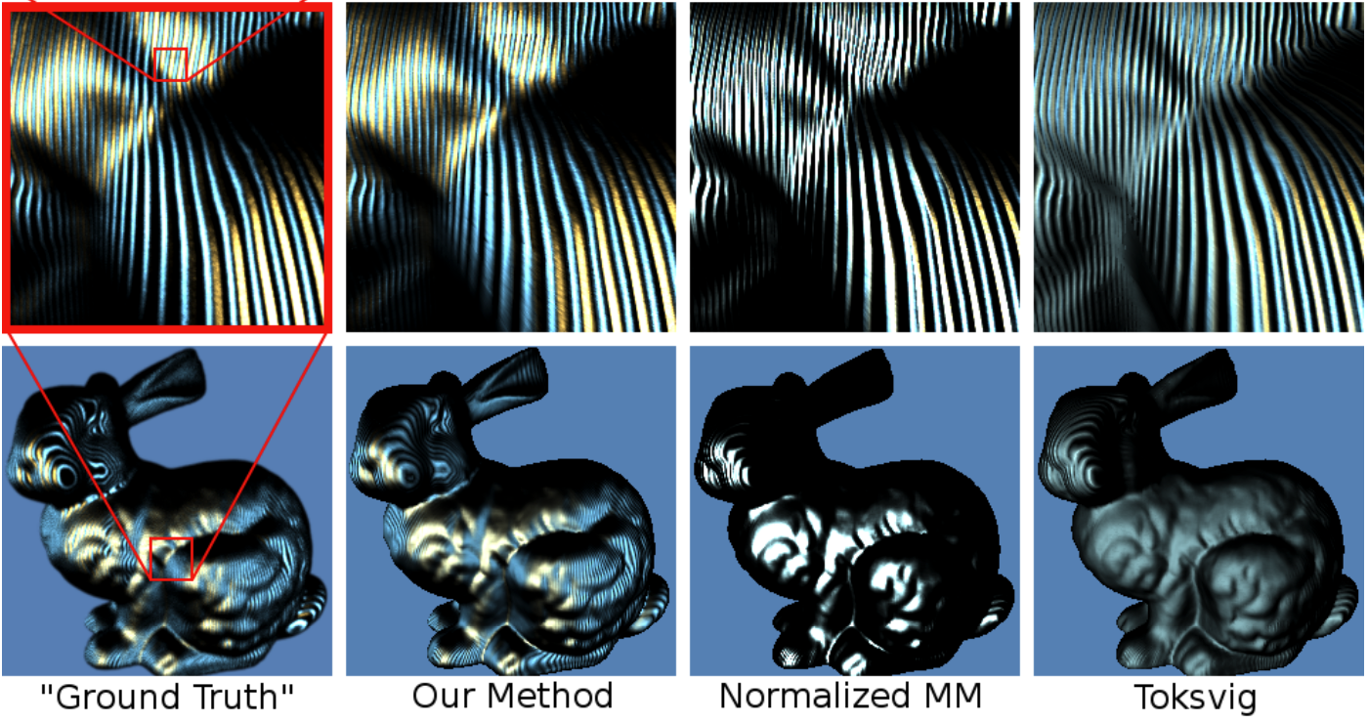
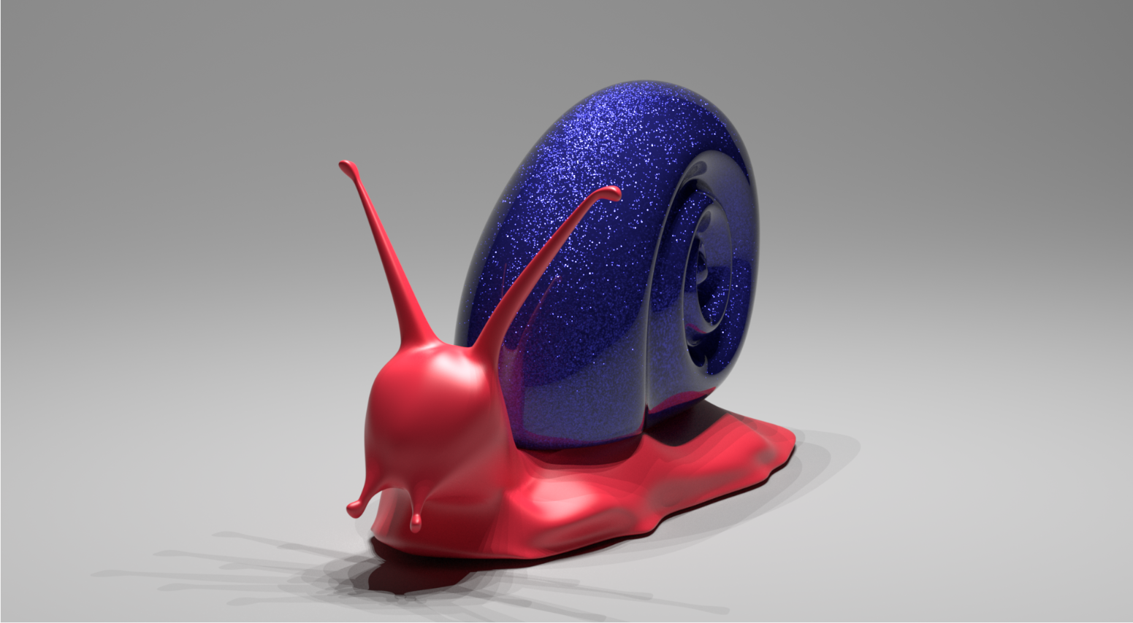
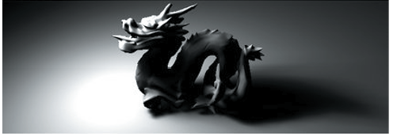
Texture
Normal Mapping
[Han et al. 2007]
glints rendering
[Yan et al. 2014]
Occlusion textures
[Eisemann et al. 2008]
Notes:
In addition to image texture, there are lots of applications related to texture, including
#Normal Mapping Filtering
#soft shadows based on occlusion texture
#glints rendering
So, the texture quality and performance is important to computer graphics

Slide 4

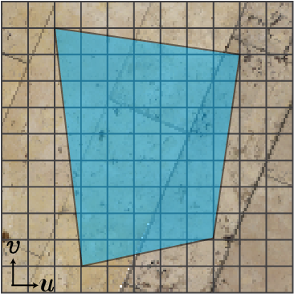
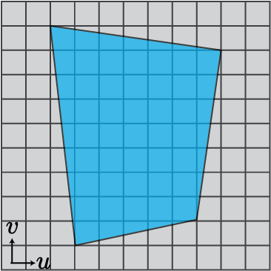
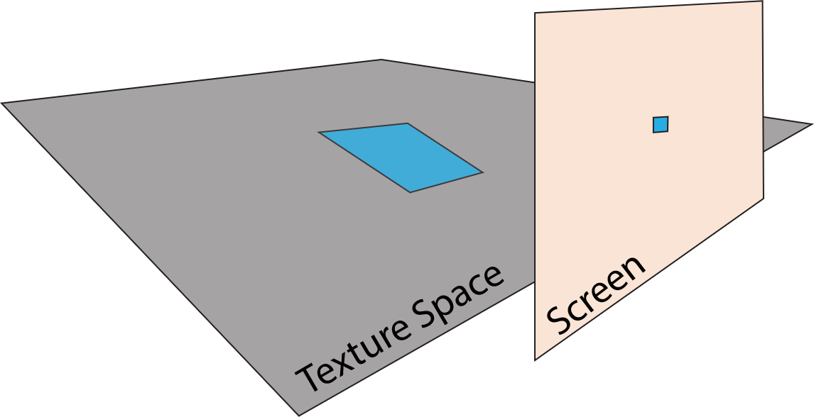
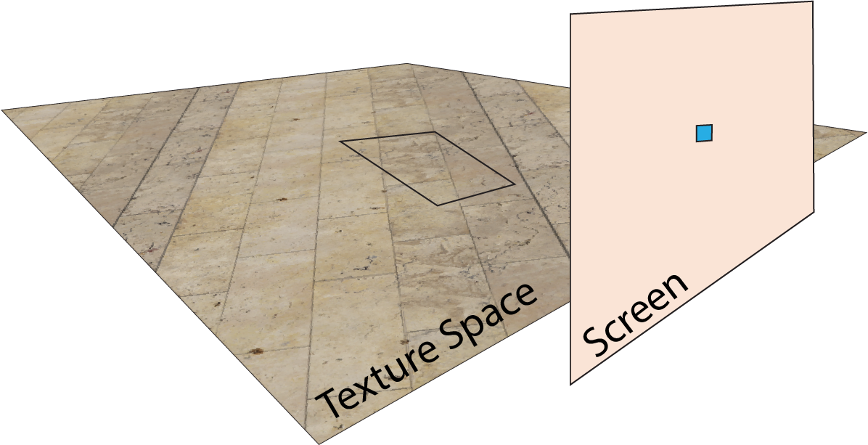


Texture Filtering
Footprint
Texel
(1) Texture mapping
Pixel
(2) Texture filtering
Notes:
And Texture filtering is a method used to improve these.
# Here, we have a perspective camera and we want to determine the value of a square pixel in screen space.
# Texture mapping helps us measure the pixel footprint in texture space, which we represent as a blue region. Typically, a pixel footprint contains many texels.
# here is the floor texture,
#To calculate the pixel value, we need to find the average value of all texels within this footprint., This process is known as texture filtering.
# Once we have the average value, we can update the pixel on the screen.

Slide 5
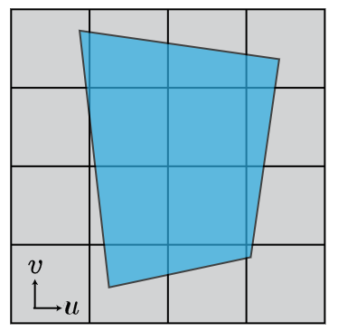
Texture Filtering
Notes:
To calculate the average value efficiently and accurately, we need to solve this integral
# by visiting all the texels inside the quadrilateral domain.

Slide 6
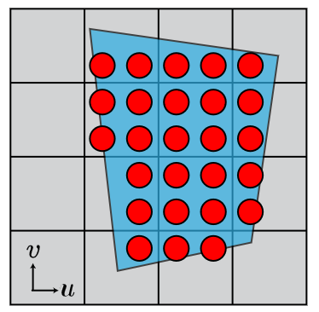
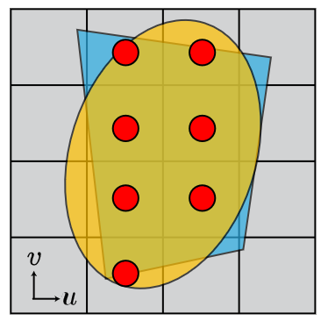
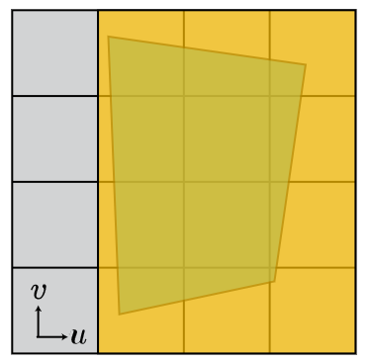
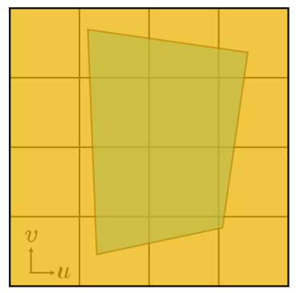
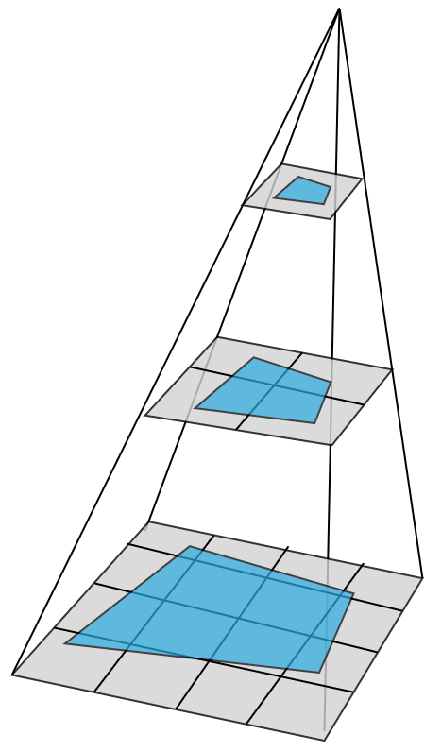
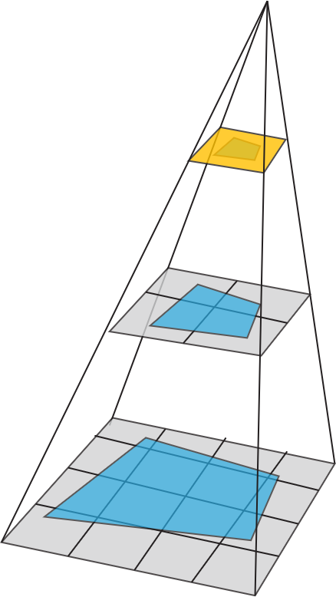
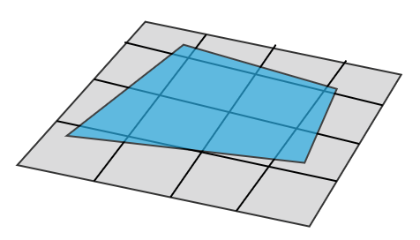


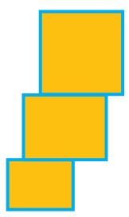
Texture Filtering
Super Sample
EWA
Anisotropic Filtering
Mipmap
Point Query
Line Query?
Range Query
Very slow
Very fast (prefilter)
High quality
Low quality
Notes:
One brute force approach is super sampling
# which is a point query method.
# alternatively, mipmapping allows a range query to get a square approximation based on the image pyramid idea. ,
# this method is fast but could be over blurred because it assumes a square footprint..
# In this direction, as an anisotropic filtering method, SAT supports a rectangle
# while EWA assumes an elliptical footprint for point queries.
# Comparing these methods, Point query provides an accurate footprint for high quality.
# and Range query is fast due to prefiltering.
the challenge is how to reach the balance between quality and performance.
# This leads to the question:
#Can a line query achieve both? This is our initial motivation.

Slide 7
SPTF
Sheared Polygonal Texture Filtering
Notes:
With our approach, called sheared polygonal texture filtering, we seek to combine the strengths of both methods: achieving high accuracy at a low computational cost.

Slide 8
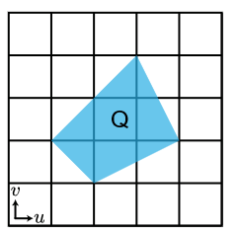
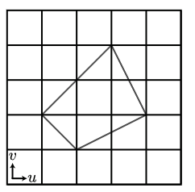
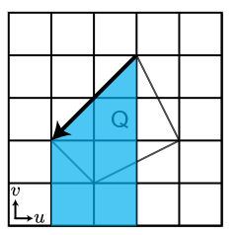
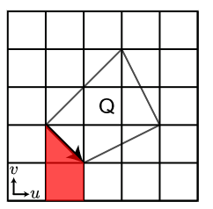
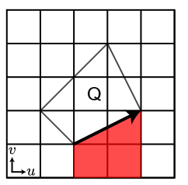
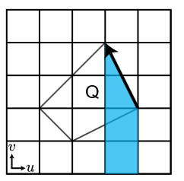
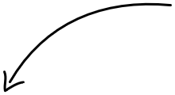
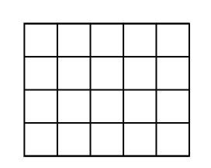




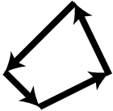

SPTF
O(n^4)
Area integral
Line integrals
Sheared Polygonal Texture Filtering
High quality
With 4-line queries
How to prefilter
an arbitrary line segment?
Notes:
A square pixel footprint in texture space forms an arbitrary quadrilateral shape.,
# We focus on its closed boundary
# By walking along the edges,
# and measuring the area below each edge
# we can sum these four areas to determine the total area of the quadrilateral.
# If we can prefilter this yellow quadrilateral under an arbitrary line segment,
# we only need to visit the 4 edges in rendering to solve this integral.
# However, dealing with arbitrary line segments remains challenging due to their complexity
# We have our line query method, but prefilter is still unsolved.

Slide 9
SSAT
O(n^4) +O(1)
O(n^2) +O(4)
Summed Area Table (SAT)
Notes:
"Let's first consider a special case with a horizontal line segment,
#The complexity is n to the fourth power, requiring one query.
#Using the summed area table, the space complexity is quadratic with 4 queries..

Slide 10
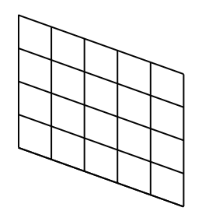

SSAT
O(n^4) +O(1)
O(k*n^2) +O(2)
O(n^4) +O(1)
O(n^2) +O(4)
$$T_{λ}$$
Summed Area Table (SAT)
Sheared SAT
Notes:
#Now, for the general case with an arbitrary line segment:
# We apply a shear transformation
# resulting in two empty and black triangles outside the boundary.
# This transforms the quadrilateral into a rectangle, simplifying our calculations.
# We call this new approach the Sheared Summed Area Table (SSAT). With SSAT, we need 2 queries, and the space complexity is n squared multiplied by k, where k is the number of slopes (λ)

Slide 11

SSAT
O(n^4) +O(1)
O(k*n^2) +O(2)
O(n^4) +O(1)
O(n^2) +O(4)
$$T_{λ}$$
Summed Area Table (SAT)
Sheared SAT
Step size k:
uniform sample the slope $λ$
Notes:
To address the numerical issue, we use a step size k to uniformly sample the slope λ. Our results show that usually, k is not large, 8 is sufficient usually.
The last thing about SSAT I want to talk about is while it seems that we need a larger texture to store the sheared version, it is actually possible to rearrange the pixels to fit them such as to avoid additional memory cost, as the part that exceeds the top is equivalent in size to the unused part at the bottom. The details are in the paper.

Slide 12
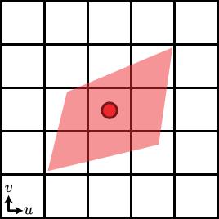
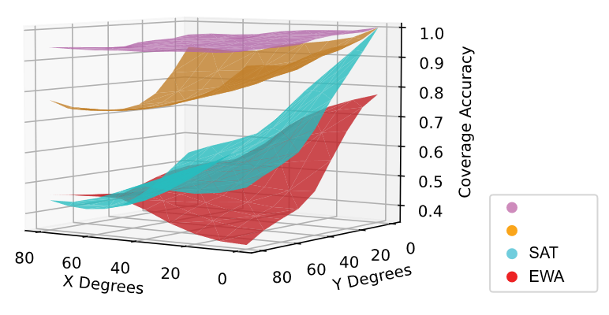
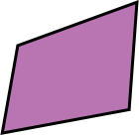
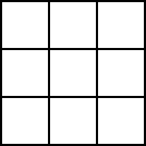

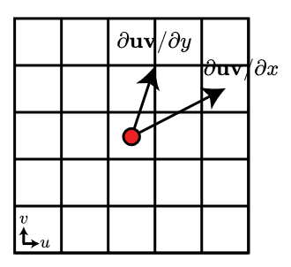
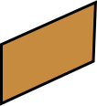




Texture mapping
$$SPTF_{Q}$$
$$SPTF_{Q}$$
$$SPTF_{S}$$
Screen
$$SPTF_{S}$$
Notes:
Our method cannot integrate completely arbitrary polygons so we need to construct a polygon that best approximates arbitrary pixel footprint but that can be integrated by our method
We present two different approximations
#Given 4 blue corners of this pixel
#we search for the nearest slopes and get this new quadrilateral.
This is a nearest quadrilateral SPTF_Q, which has a high quality
#Another method utilizes the two neighbor pixels
#to find Principal axis, which is the same to the EWA filter.
#We then perform Cholesky decomposition to obtain the semi-axis aligned parallelogram. Because the slopes are the same， this approach require only 4 unique SSAT samples similar to SATs for a rectangular area, which is high performance
# We analyze the accuracy of these four footprint approximation methods using the intersection over union metric. The quadrilateral approximation closely matches the ground truth, while the semi-parallel approximation is less effective in anisotropic situations but still provides acceptable results. However, the SAT method performs worse as the anisotropic angle increases. The reason for the poor performance of EWA is its assumption of circular pixels, which contrasts with the square pixels used in our scenario."

Slide 13
Results & Applications
Notes:
Now, we can see the results and applications.

Slide 14
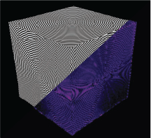
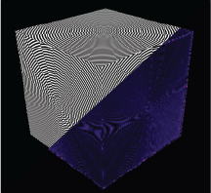
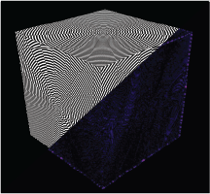
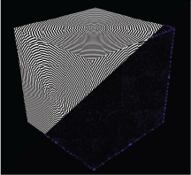
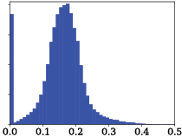
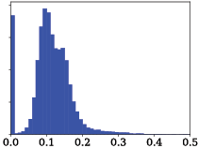
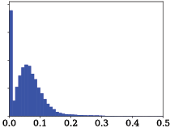
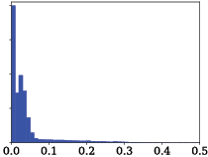

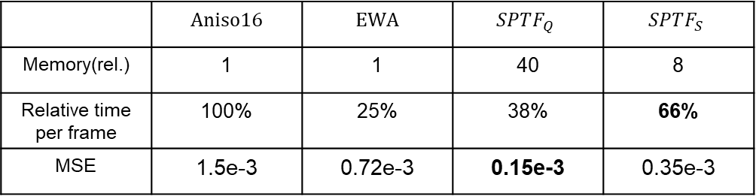

Checkerboard
Aniso16
EWA
$$SPTF_{S}$$
$$SPTF_{Q}$$
Error map(FLIP)
 | Aniso16 | EWA | $$SPTF_{Q}$$ | $$SPTF_{S}$$
Memory(rel.) | 1 | 1 | 40 | 8
Relative time per frame | 100% | 25% | 38% | 66%
MSE | 1.5e-3 | 0.72e-3 | 0.15e-3 | 0.35e-3
Table: Checkerboard Analysis
Notes:
We compared our method with Aniso16 and EWA using checkerboard analysis. We obtained reference images via the PBRT ray tracer.
The checkerboard analysis and FLIP error maps demonstrate that both variants of our method produce significantly lower errors in this texture minification task.
#Additionally, histograms of the full FLIP maps show that the errors in our methods are smaller. The table provides more details
#The MSE for the Semi Parallelogram method is significantly smaller while maintaining two-thirds of the relative time per frame compared to Aniso16. and it requires 8 ssat tables.

Slide 15
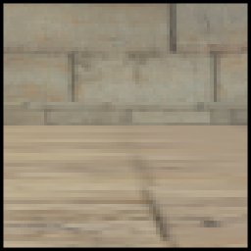
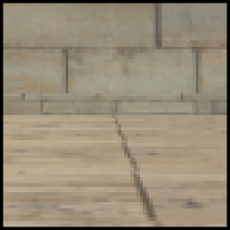
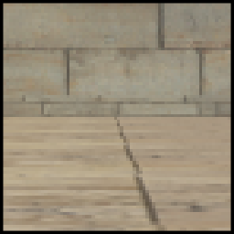

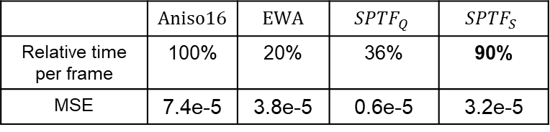

Anisotropic Filter
Aniso16
$$EWA$$
$$SPTF_{S}$$
Grazing View
 | Aniso16 | EWA | $$SPTF_{Q}$$ | $$SPTF_{S}$$
Relative time per frame | 100% | 20% | 36% | 90%
MSE | 7.4e-5 | 3.8e-5 | 0.6e-5 | 3.2e-5
Table: Sponza
Notes:
We tested the anisotropic ability at grazing angles in the Sponza scene. Our method enhances floor sharpness and detail at these angles, unlike the overly blurred result with hardware Aniso16, while maintaining good performance.

Slide 16
Sponza
Notes:
Here is a video demonstrating the temporal stability of our method. When zooming in or out and rotating the camera, the filtering result remains stable.

Slide 17
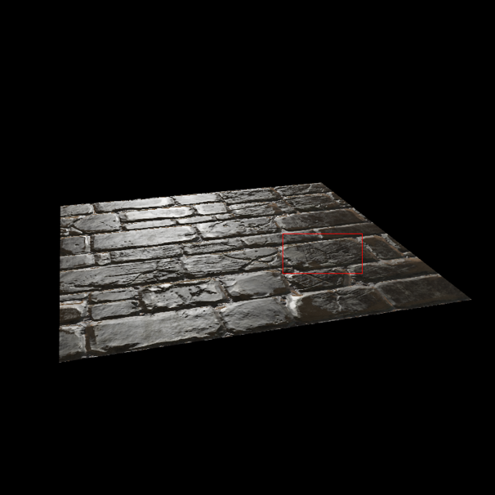
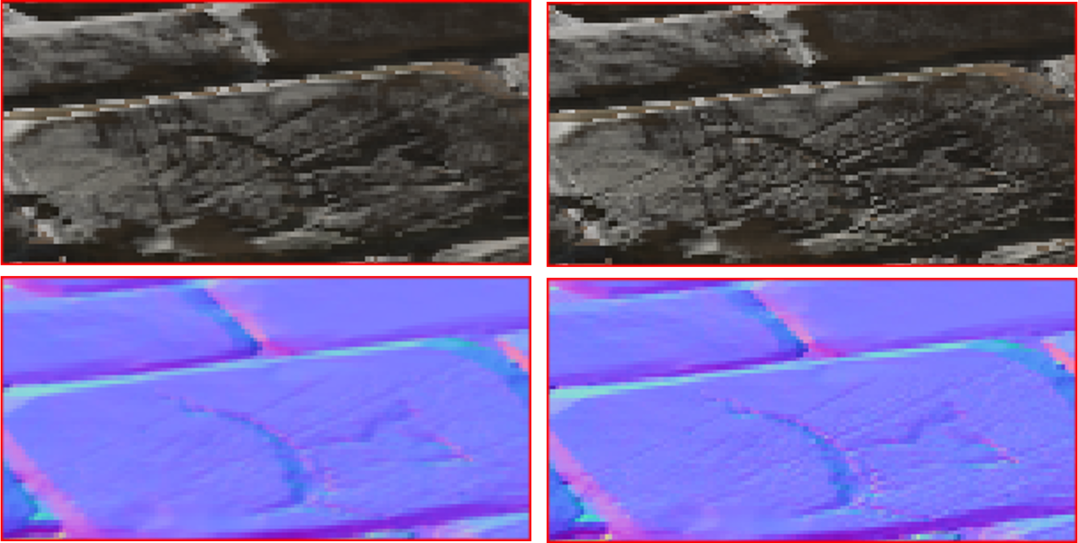
Applications---Normal Mapping
Aniso16+Toksvig
Ours+Toksvig
Notes:
In normal mapping, we can notice the cracks in the bricks, our method preserves more details compared to Aniso16.

Slide 18
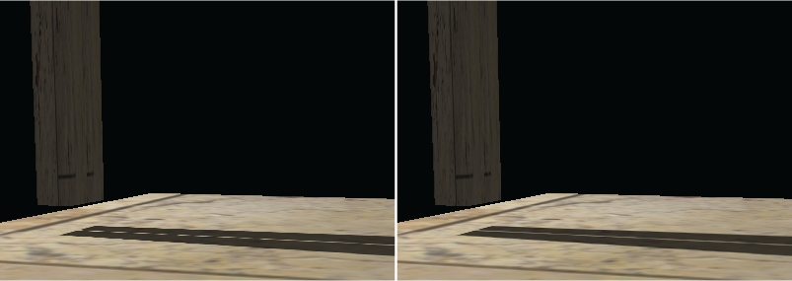

Applications---Soft shadows
[Eisemann et al. 2008]
Aniso16
Ours
Notes:
The next one is soft shadows.
In occlusion textures, when at grazing views, the projected footprint becomes larger. Ignoring this can lead to aliasing. To address this, we convolve the shadow filter kernel with the projected pixel footprint, resulting in smoother and higher quality soft shadows at grazing angles."

Slide 19


Applications---Soft shadows
[Eisemann et al. 2008]
Aniso16
Ours
Notes:
In occlusion textures, when at grazing views, the projected footprint becomes larger. Ignoring this can lead to aliasing. To address this, we convolve the shadow filter kernel with the projected pixel footprint, resulting in smoother and higher quality soft shadows at grazing angles."

Slide 20

Real-time Glints Rendering
Notes:
We use a texture to represent per-texel particle counts and mean normals to obtain specular contributions for the glint effect

Slide 21


Conclusion
Point Query
Line Query
Range Query
SPTF
a fast anisotropic filtering
With two variants
Project Page
Memory $O(kn^{2})$
Notes:
In conclusion, we find a line query method between point query and range query, called SPTF, which supports polygonal texture filtering at a low computational cost. Our result and applications illustrates its versatility.
One limitation is the space complexity, which could be our future work.

Slide 22




Questions?
Author
Photo
Peter Lu
Jerry Guo
Petr Kellnhofer
Elmar Eisemann
Scan me
Notes:
Thank you for your listening.

