Slide 1
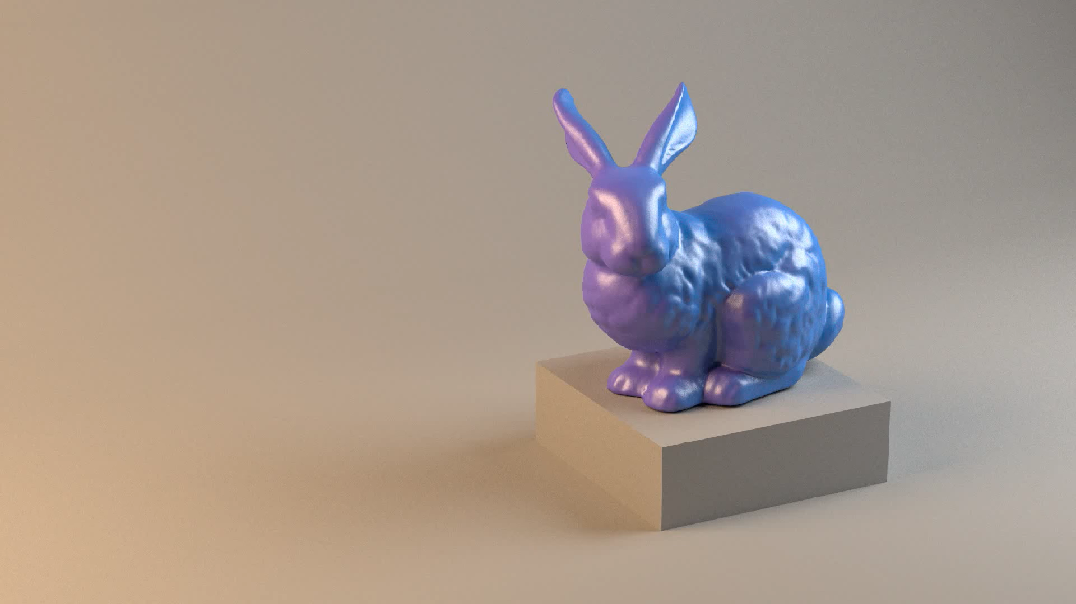



Controlled Spectral Uplifting for Indirect-Light-Metamerism
Mark van de Ruit and Elmar Eisemann
Delft University of Technology

Slide 2
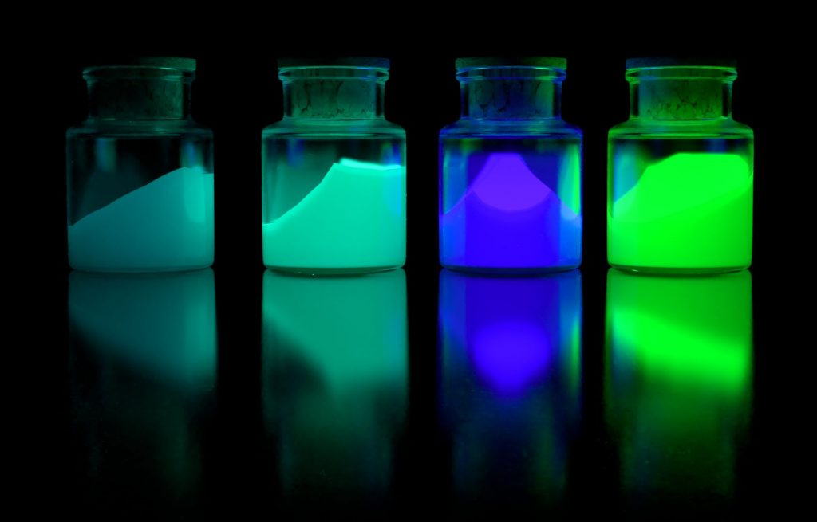
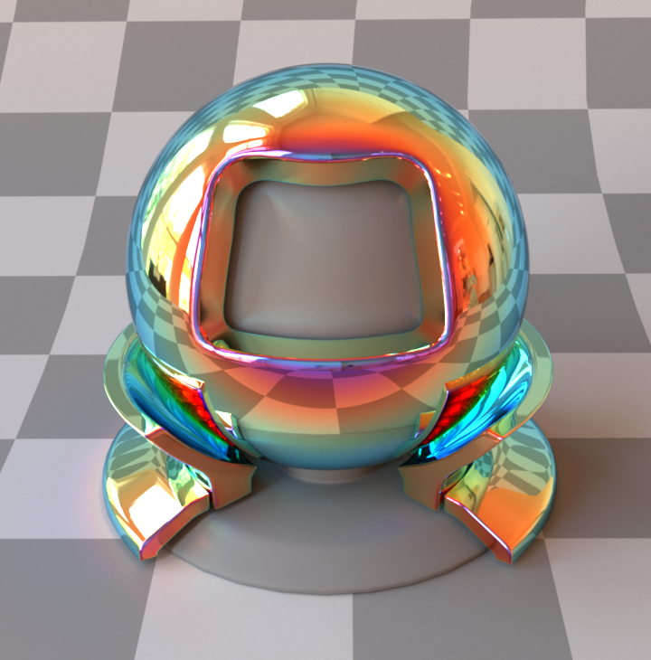
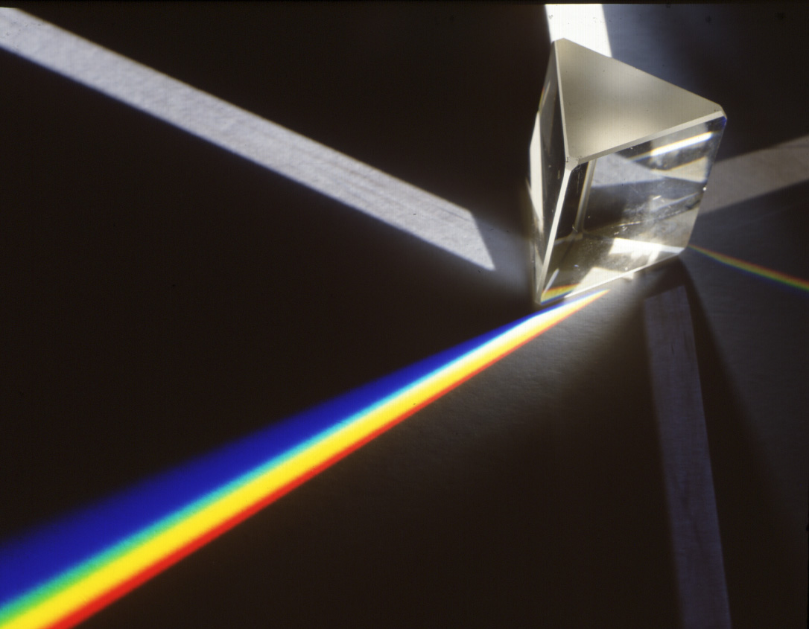

Slide 3

Color system
λ
λ
observer
illuminant
$$Φ\left(r\right)=\int_{Λ}{e_{Φ}\left(λ\right) r\left(λ\right) i_{Φ}\left(λ\right) dλ}$$
color
reflectances
λ

Slide 4
Color system
λ
λ
observer
illuminant
$$Φ\left(r\right)=\int_{Λ}{e_{Φ}\left(λ\right) r\left(λ\right) i_{Φ}\left(λ\right) dλ}$$
color
reflectance
spectral uplifting
very very
underconstrained

Slide 6
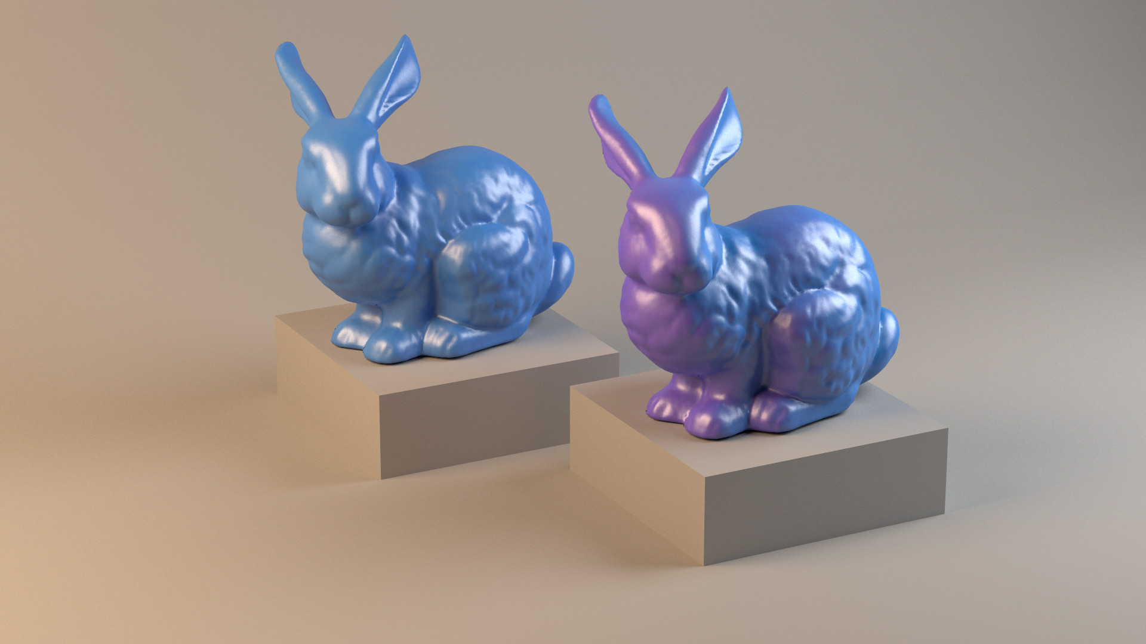

Slide 7
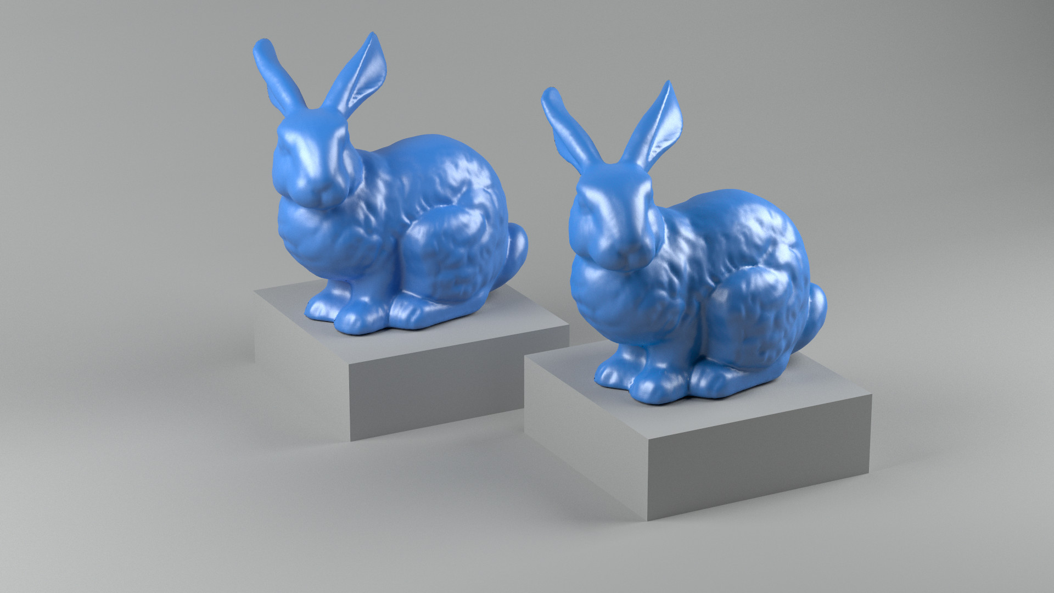
r(λ)
r(λ)

Slide 8


Slide 9


Slide 10





Slide 11
Controllable spectral uplifting
supporting many constraints

Slide 12
Controllable spectral uplifting
supporting many constraints
Controllable spectral behavior
under indirect light

Slide 13
Controllable uplifting
color system
boundary
λ
λ
λ
λ
λ
λ
Mackiewicz et al., 2018. Spherical Sampling Methods for the Calculation of Metamer Mismatch Volumes.

Slide 14
Controllable uplifting
color system
boundary
λ
λ
tessellation
RGB input
λ
λ
λ
λ

Slide 15
spectral output
λ
λ
barycentric
interpolation
RGB input
λ
actually a tetrahedron
λ

Slide 16
spectral output
λ
boundary
RGB input

Slide 17
spectral output
λ
boundary
constraint
RGB input
λ
spectral input

Slide 18
spectral output
λ
boundary
λ
spectral input

Slide 19

Controllable uplifting
Artist inputs
spectral output
Measured spectra
Direct color system
Indirect color system
λ
boundary
λ
spectral input
Controlled Spectral Uplifting for Indirect-Light-Metamerism
19

Slide 20


Slide 21
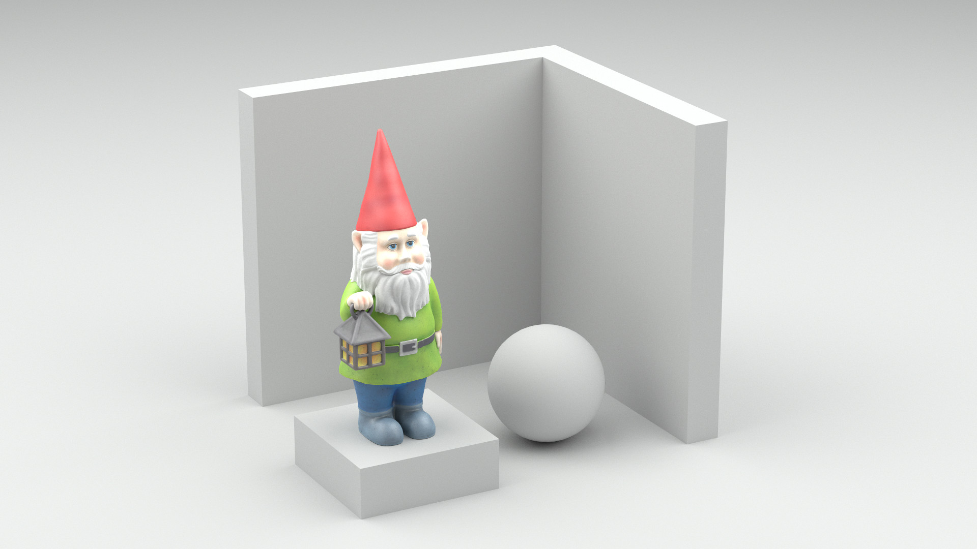

Slide 22
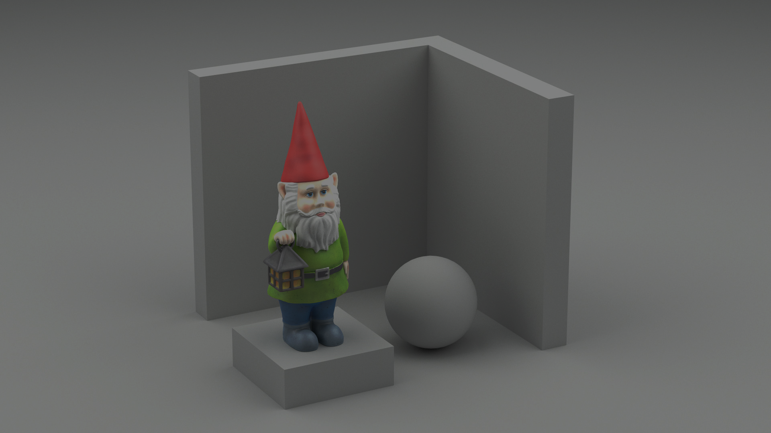

artist constraint
$$r$$
λ
λ

Slide 23



Reflectance recovery
λ
first
bounce
$$r$$
$$r$$
λ
λ
third
bounce
$$r$$
λ

Slide 24





Reflectance recovery
λ
constraint
reflectance
other
reflectances
$$w$$
$$r′$$
$$r^{′}=a r+w$$
$$a$$
$$r$$
barycentric
λ

Slide 25







Path expression
$$r_{1}$$
$$r$$
$$r_{2}$$
$$r$$
$$r_{3}$$
$$f\left(\overline{x}\right)$$
$$r$$

Slide 26








Path expression
path
throughput
uplifted
reflectances
$$r_{1}$$
$$r$$
$$f\left(\overline{x}\right)=f_{o}\left(\overline{x}\right)\prod_{b=1}^{n−1}{r_{b}}$$
$$r_{2}$$
$$r$$
$$r_{3}$$
$$f\left(\overline{x}\right)$$
$$r$$

Slide 27


Path expression
$$f\left(\overline{x}\right)=f_{o}\left(\overline{x}\right)\prod_{b=1}^{n−1}{r_{b}}$$
$$r_{1}$$
$$r$$
$$=f_{o}\left(\overline{x}\right)\prod_{b=1}^{n−1}{\left(a_{b}r+w_{b}\right)}$$
$$r_{2}$$
$$r$$
$$r_{3}$$
$$f\left(\overline{x}\right)$$
$$r$$

Slide 28



Path expression
$$=f_{o}\left(\overline{x}\right)\prod_{b=1}^{n−1}{\left(a_{b}r+w_{b}\right)}$$
$$r_{1}$$
$$r$$
$$=f_{o}\left(\overline{x}\right)\left( r^{n−1}(a_{1}a_{2}…a_{n})\right.$$
$$r$$
$$+ r^{n−2}\left(w_{1}a_{2}…a_{n}\right)$$
$$r_{2}$$
$$+ r^{n−2}\left(a_{1}w_{2}…a_{n}\right)$$
$$+ r^{n−3}\left(w_{1}w_{2}…a_{n}\right)$$
$$⋯$$
$$r_{3}$$
$$\left.+ r^{0} \left(w_{1}w_{2}…w_{n}\right)\right)$$
$$f\left(\overline{x}\right)$$
$$r$$

Slide 29



Path expression
$$=f_{o}\left(\overline{x}\right)\left( r^{n−1}(a_{1}a_{2}…a_{n})\right.$$
$$+ r^{n−2}\left(w_{1}a_{2}…a_{n}\right)$$
$$+ r^{n−2}\left(a_{1}w_{2}…a_{n}\right)$$
$$+ r^{n−3}\left(w_{1}w_{2}…a_{n}\right)$$
$$r_{1}$$
$$⋯$$
$$r$$
$$\left.+ r^{0} \left(w_{1}w_{2}…w_{n}\right)\right)$$
$$r_{2}$$
$$r$$
$$f(x)=f_{o}\left(\overline{x}\right)\sum_{b=0}^{n−1}{{t_{b} r}^{b} }$$
$$r_{3}$$
$$f\left(\overline{x}\right)$$
$$r$$

Slide 30
Path expression
$$=f_{o}\left(\overline{x}\right)\left( r^{n−1}(a_{1}a_{2}…a_{n})\right.$$
$$+ r^{n−2}\left(w_{1}a_{2}…a_{n}\right)$$
$$+ r^{n−2}\left(a_{1}w_{2}…a_{n}\right)$$
$$+ r^{n−3}\left(w_{1}w_{2}…a_{n}\right)$$
$$r_{1}$$
$$⋯$$
$$r$$
$$\left.+ r^{0} \left(w_{1}w_{2}…w_{n}\right)\right)$$
$$r_{2}$$
$$r$$
$$f(x)=f_{o}\left(\overline{x}\right)\sum_{b=0}^{n−1}{{t_{b} r}^{b} }$$
$$r_{3}$$
$$f\left(\overline{x}\right)$$
$$r$$

Slide 31


Path measure
artist constraint
spectral
coefficient
constraint
reflectance
$$r$$
$$f(x)=f_{o}\left(\overline{x}\right)\sum_{b=0}^{n−1}{{t_{b} r}^{b} }$$
path bounces

Slide 32



Path measure
$$∑$$
monte carlo
estimate
constraint
reflectance
$$r$$
$$I_{r}≈\sum_{b=0}^{n−1}{c_{b} r^{b}}$$
incident
radiance
$$c_{b}=\frac{1}{N}\sum_{i}^{N}{\frac{f_{o}\left({\overline{x}}_{i}\right) t_{b}({\overline{x}}_{i})}{p({\overline{x}}_{i})}}$$

Slide 33

Indirect color system
observer
$$Φ(r)=\int_{Λ}{e_{Φ}\left(λ\right) I_{r}\left(λ\right) dλ}$$
incident
radiance

Slide 34
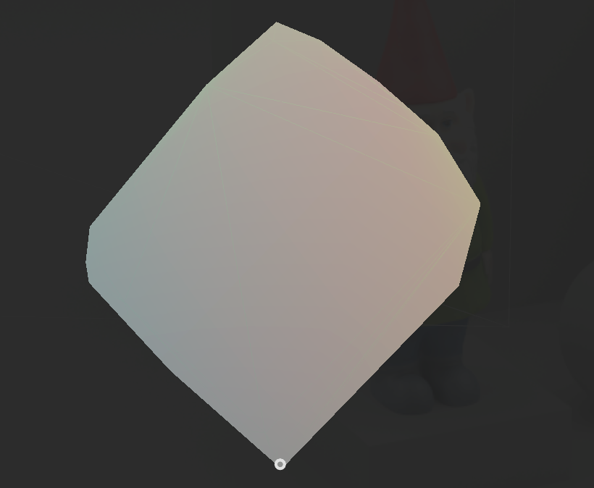

Indirect color system
mismatch boundary
metamer
$$Φ(r)=\int_{Λ}{e_{Φ}\left(λ\right) I_{r}\left(λ\right) dλ}$$
λ
Van de Ruit and Eisemann, 2023. Metameric: Spectral Uplifting via Controllable Color Constraints.
Mackiewicz et al., 2018. Spherical Sampling Methods for the Calculation of Metamer Mismatch Volumes.

Slide 35
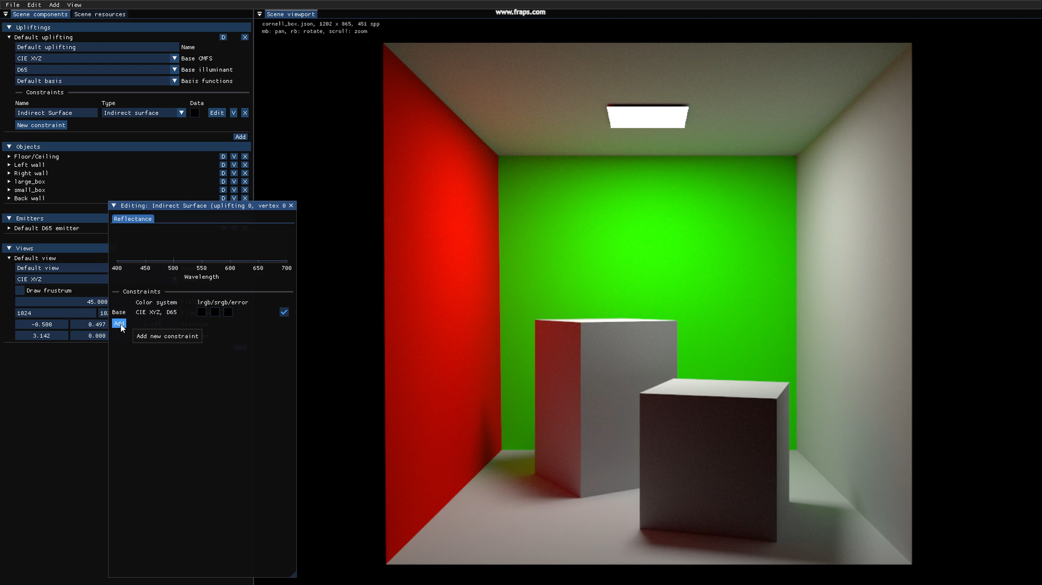

Slide 36
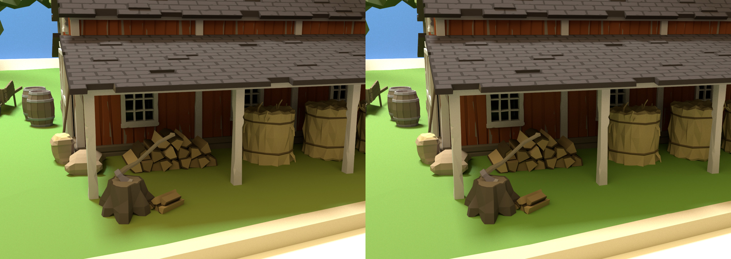
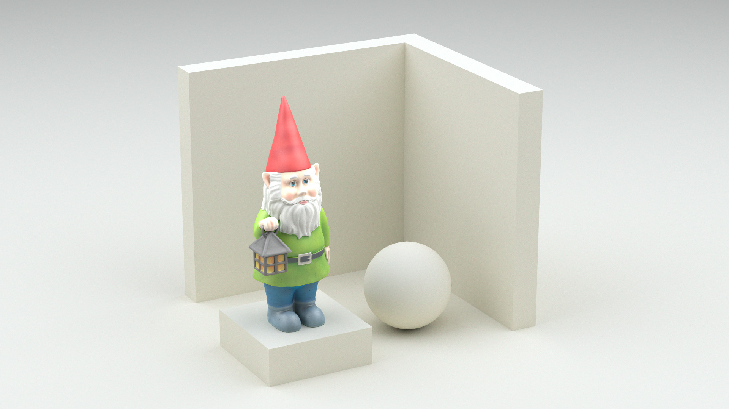
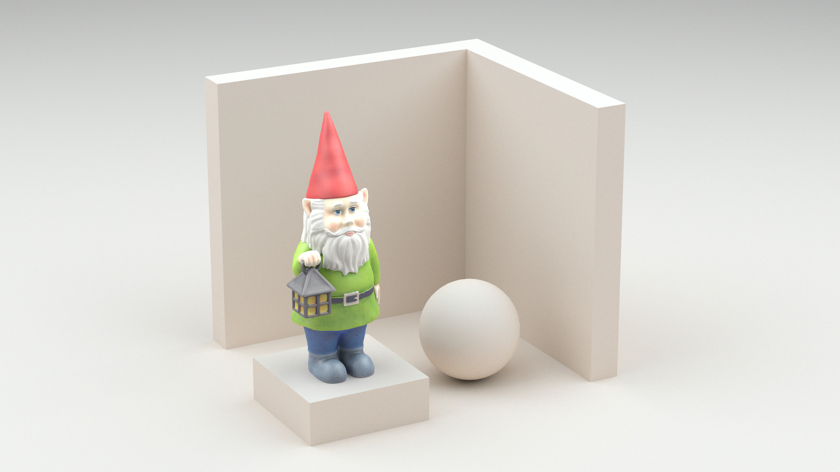
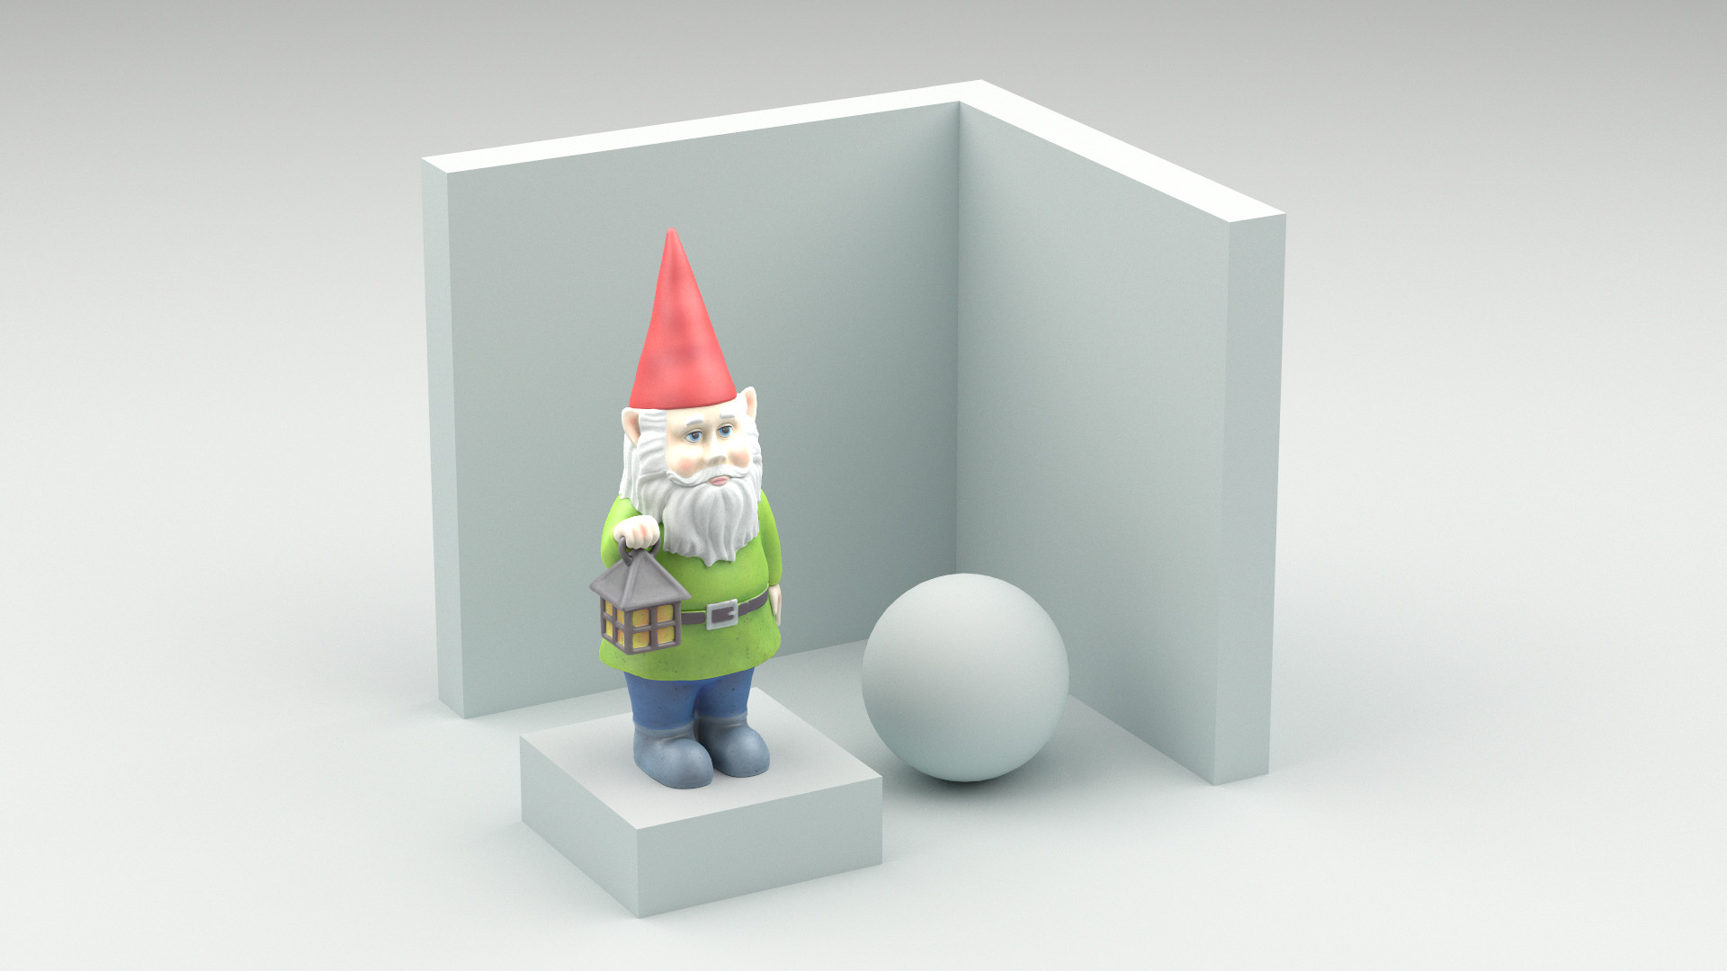
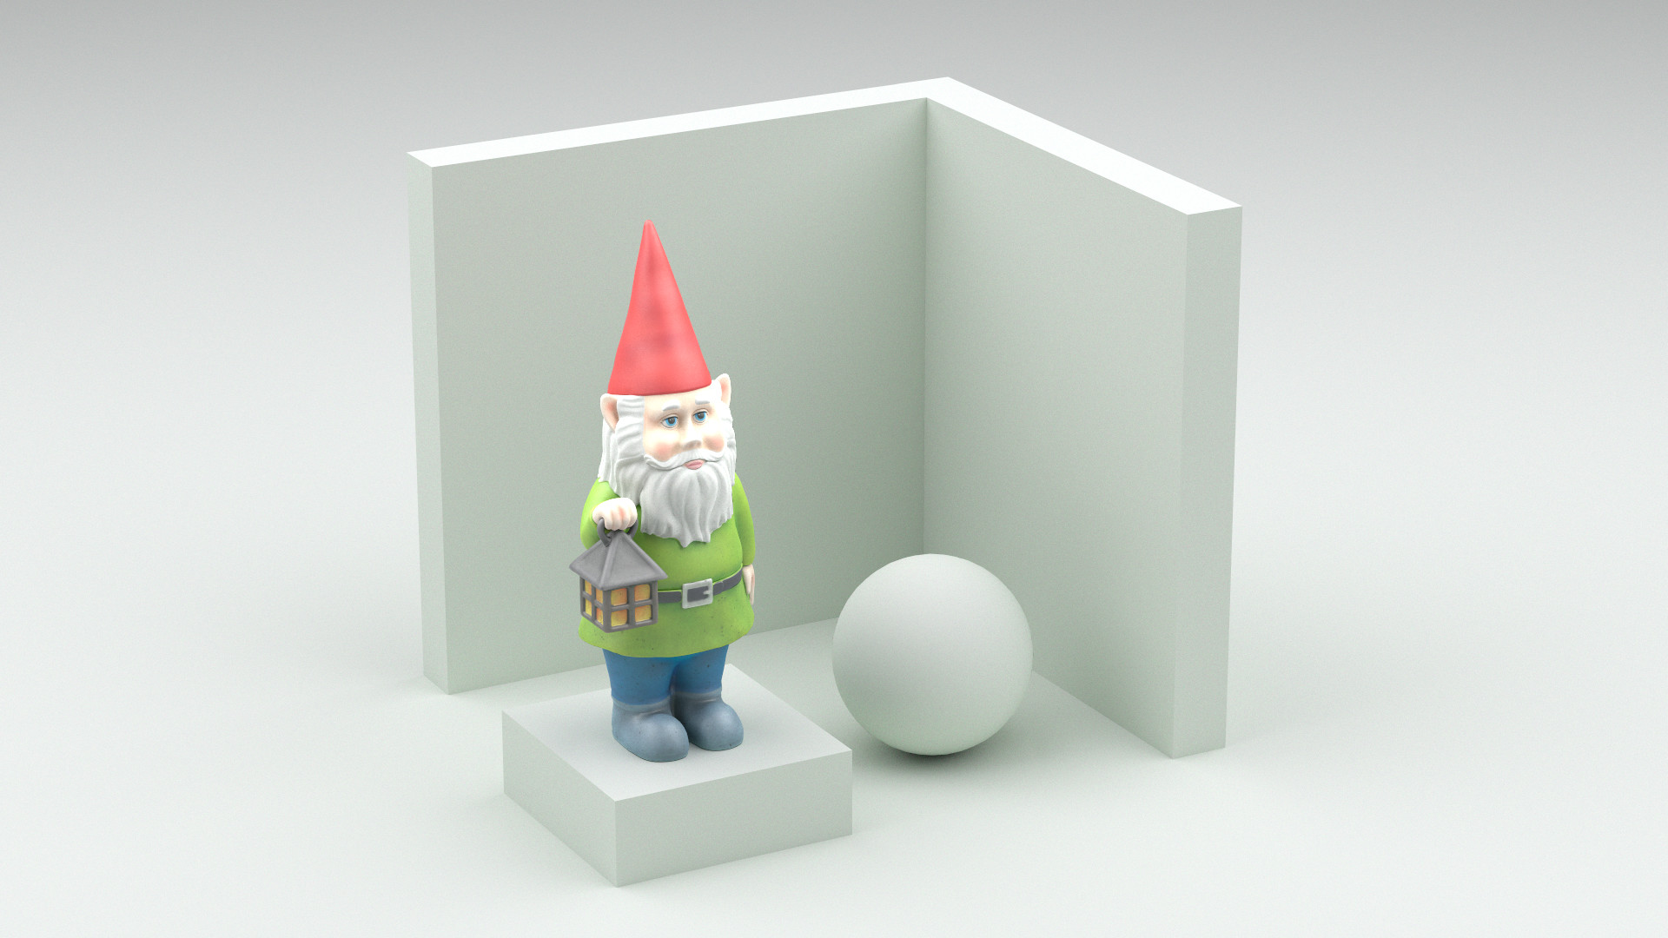
Results
Edited mismatching behavior

Slide 37
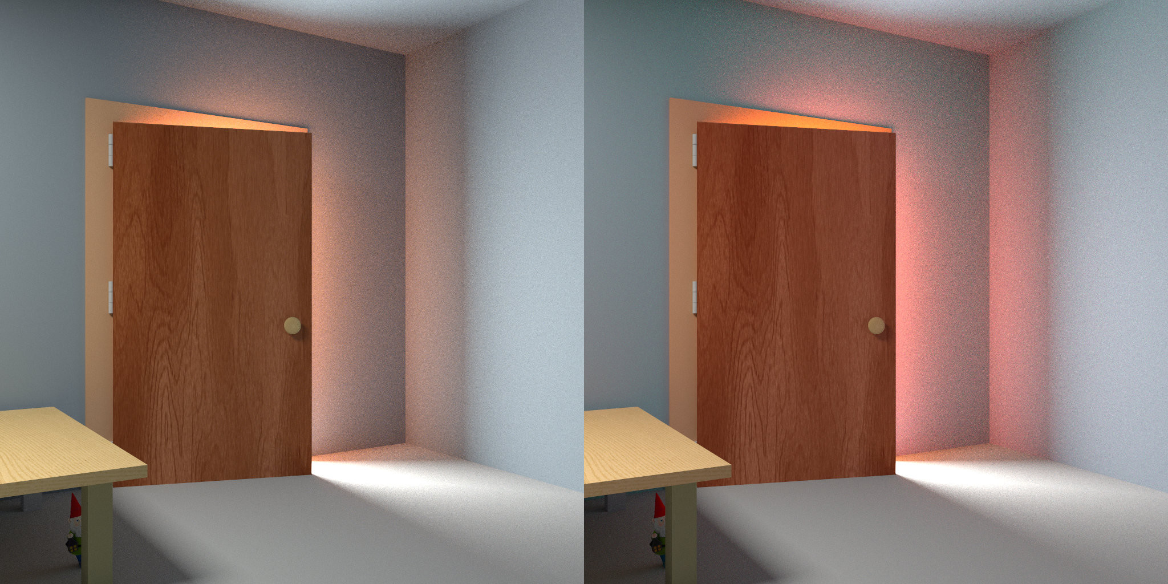
Results
Edited shadow behavior

Slide 38
Results
Edited interreflection behavior

Slide 39
Results
Edited mismatching behavior

Slide 40
Recap
Controllable spectral uplifting
supporting many constraints
Controllable spectral behavior
under indirect light
Practical details…
  Texture baking
  Nested constraints
  Per-object uplifting

Slide 41


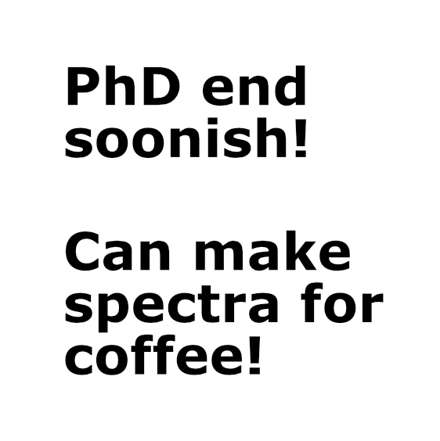
Controlled Spectral Uplifting
for Indirect-Light-Metamerism
Code & Paper
Mark van de Ruit and Elmar Eisemann
Delft University of Technology

Slide 42

Controlled Spectral Uplifting
for Indirect-Light-Metamerism
Paper & Code
Mark van de Ruit and Elmar Eisemann
Delft University of Technology

