Slide 1
Directed acyclic graph encoding for compressed shadow maps
Leonardo Scandolo Elmar Eisemann
Delft University of Technology

Slide 2
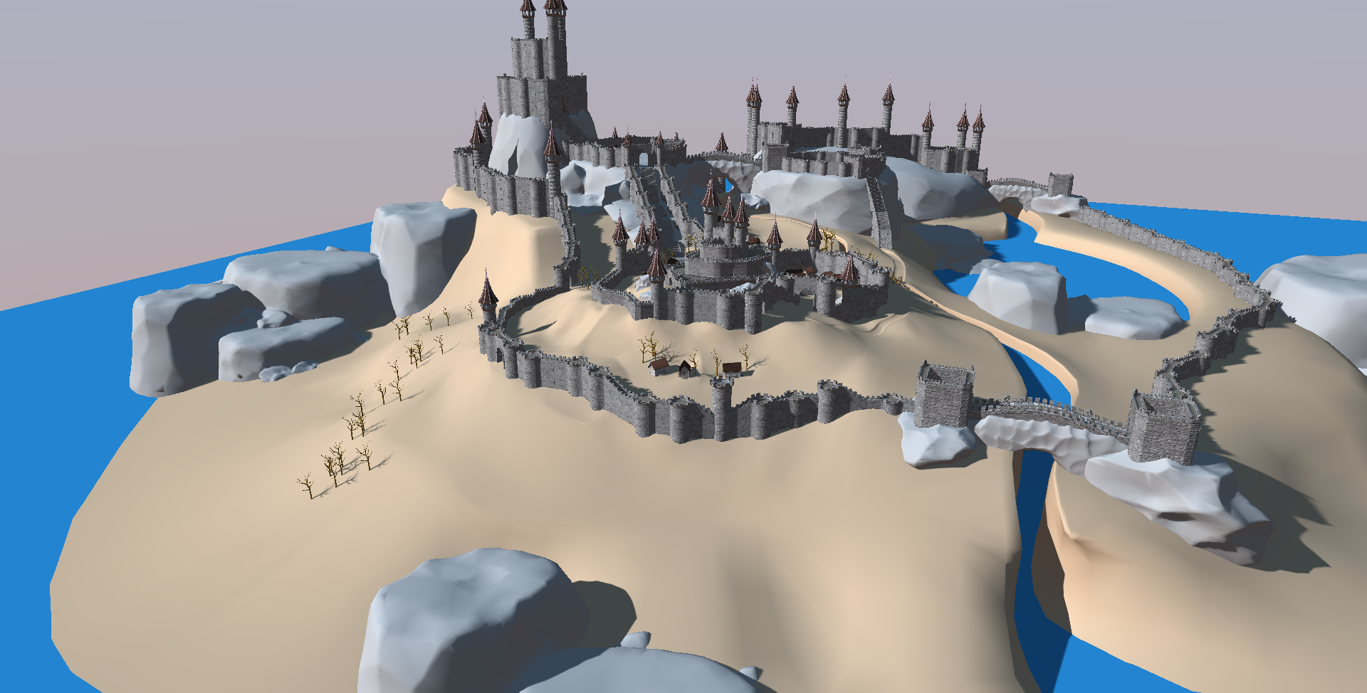
Introduction
Static geometry and lights
Notes:
In most applications, static geometry is a large part of the scene
Static lights, such as the sun, are also common.
Therefore, we end up with a lot of static shadows, which it would make sense to precompute

Slide 3
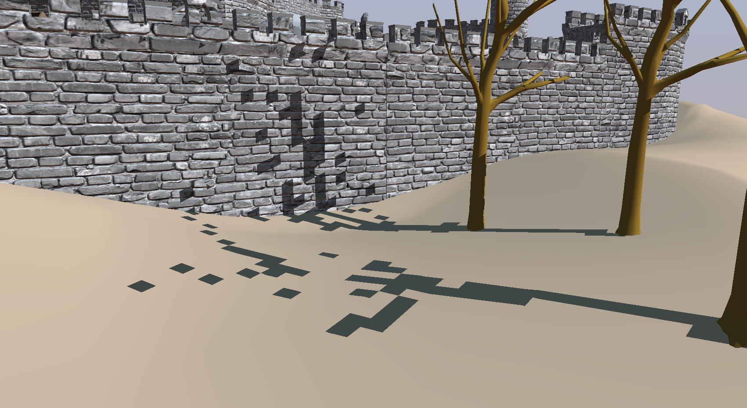
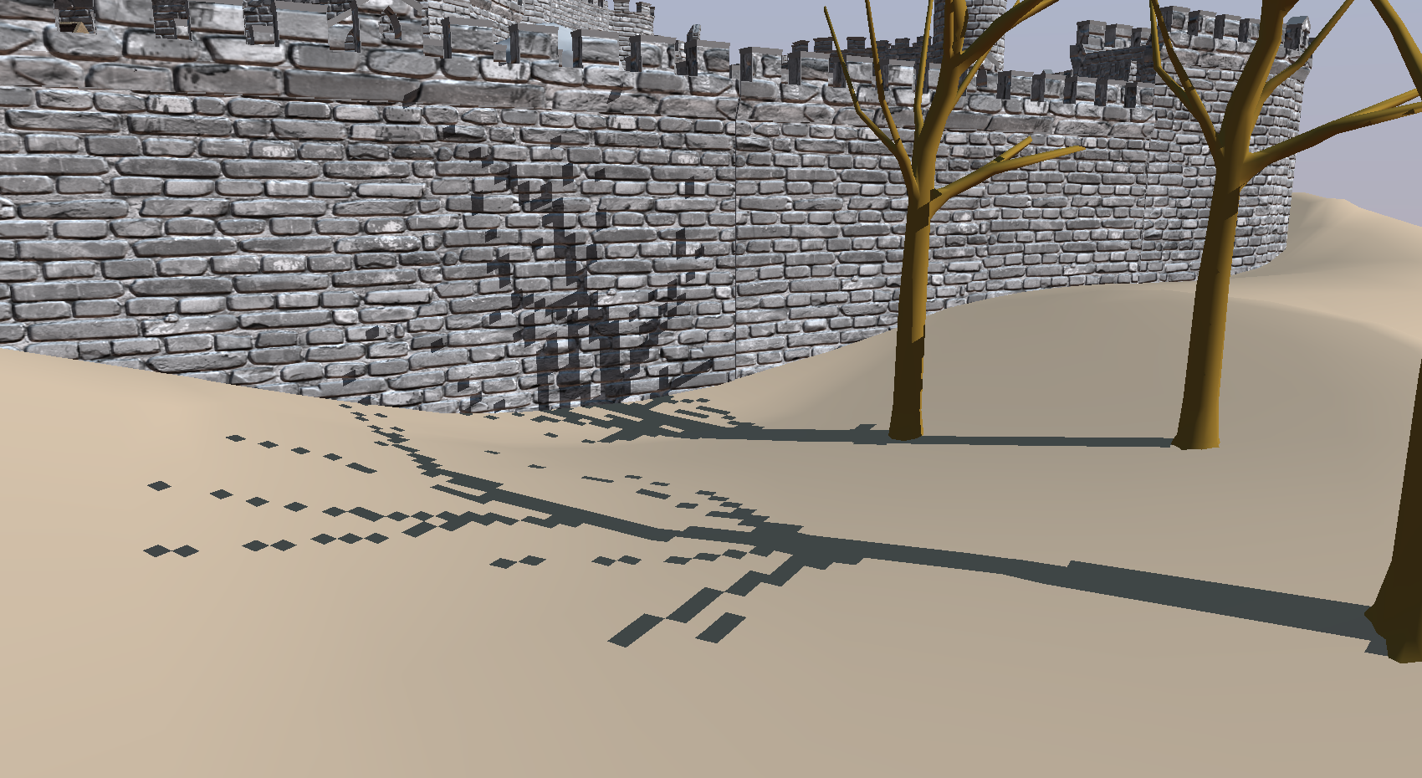
Introduction
4K x 4K (64MB)
16K x 16K
(1GB)
64K x 64K
(16GB)
256K x 256K
(256GB)
Notes:
If you were to compute a single static shadow map for such a large scene, the results would look blocky even for large resolutions
Going to the GPU limit of 16kx16k would still fail.
Resolutions in the order of 100.000 are needed, but cannot fit in GPU memory.

Slide 4
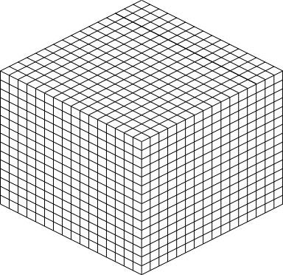
Introduction
Solution: Compression
Directed Acyclic Graphs (DAG)
Multiresolution Hierarchies (MH)
Hierarchical Compression
Similarity Compression
Sintorn, Erik, et al. "Compact precomputed voxelized shadows.“,
ACM Transactions on Graphics (TOG) 33.4 (2014): 1-8.
Scandolo, Leonardo, et al. "Compressed Multiresolution Hierarchies for High‐Quality Precomputed Shadows.“,
Computer Graphics Forum. Vol. 35. No. 2. 2016.
Notes:
Therefore, fast real-time access compressed shadow map encodings can help.
Previous work can be divided in DAG-based or MH-based solutions.
I will explain both of these solutions in more detail, as our proposed solution uses ideas from both.

Slide 5
Introduction: Voxelized DAG shadows
Binary Voxel Grid
Sparse Voxel Octree
DAG
Notes:
DAG-based shadows encode shadow information as a binary voxel grid: 1 is lit, 0 is shadow.
This very large resolution grid can then be encoded as a sparse voxel octree, which is finally further compressed as a DAG.

Slide 6
Introduction: Voxelized DAG shadows
DAGs fully exploit structure similarity
Very fast evaluation
DAG-based shadows resolution is limited
Filtering is fast but works only at highest resolution level
Notes:
DAGs compress tree structures by finding equal subtrees at any level. It then keeps only a single instance, and redirects original pointers to that instance.
DAGs fully exploit structural similarity and are very fast to evaluate, only a tree traversal.
Nevertheless, their depth resolution is limited by the voxel grid resolution, and filtering is fast but can only be done at the lowest level.

Slide 7
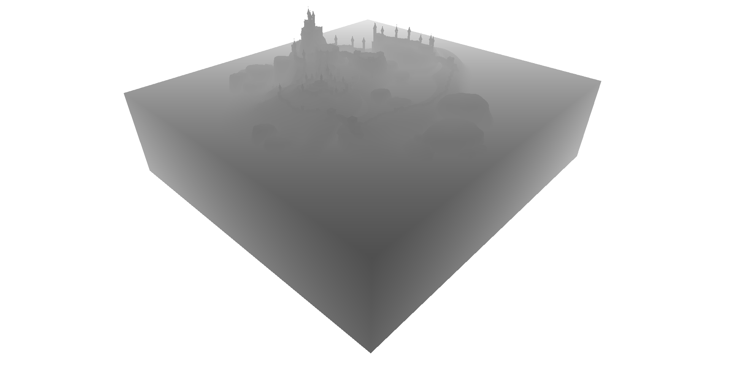
Introduction: Multiresolution hierarchies
Notes:
Multiresolution hierarchies, on the other hand, encode a normal very large resolution depth map.
An observation it uses is that a single texel in a shadow map represents a ray from the light source towards the scene.

Slide 8
Introduction: Multiresolution hierarchies
Any value in this interval works!
Far plane
Depth = 1
Near plane
Depth = 0
One depth interval per pixel
Lit
Value saved in typical shadow maps
Shadowed
Notes:
This ray goes from a near plane at depth 0 to a far plane at depth 1.
Shadow maps normally store the first intersection.
If we continue to trace that ray, we will go through the first object and out the back.
The key observation is that we use that stored value to compare to objects behind or in front of the object.
Nevertheless, any depth value within the object would work the same.
That means we have an interval of possible values we can store for each pixel.

Slide 9
Introduction: Multiresolution hierarchies
Notes:
MHs exploit these intervals.
The main operation is to look at the intervals of 4 neighboring pixels.

Slide 10
Introduction: Multiresolution hierarchies
Notes:
We can create a new interval that is the intersection of as many of the originals as possible, in this case 3.
This new interval can replace the 3 original ones, since any value we choose within it, still works for the other 3.
We can then store this new interval, and remove the originals, and we still need to keep the non-intersecting one.

Slide 11
Introduction: Multiresolution hierarchies
Need to add empty nodes
Hierarchical Compression
Encoded as a sparse quadtree
MHs exploit hierarchical similarity
Very fast evaluation
Hierarchical filtering is possible
No structural similarity captured
Notes:
This can be done for the whole shadow map in a bottom up manner, creating a hierarchy of very sparse grids.
In the end this structure is stored as a quadtree, where some nodes are empty, since they are there only to keep the connectivity to lower levels.
MHs therefore exploit hierarchical similarity, and is also fast to evaluate.
We can even do hierarchical PCF filtering, since we filter at a level where the filter kernel matches the pixel footprint.
Nevertheless there is no tree structural similarity captured.

Slide 12
Introduction: Merged Multiresolution hierarchies
Hierarchical Compression
Similarity Compression
Notes:
We can capture some structural similarity by searching for similar structures at the same level in the MH.

Slide 13
Introduction: Merged Multiresolution hierarchies
Same structure and each interval must intersect
Some similarity compression achieved
Retains advantages from MHs
Not all possible structural similarity captured
Notes:
That means we look for subtrees with the same structure. But now we can only point to a single instance if there is an intersection between all corresponding intervals.
This captures some similarity, but not enough.

Slide 14
Our solution

Slide 15
Our solution
Goal: combine strengths of both representations
Retain the hierarchical compression from MHs
Hierarchical Compression
Fully exploit structural similarity as DAGs
Notes:
So our goal is to combine both compressions, we start with a Multiresolution Hierarchy, and we want to capture the full structural similarity like DAGs.

Slide 16
Our solution
Compressed values
Notes:
The way we will do this is to decouple the quadtree structure from the intervals in a way that they can still be linked.
In this way, we can compress the quadtree as a DAG, fully capturing structural similarity. Additionally, we can compress the list of final value, starting from the intervals.

Slide 17
Our solution
Dado, Bas, et al. "Geometry and attribute compression for voxel scenes.“,
Computer Graphics Forum. Vol. 35. No. 2. 2016.
Notes:
And this is not a new idea.
We base our solution on previous work that compresses attribute voxel grids using DAGs, where each voxel has a color and normal.

Slide 18
Our solution
Subtree node count
11
5
5
0
1
3
1
3
1
6
1
1
1
1
2
3
7
8
(5 + 1)
+ (1 + 1)
+ (0 + 1)
= 9
4
5
9
10
Depth-first ordering
0
1
2
3
4
5
6
7
8
9
10
Notes:
In our case, we want to store a depth value for each node. We will keep the intervals for now, since that will allow us to compress the values more efficiently.
To retain similarity compression, the tree structure and the values are encoded separately.
First, we will order the values according to a depth-first order traversal of the tree.
To link both structures, we add extra information to each node: the count of nodes that each node spans.
Now we want to obtain the value for the highlighted node.
That means we will traverse the tree, and obtain the value index, 9 in this case, to then query the value list.
When traversing the tree, we keep track of how many values we have skipped over, so in the first step we take the right branch, and so we skip 5 nodes, plus 1 from the node we started from. Next step, we skip 1 node from the left branch, plus 1 from the past node. In the last step we go left, so we only skip the parent node. In total we arrive at index 9, as expected.
Now, we still have a node count per node, but since the value is local, two subtrees with equal structure have equal node counts and we can keep a single instance.
So we can capture the full structural similarity, as binary DAGs.

Slide 19
Our solution
Important differences to attribute voxel DAGs:
Our quadtree has empty nodes
We encode the final levels of the quadtree as 4-level treelets.
treelet
Specialized depth value encoding
Notes:
In general, our solution differs from typical attribute DAGs in 3 important ways.
First, our structure has empty nodes, which require us to keep track of in the structure and during traversal.
Second, we replace small subtrees with binary treelets to further compress the structure.
And third, we propose a specialized encoding for the depth values that exploits the interval similarity.

Slide 20
Our solution: treelets
DAG encoding
6 Inner Nodes: 12 bytes
5 Pointers: 20 bytes
Total : 32 bytes
Bitwise encoding
Node count: 1 byte
Bitfield: 11 bytes
Total : 12 bytes
1
0
0
1
0
0
1
0
0
0
0
0
0
1
0
0
0
0
0
0
0
0
0
0
0
1
0
0
0
0
0
0
0
0
0
0
0
0
0
0
0
0
0
0
0
0
0
0
0
0
0
0
0
1
1
0
1
0
0
0
0
0
0
0
0
0
0
1
1
0
0
0
0
0
0
0
0
0
0
0
0
0
0
0
0
+ Can compress through pointer sharing
- Pointers are costly
- Top down traversal
+ Pointerless compact representation
+ Direct cache-friendly traversal
- No pointer sharing compression
Notes:
Treelets are a binary representation of a small tree in the structure, and here is an example for a 4 level subtree.
Our normal encoding would use 32 bytes for this tree, with most memory used in storing pointers.
Conversely, a binary representation can be more compact because no pointers are stored.
This works well for smaller subtrees, but since the binary representation cannot capture structural similarity, it fails for larger subtree sizes.

Slide 21
Our solution: Depth value encoding
Bitmap:
Representative:
R
B
Fm
Fa
Ptr
R
B
Fm
Fa
Ptr
R
B
Fm
Fa
Ptr
shared FP32
Fa + Fm X Iv
low bitrate int
Split to chunks
1st step: representative encoding
2nd step: factorized encoding
Notes:
We also want to create a compressed value list from the interval list.
We start by splitting the list into chunks that we compress individually.
Within this chunk, we first find a single representative value that satisfies as many intervals as possible, which we store along with a bitmap.
We store the rest of the values in a factorized encoding using this formula, where we store two shared factors per chunk, and a low bitrate integer per value.
We end up with a fixed sized chunk list and a variable sized integer factor list.

Slide 22
Our solution: Traversal
Reconstructed value
Result: Value index
Notes:
So the traversal in the end is simple, we traverse the resulting DAG structure and obtain a value index, which we use to query our chunk list to obtain a final depth value.

Slide 23
Results

Slide 24
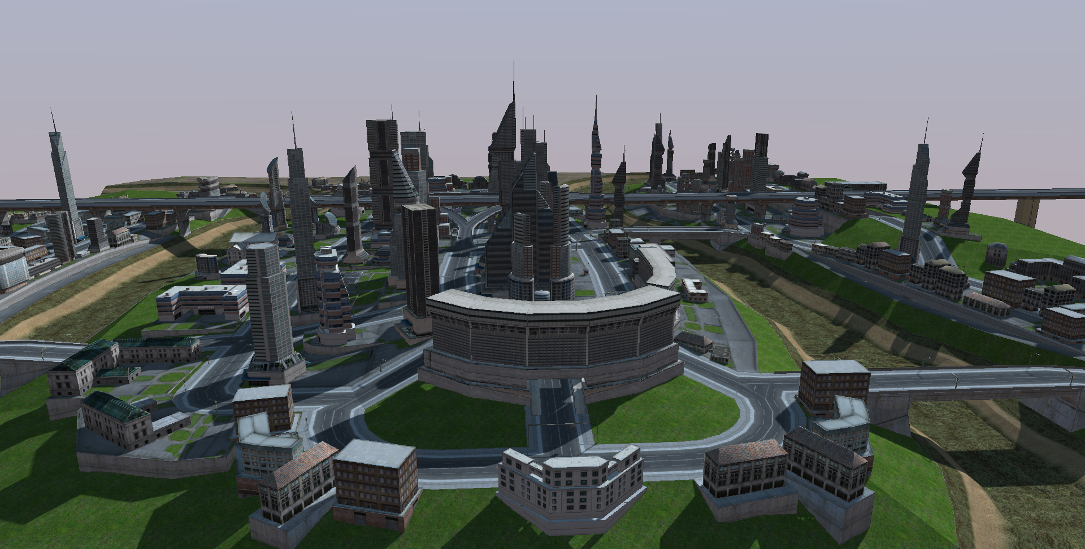
Results: size
CITADEL
CITY
Notes:
Compression rates for our structure are 20% to 50% better than the best representation (MMH).
Additionally, build times are as fast as the rest of representations.

Slide 25
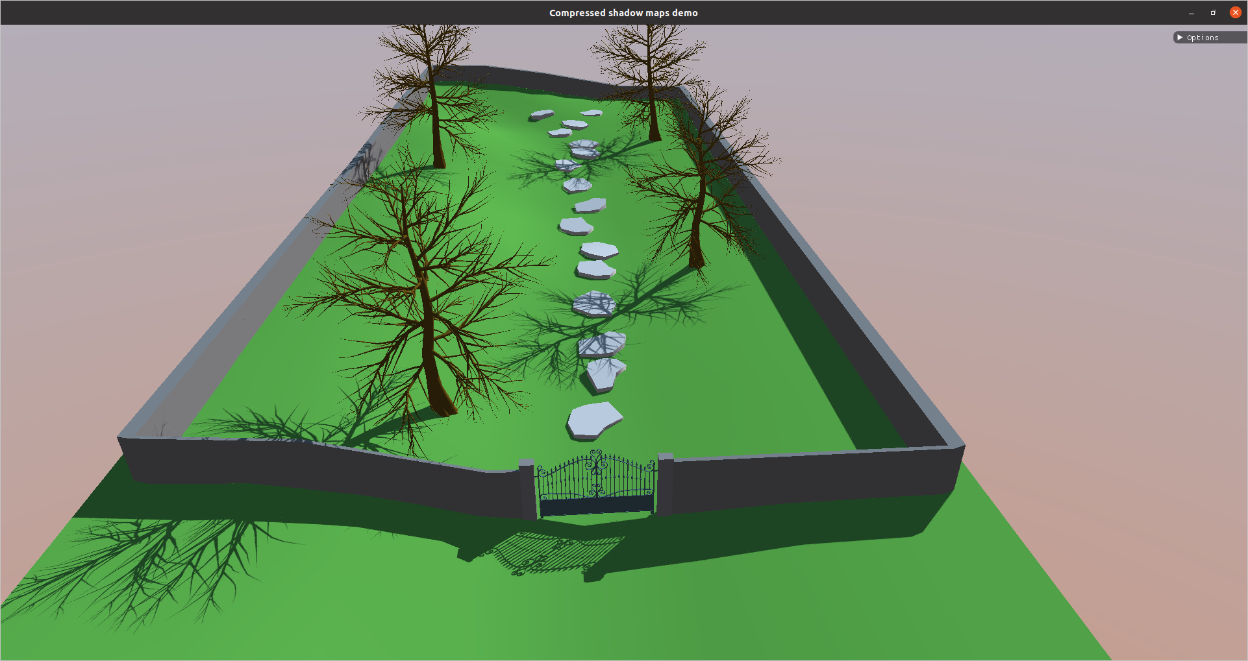
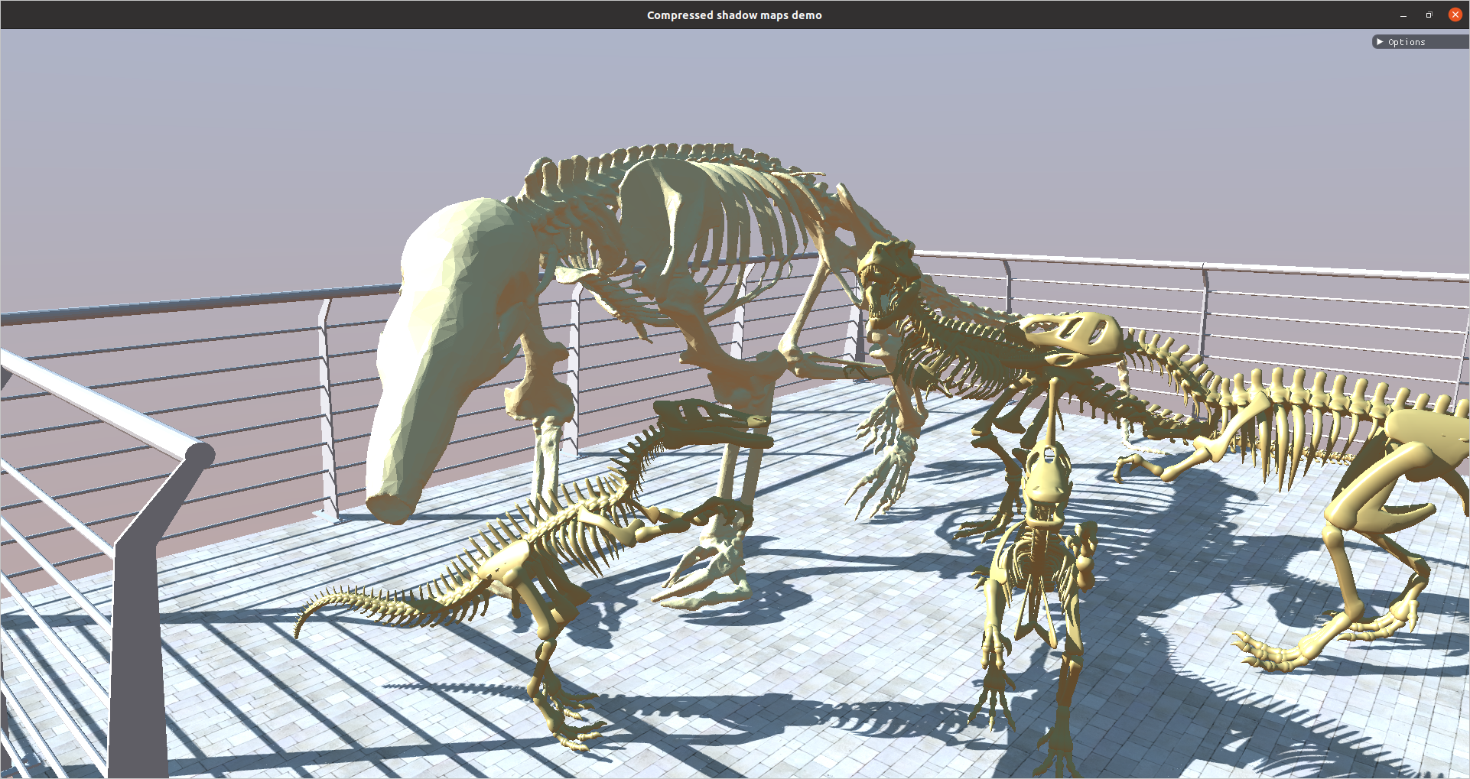
Results: size
TREES
DINOS
Notes:
In these scenes, we can use high resolution maps to

Slide 26
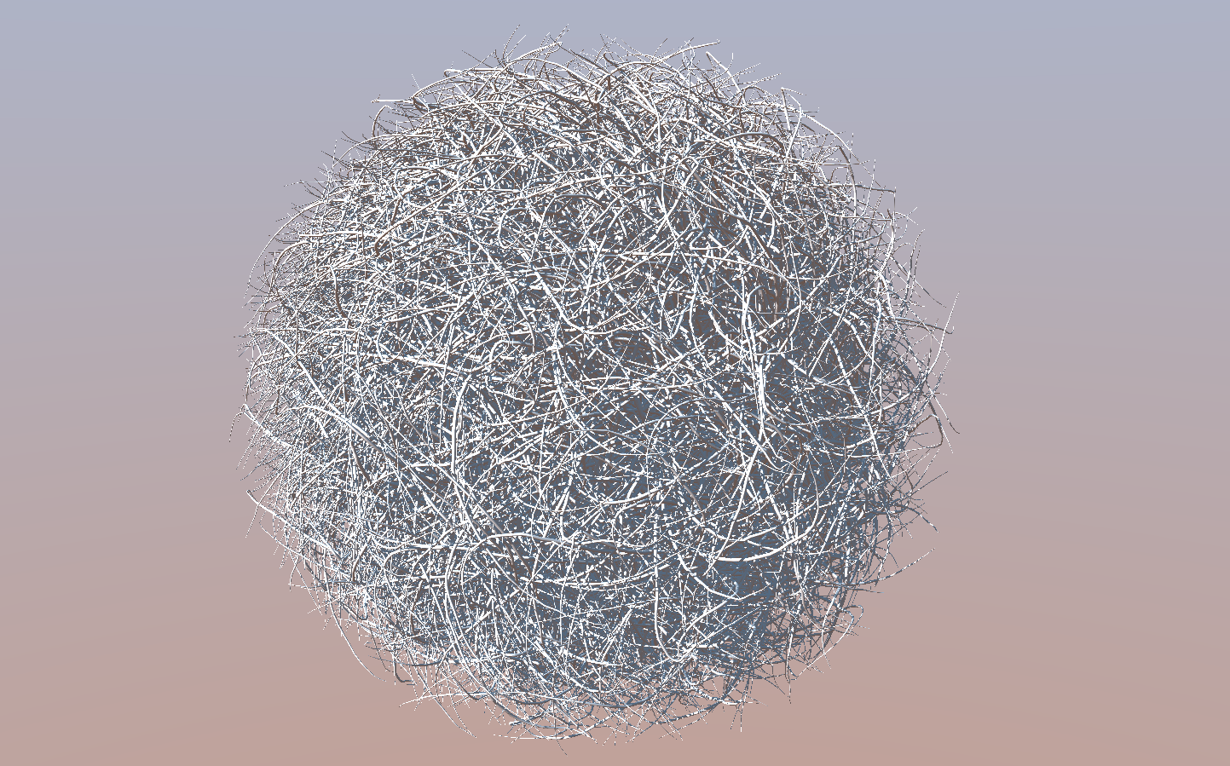
Results: size
HAIRBALL
Notes:
We achieve the highest compression gains in the hairball scene, which has very complex and thin geometry.

Slide 27
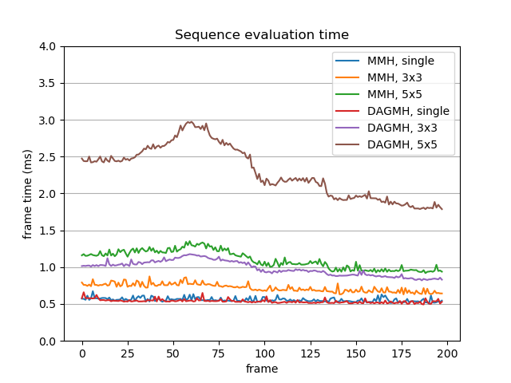
Results: evaluation
Notes:
Evaluation time for a single value per pixel matches MH speeds. Nevertheless, for PCF filtering evaluation is a bit slower, at around 1 ms for 3x3 filters and 3 ms for 5x5. This is still fast enough for real-time evaluation, but we are keen on improving those times.

Slide 28
Results: treelet levels choice
Treelet levels
2
3
4
5
Notes:
We empirically found that replacing subtrees of height 4 or less with binary treelets achieves the best compression rate.

Slide 29
Results: chunk size choice
Chunk size
16
32
64
128
Notes:
Experimentally, we found that chunk sizes of 32 achieve the best compromise between compression and evaluation speed.

Slide 30
Conclusion
Notes:
So, to conclude…

Slide 31
Conclusion
New compression scheme merging MHs and DAGs
Achieves up to 50% better compression rates
Introduces treelets and chunk-based compression
Retains hierarchical evaluation from MH representations
Future work:
Advanced DAG encodings, capture symmetry / smaller pointers
Improve evaluation time
Notes:
To conclude, we presented a new shadow map compression scheme that combines the strengths of previous methods, achieving up to 50% better compression rates
We introduce binary treelets and a specialized depth value compression scheme.
It retains real-time evaluation rates, even for hierarchical PCF filtering.

