Slide 1
Adaptively Layered Statistical Volumetric Obscurance
Quintjin Hendrickx¹
Leonardo Scandolo¹
Martin Eisemann^{1,2}
Elmar Eisemann¹
¹Delft University of Technology
²TH Köln
HPG 2015
Los Angeles, California

Slide 2
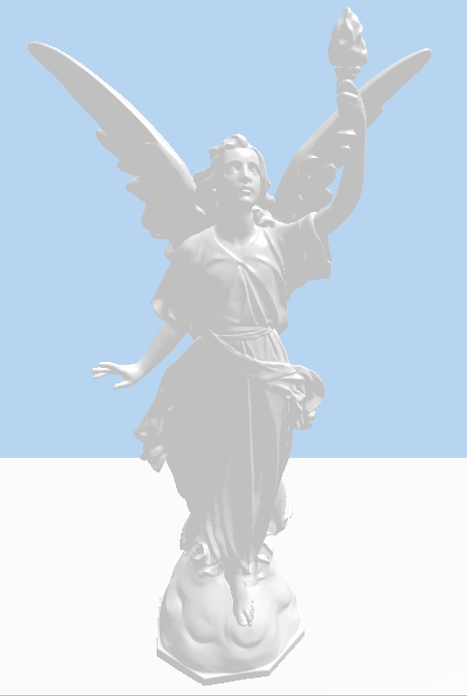
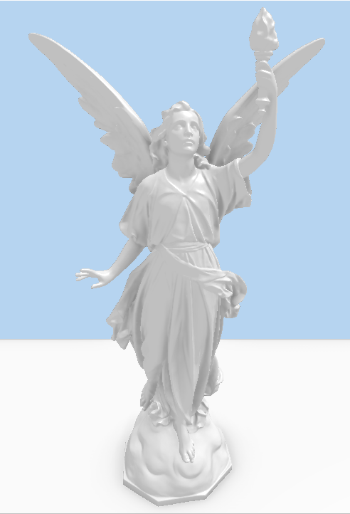
Ambient Occlusion
No AO
With AO
Notes:
If we are going to talk about volumetric obscurance we should first take a look at ambien occlusion

Slide 3
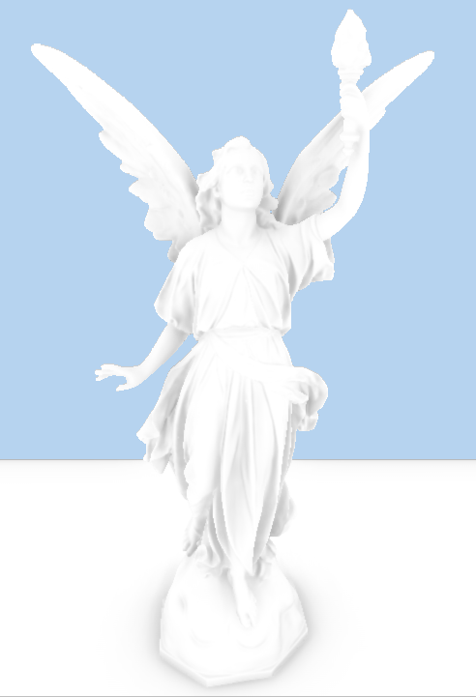
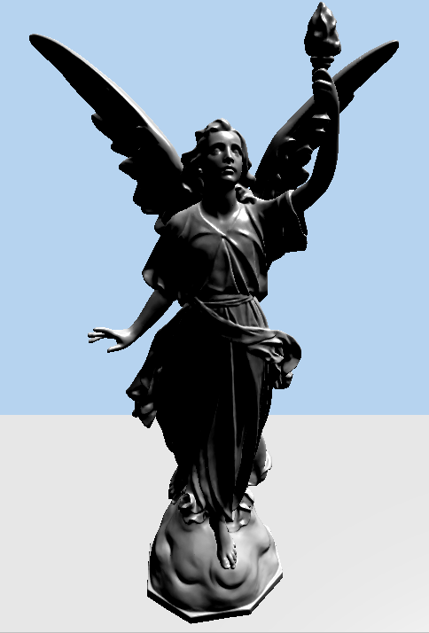
Ambient Occlusion
+
=
AO
Directional ight

Slide 4
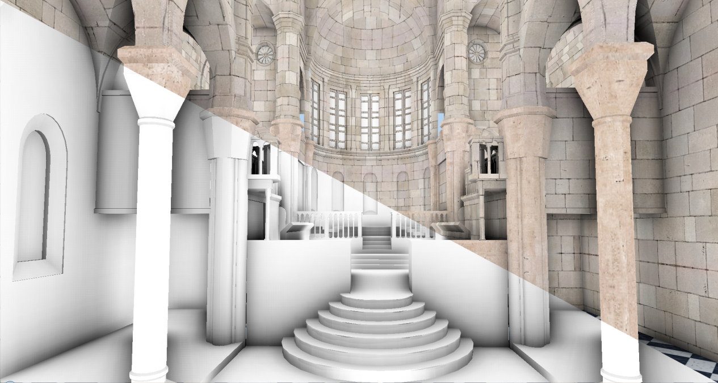
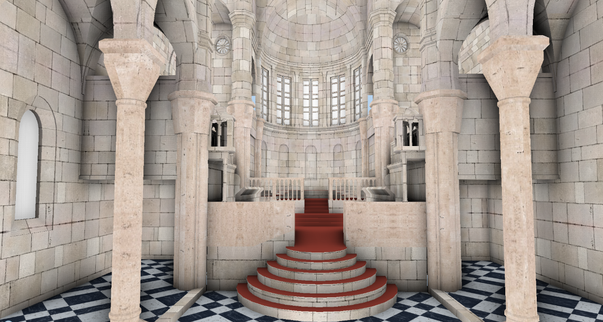
Motivation
Attenuation of ambient (indirect) lighting
Greatly improves geometric understanding
Notes:
We have this approximation of environmental lighting and I explained that is useful for geom. Understanding
Now let’s see how it works in practice.

Slide 5
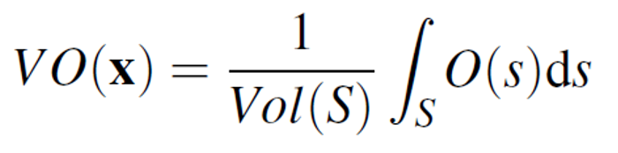
Definition
Volumetric obscurance
Average geometry nearby sample point
Crude approximation, but works well in practice
Notes:
So we’ve seen that ambien occlusion is a very coarse approximation but VO is cruder. Instead of looking at each ray direction we are only concerned about how filled the neighbourhood of a sample point is.
In other words, we want to compute an average fill.

Slide 6
Definition
Volumetric obscurance
Average geometry nearby sample point
Crude approximation, but works well in practice

Slide 7
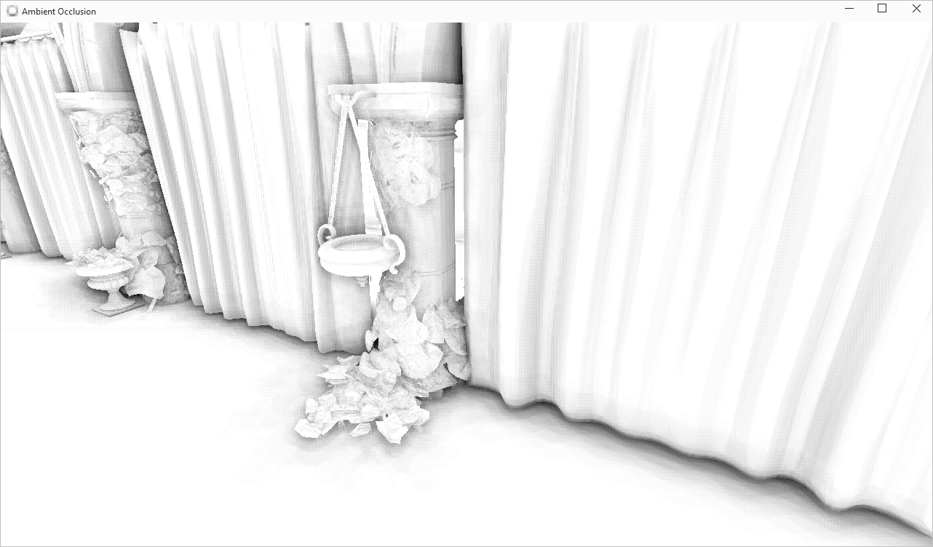
Pixel Sampling
Noisy or costly

Slide 8

Pixel Sampling - Filtering
Removing noise with (expensive) cross bilateral blur
also removes details
Notes:
So usually people get rid of the noise by applying a blur. One choice is a cross bi;ateral blur, but in some cases it’s very expensive and furthermore you lose a lot of detail.

Slide 9
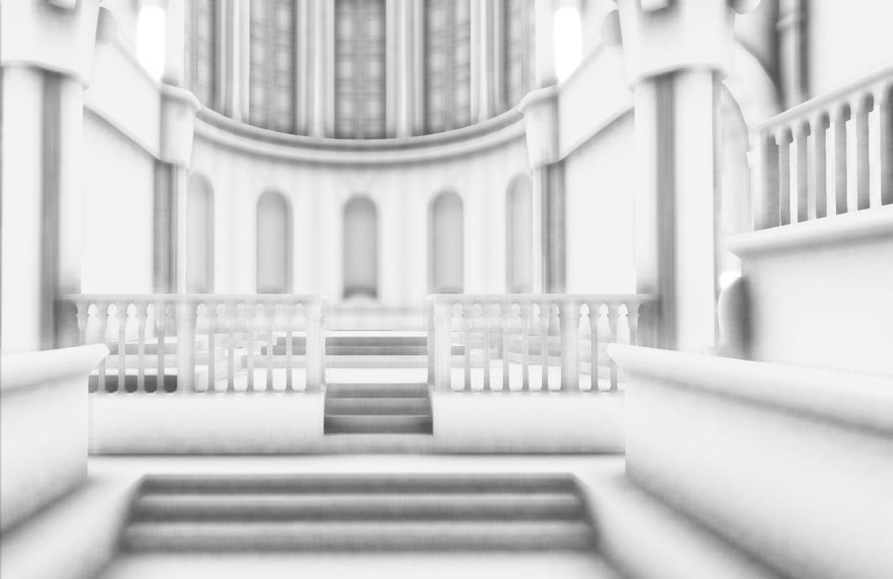
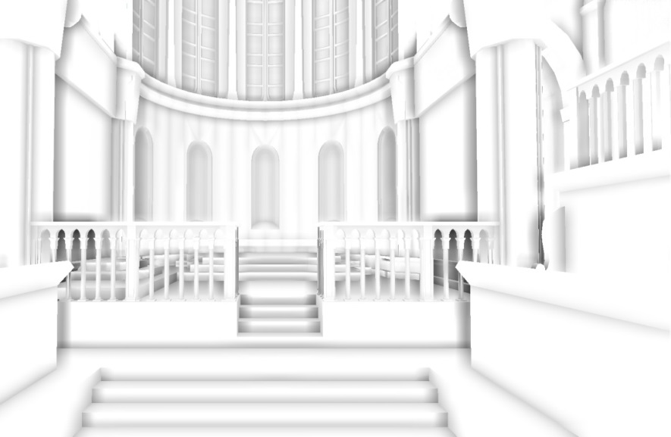


Motivation
High-performance SSAO => Less samples can be evaluated
SSAO with few samples => noise or blur
Our goal : avoid single-pixel sampling, as well as filtering
SSAO
Ours

Slide 10
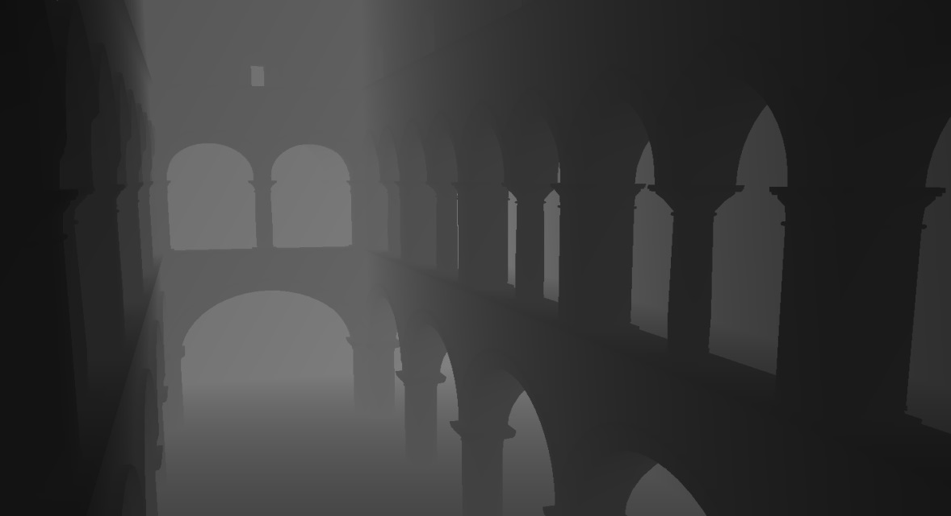
Screen-Space Volumetric Obscurance
Sample box instead of a sphere
Notes:
Like in other AO methods, the size of the neighborhood depends on the distance to the camera, because we want a constant world space neighborhood.
A common change for real-time performance is to switch to a rectangular neighborhood.

Slide 11
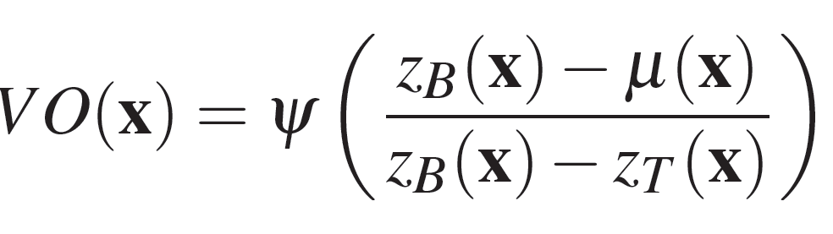
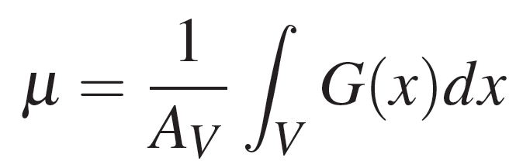

Screen-Space Volumetric Obscurance
Definition
average
V
ZT
μ
ZB
G

Slide 12
Screen-Space Volumetric Obscurance
Need to compute an average in a rectangular pixel neighborhood!
Mipmaps
N-Buffers
Y-Buffers
SAT
Notes:
SATs are efficient and accurate

Slide 13
Computing Averages: Fast Summed-Area Tables [Crow1984]
FSAT
1
0
0
1
0
1
1
0
1
0
0
0
2
0
1
0
1

Slide 14
Computing Averages: Fast Summed-Area Tables [Crow1984]
FSAT
1
0
0
1
0
1
1
0
1
0
0
0
2
3
0
1
0
1

Slide 15
Computing Averages: Fast Summed-Area Tables [Crow1984]
FSAT
1
0
0
1
0
1
1
0
1
0
0
0
2
3
0
1
0
1
4

Slide 16
Computing Averages: Fast Summed-Area Tables [Crow1984]
FSAT
1
0
0
1
0
0
0
0
0
1
1
0
0
1
1
1
1
0
0
0
0
1
2
3
0
1
0
1
0
2
3
4

Slide 17
Computing Averages: Fast Summed-Area Tables [Crow1984]
FSAT
1
0
0
1
0
0
0
0
0
1
1
0
0
1
1
1
1
0
0
0
0
1
2
3
0
1
0
1
0
2
3
4
Get average of any window with just 4 value lookups!
4 -1 -2 +1 = 2
Notes:
TAKE THE 4 CORNERS

Slide 18
Computing Averages: Fast Summed-Area Tables [Crow1984]
FSAT
1
0
0
1
0
0
0
0
0
1
1
0
0
1
1
1
1
0
0
0
0
1
2
3
0
1
0
1
0
2
3
4
Get average of any window with just 4 value lookups!
4 -1 -2 +1 = 2

Slide 19
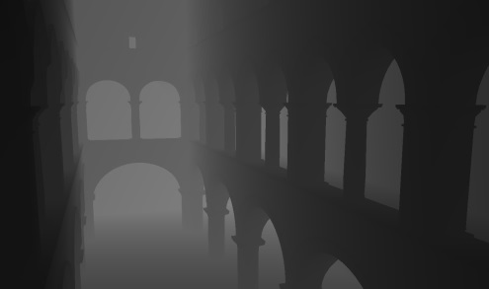
Screen-Space Volumetric Obscurance
[Slomp et al. 2010; Diaz et al. 2010]:
Generate depth map
Create SATs from the depth map
Use the SATs to compute the local average and evaluate VO
?

Slide 20
Limitations
In practice not applied because:
Ignoring surface normals leads to missing details
Strong halos at depth discontinuities

Slide 21
Statistical
Volumetric Obscurance
(StatVO)

Slide 22
Statistical Volumetric Obscurance
Increase details
Involve normal in the evaluation
Notes:
If

Slide 23
Statistical Volumetric Obscurance
Increase details
Involve normal in the evaluation
Notes:
If

Slide 24
Statistical Volumetric Obscurance
Considering the normal
We need to project every point to the normal
?
Σ < p, n2 >
Σ < p, n1 >
< Σ p, n2 >
< Σ p, n1 >

Slide 25
Statistical Volumetric Obscurance
Computing the average position
For each coordinate (x,y,z) create an SAT
X
Y
Z

Slide 26
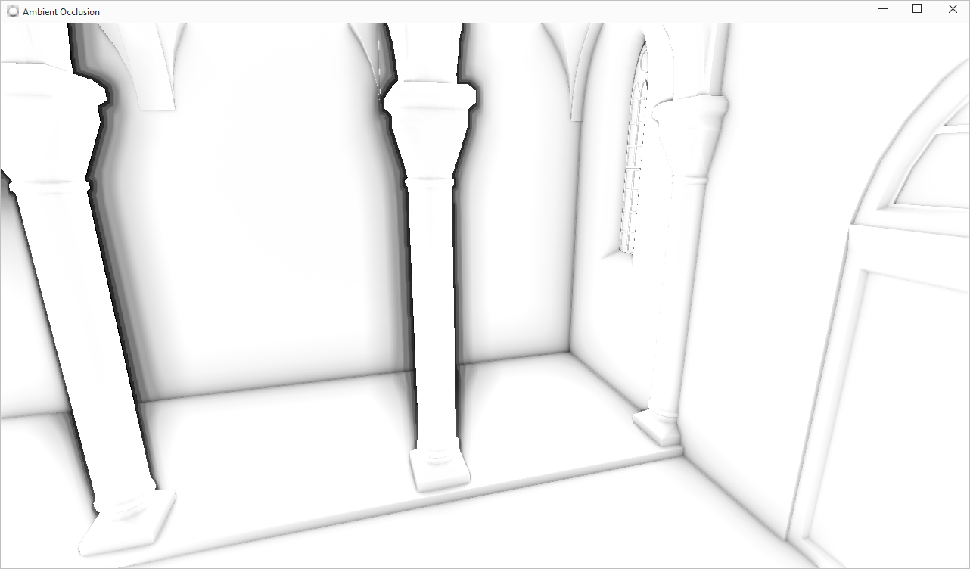
Statistical Volumetric Obscurance
No banding
No noise
No blur
Notes:
We solved the first problem

Slide 27
Statistical Volumetric Obscurance
No banding
No noise
No blur
Halos
Notes:
But halos remain an issue

Slide 28
Statistical Volumetric Obscurance
Source of halos
Some pixels are outside the sample box
Average is wrong
μ

Slide 29
Adaptive
depth layers

Slide 30
Adaptive depth layers
Producing uniform layers ?
One SAT per layer
μ2
μ5
μ4
μ
μ3
μ1
μ2
μ1
Notes:
The first idea that comes to mind is to uniformly divide the depth buffer.
Now we can evaluate it for each layer independently and realize when one of the averages is not useful.

Slide 31
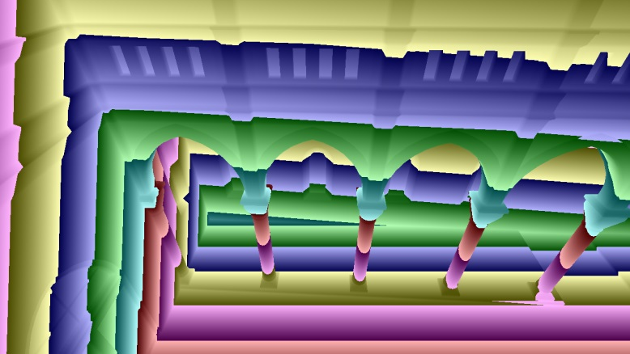
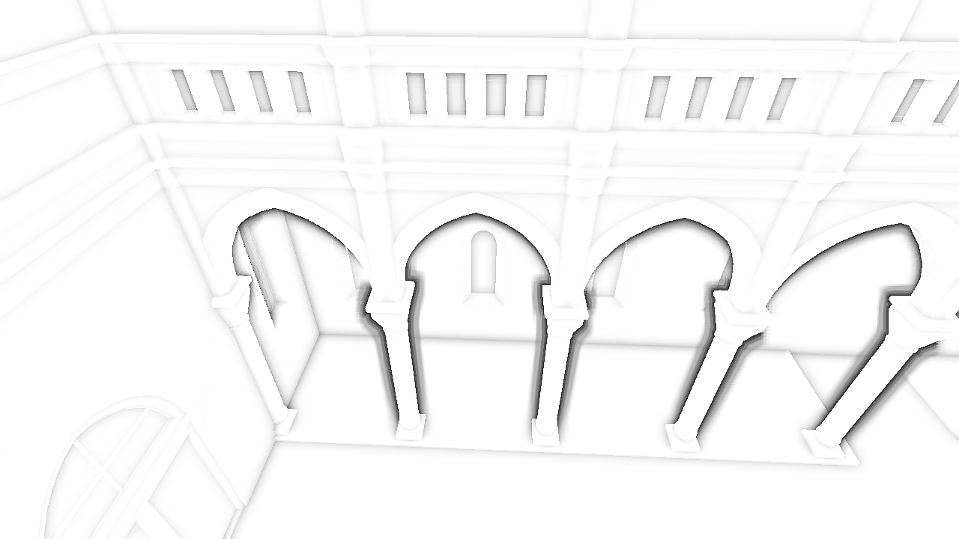
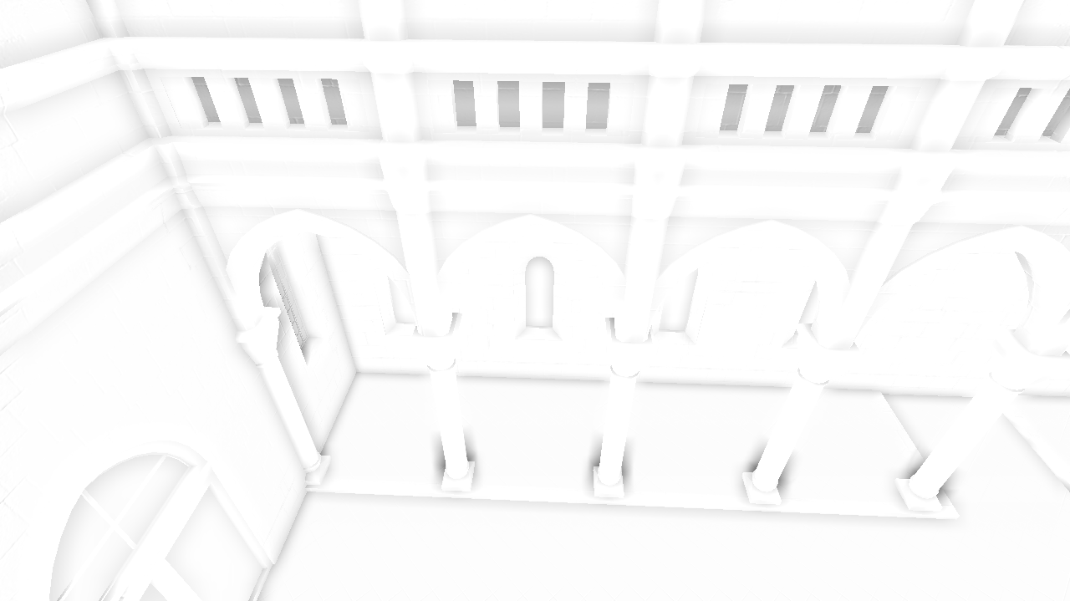
Adaptive depth layers
Producing uniform layers ?
One SAT per layer
But we need lots of layers

Slide 32
Adaptive depth layers
How to reduce number of layers ?
Idea: Separate strong discontinuities
Observation: average lies between discontinuities

Slide 33

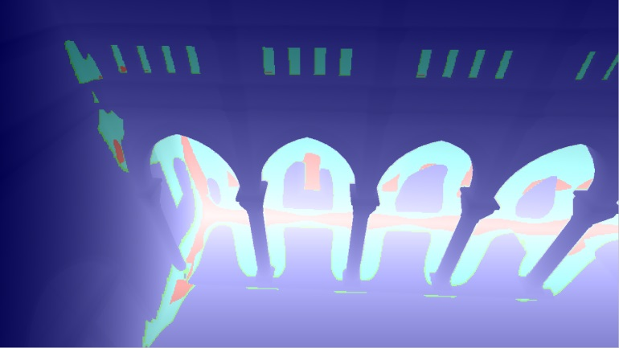
Adaptive depth layers
How to reduce number of layers ?
Idea: Separate strong discontinuities
Observation: average lies between discontinuities
Recursive application for more layers (4 in practice)

Slide 34
Adaptive depth layers
Create adaptive layers
Start with depth buffer and its SAT
Mark pixels as higher or lower based on local average
Create one SAT for each new layer
Apply recursively for more layers
μ2
μ1

Slide 35
Statistical Volumetric Obscurance
The StatVO steps
Generate depth map
Create SATs from the depth map
Create the layers
Use the SATs to compute the local average and evaluate StatVO
μ2
μ1

Slide 36
Bells & Whistles
Notes:
Of course I cannot give all the details in this talk, they are in the paper. But let me show some important considerations.

Slide 37
Bells & Whistles
Avoid computing SATs for each layer
Derive from parent + sibling

Slide 38
Bells & Whistles
Avoid computing SATs for each layer
Derive from parent + sibling
Downsampling of SATs
Lookup of averages implies low frequencies
Notes:
VERY DIFFERENT FROM DOWNSAMPLING THE DEPTH BUFFER AND DOING AO, WHICH IS UNFEASIBLE

Slide 39
Bells & Whistles
Avoid computing SATs for each layer
Derive from parent + sibling
Downsampling of SATs
Lookup of averages implies low frequencies
Quadrant-based evaluation for higher precision
Overlap of corners exploited in SAT lookups

Slide 40
Results

Slide 41
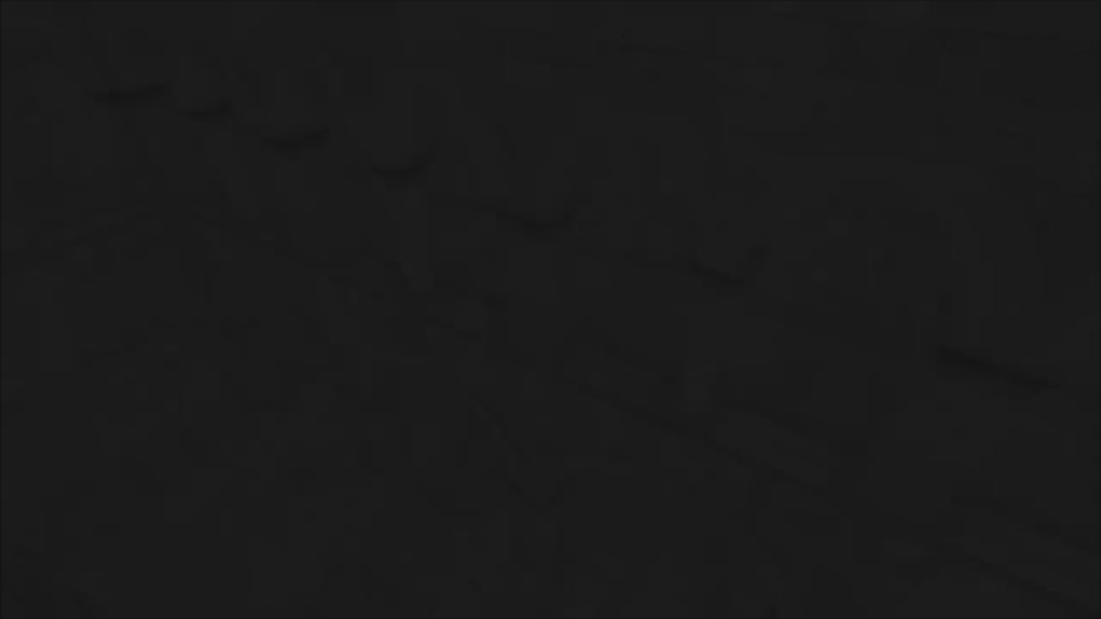
Results

Slide 42
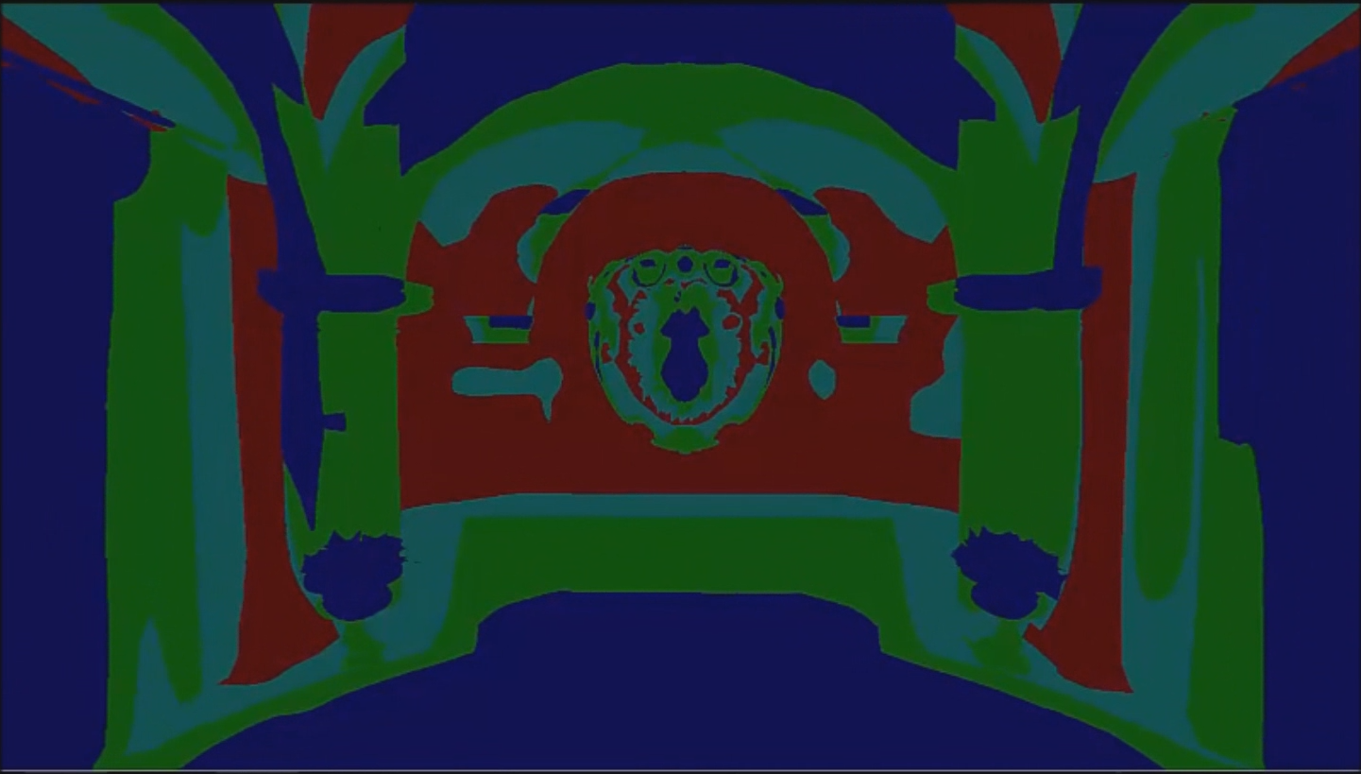
Results
Adaptive layers

Slide 43
Results
Timings 1280x720 – NVidia GTX770

Slide 44
Results
Downsampling to half resolution

Slide 45
Results
Timings 1280x720 – NVidia GTX770

Slide 46
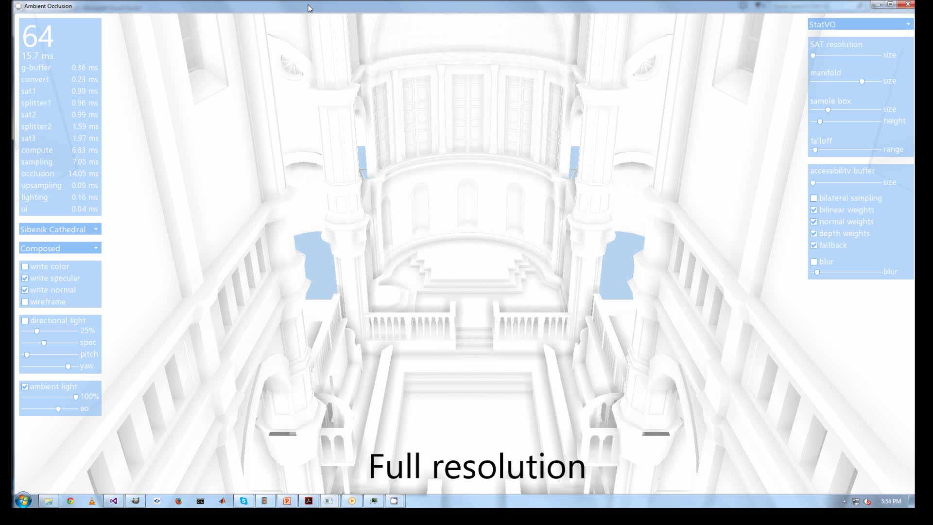
Limitations
Flickering
Notes:
If you go further down some details are lost and you can see flickering in the pillars.

Slide 47
Conclusions
StatVO is a real-time screen-space method
Statistical formulation to avoid sampling
High-quality smooth results

Slide 48
Future work
Alternatives for SATs
Higher-order moments
Additional surface information

Slide 49
Questions ?
Thank you
very much!
This work was partially financed by the Intel Visual Computing Insitute and the EU FP7 Project Harvest4D

